Slide 1



Mustangs and Unicorns
A Commercial Drone Integration Story
Presented to:
AUVSI Defense Protection Security
Washington DC
August 21, 2019
Mark L Bathrick SES
CAPT USN (Ret)
Director, Office of Aviation Services
Boise, Idaho
https://www.doi.gov/aviation/
Notes:
Commercial drone use in government applications has been a source of controversy and the subject of numerous articles, and drone conference discussions, also serving as regular fare on social media. This presentation will share the story of commercial drone integration from the perspective of a large federal department that has actually done it, successfully. Challenges, strategies, practices, myths, realities, metrics that matter, and future goals will be discussed.
Mustangs and Unicorns – The mustang horse is often referred to as a living American icon. Strong-willed, hardy, resourceful, and spirited, mustangs remind us of America’s frontier past. However, the provenance of the American mustang is foreign; they originated from Spanish horses introduced by explorers in the 16th Century. Today, mustangs are a mix of those and horses brought in from other countries who either escaped or were released into the wild. While no mustang is a purebred, if properly trained and managed, they have proven their ability to serve in many useful capacities. Likewise, commercial drones available today have a mixed and often foreign provenance. They are often manufactured outside the country in which the company is based and all have components and commodities that were manufactured elsewhere. Like mustangs, if what they are is understood and properly considered, commercial drones can become incredibly useful and versatile tools for many industry and government uses.
Unicorns on the other hand are mythical creatures. In business, they have also come to represent something that is highly desirable, yet difficult to find or obtain. In this presentation we’ll also examine some of the common myths surrounding the unicorn of the commercial drone world; a “pure U.S.” commercial drone.

Slide 2
Mission Objectives
WHO ?
WHY ?
WHAT ?
HOW ?
SO WHAT ?
WHAT’S NEXT ?
Notes:
Objectives – In this presentation we’ll discuss the who, why, what, how, so what, and what’s next of Interior’s journey to safely and responsibly integrate commercial drones into our mission support space.

Slide 3










WHO
500M acres, 1 in 5.
1.7B acres offshore.
Public land: >415M visits
23% of U.S. energy supplies.
Largest water supplier in 17 western states.
< 1/60th DOD’s budget.
Notes:
Who is Interior? – Many people are unfamiliar with the U.S. Department of the Interior (DOI). Established by Congress on March 3, 1849, DOI conserves and manages the Nation’s natural resources and cultural heritage for the benefit and enjoyment of the American people, provides scientific and other information about natural resources and natural hazards to address societal challenges and create opportunities for the American people, and honors the Nation’s trust responsibilities or special commitments to American Indians, Alaska Natives, and affiliated island communities to help them prosper. DOI is the nation’s largest land steward with responsibility for ~500 million acres of public land (~1 in 5) across all 50 States and U.S. Territories and 1.7 billion acres in the outer continental shelf. As stewards of “the people’s land,” Interior hosts over 415 million visitors annually. Interior is comprised of nine bureaus: (1) Bureau of Land Management, (2) National Park Service, (3) Bureau of Indian Affairs, (4) U.S. Fish and Wildlife Service, (5) Bureau of Safety and Environmental Enforcement, (6) U.S. Geological Survey, (7) U.S. Bureau of Reclamation, (8) Bureau of Ocean Energy Management, and (9) Office of Surface Mining Reclamation and Enforcement.
Given the vast scope of Interior’s responsibilities, the challenges of terrain, weather, inherent landscape and animal sensitivities, and limited budget and personnel resources, Interior’s mission has long been the beneficiary of manned aircraft and was tailor-made for leveraging unmanned aircraft systems (UAS).

Slide 4
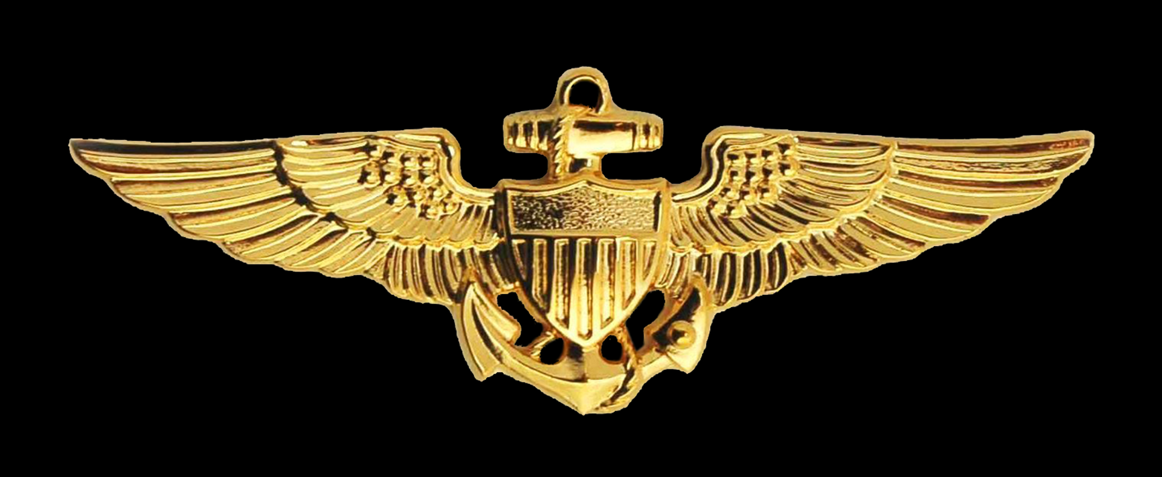
WHO
TS SCI
Tomcat: fighter, strike, tac photo recce.
Empire Test Pilots School.
Pentagon – OPNAV (N80), JCS (J-8).
DAWIA T&E Level III.
Acquisition & financial mgmt.
F-14, Naval Weapons Test Squadron, & Air Engineering Station commands.
Fleet – 100 manned, 650+ unmanned.
DOI Pilots – 100 manned, 450+ unmanned.
~450 contracts, ~1,200 manned & unmanned aircraft & pilots.
30+ mission apps, 42 States, U.S. Territories.
>20,000 UAS flights, zero complaints.
Million$ in documented savings.
30+ years UAS development, testing, acquisition, operations experience.
Notes:
Who is Your Presenter? – Mark L Bathrick, Director, DOI Office of Aviation Services (OAS). Prior to DOI, Mark served in the U.S. Navy, retiring with the rank of Captain (O-6). Mark was an F-14 Tomcat pilot where he participated in repeated deployments, exercising fighter, strike, and tactical photo reconnaissance missions. His experience in opposed photo reconnaissance missions gave him an appreciation for the need and value of UAS for these missions as well as unique operational, planning, and policy insight into the issues of intelligence gathering, counter-intelligence, and operational security. Mark’s involvement with UAS began when he was selected as the Navy student to attend the Empire Test Pilots School (ETPS) in the U.K. The ETPS curriculum included courses related to UAS systems and testing. His experience with UAS development, acquisition, testing, and operations continued through tours as a Navy Test Pilot, in acquisition and finance at the Pentagon, and in command tours of a deployed F-14 squadron, a Naval Weapons Test Squadron, that included 19 optionally-piloted jet fighters, and a Naval Air Engineering Station that supported testing of numerous interagency UAS. Following his Navy career, Mark was appointed to the Senior Executive Service (SES) as the OAS Director. Quickly seeing the link between DOI’s mission requirements/challenges and the potential for UAS to close historical performance gaps and leap-frog the traditional pace of change, Mark initiated the development of Interior’s UAS program in 2006. Today, DOI possesses the largest non-military drone program in the world, with over 650 fleet UAS, more than 450 FAA certified and OAS credentialed UAS pilots and numerous contracts that provide access to commercial UAS services. Interior has integrated UAS into over 30 different mission applications and flown them in 42 States and U.S. Territories, documenting millions of dollars in savings through their employment. Between his Navy and Interior careers, Mark has over 30 years’ experience in UAS development, testing, acquisition, and operations.

Slide 5
A Common Myth
Domestic applications
Commercial drones
Military applications
Military UAS
Notes:
Clearing Up the Most Common Myth – Before we continue to the Why, What, How, So What, and What’s Next, we need to clear up a common myth. As drones originated in the military and DOD has been a leader in the development and use of drones, it’s common to think that there is a high degree of overlap between military UAS and commercial UAS. Often, we see this belief exhibited across many consulting firms seeking to “help” agencies build and sustain a UAS program; they hire former military personnel with aviation/UAS experience and then propose to replicate the military model on commercial UAS programs in domestic government and industry applications. Coming from a career military background that was the belief I held as well. However, in the early developmental years of our UAS program, when we were flying excess military small UAS to help inform our requirements development, I learned the reality of the true degree of overlap between military and domestic commercial UAS was much, much less than many still continue to believe.

Slide 6
The Reality
Domestic
Commercial
Do
Military
Operating Environment.
Mission.
Product Range.
Maintenance.
Automation.
Training.
Privacy.
Transparency.
Collaboration.
Budget.
AI RCRAFT
https://www.doi.gov/aviation/uas/news
Notes:
The Reality – In reality, the intersection of military and commercial drones and applications is essentially limited to the fact that both military and commercial UAS are aircraft. Substantive differences between these two worlds include:
Operating Environment – While the military conducts training within the U.S. (often in military controlled airspace), they operate outside the U.S. in airspace they often control, without many of the legal and regulatory constraints imposed on commercial drone operations in the U.S. The military also exercises significant centralized control over the scheduling, planning, and execution of missions and in hostile territory may actually have air supremacy and control. Commercial drone operations in the U.S. are numerous, decentralized, and operate within the National Airspace System (NAS) in accordance with Federal Aviation Administration (FAA) regulations.
Mission – As we learned during our four years of operational test and evaluation flights using $25M in excess DOD small UAS (sUAS), the missions are also different. While military sUAS generally perform intelligence, surveillance, and reconnaissance (ISR) functions, commercial UAS are often employed in mission spaces requiring high degrees of sensor resolution, versatility, and complex product processing (e.g. orthographic mapping, point clouds, volumetric measurements, flow rate/direction determinations, 3-D modeling, etc.).
Product Range – The range of available commercial sUAS products available to those in the domestic commercial and government space are far greater, both in terms of variety and cost than are available to the military. This fact makes the development of and disciplined adherence to mission-focused requirements even more critical in the commercial space.
Maintenance – Another common disconnect commercial drone requirements and the military model is in required maintenance and maintenance programs. The majority of commercial drones used by companies and agencies today are electrically powered rotorcraft (quad or hexacopters), hand-launched fixed wing, or hybrid vertical takeoff and land variants that can also fly as fixed wing aircraft. These aircraft have proven to be highly reliable and in need of little maintenance and repair. As an example, across Interior’s 20,000+ UAS flights, we’ve experienced less than a dozen mechanical failures. Traditional military style calendar and flight hour based preventative maintenance programs are really only necessary for sUAS with fossil-fuel based propulsion systems.
Automation – By virtue of the fact that commercial drones are meant for a wide array of potential users, they are generally far more automated than their military equivalents. The automation also extends to the available sensors/payloads and data processing packages. This opens up the door for easier and quicker integration into commercial/domestic government applications.
Training – The high standard level of commercial sUAS automation also reduces the training requirements for commercial drone users. While training in risk management, how to responsibly operate in the National Airspace System, and basic safety principles is warranted no matter the level of automation, too many consultant companies employing former military members attempt to overlay an unnecessarily rigorous training program that fails to cover essentials of successful operations in the domestic commercial UAS space that aren’t considerations in military drone flying.
Privacy – One of those areas that isn’t a concern for military UAS programs and pilots, but is a key to the long term success of the domestic commercial drone business community and the companies that support it is considering the privacy of the people, land, and facilities we fly over. As an aircraft class, drones bring with them the reputational baggage as weapons of war and/or tools of intelligence gathering. While the privacy of the local populace has never been a concern for deployed tactical photo reconnaissance flights or UAS operations, it is very important to successful and sustained commercial drone operations in the U.S. Highly successful domestic drone operations build privacy considerations into every aspect of the program, from policy, training, hardware, software, and communications before, during, and after the flight. A testament to this is one of Interior’s “metrics that matter.” In over 10 years and 20,000+ UAS flights over public land in 42 States and U.S. Territories that are subject to over 400 million visitors annually, Interior has not received one formal complaint from the public related to drone use.
Transparency – As with privacy, military UAS programs and operators are not unconcerned about transparency, but they view it as a risk to safe and successful operations. However, in the commercial drone space, having a concerted and sustained transparency program is critical to building public trust establishing a positive reputation with current and potential customers. As with privacy, those that seek to apply the military UAS model to domestic commercial drone applications neglect this important element.
Collaboration – Success in integrating commercial drones requires a high degree of collaboration among multiple parties, including local, state, and federal government agencies, businesses, and the general public. Prospective users also often collaborate with other commercial drone programs for best practices and lessons learned. Collaboration with industry providers is key to ensuring a mutual understanding of requirements and current and developing technologies. These collaboration requirements far exceed those required in a military UAS program.
Budget – There are few if any agencies as well funded as the Department of Defense (DOD). As an example, DOI’s budget is roughly 1/60th that of DOD, or put in other terms, not enough to buy one current Navy aircraft carrier. Companies that attempt to apply the military business, budget, and acquisition model to a domestic UAS program will quickly price their services and products out of this market.

Slide 7

Why? - Requirements
Access
Ease
Price
2010 – 2014 OT&E – Raven, T-Hawk, Super Bat didn’t meet DOI platform, payload, and processing requirements.
2014 Master UAS Requirements published (9).
Security
Platform
Performance
Mission
Payload
Scalability
Price
Processing
Disciplined Adherence
Notes:
Why? – So, why did Interior pursue the use of commercial drones? It all comes down to requirements. The biggest reason most technology-centric programs fail is that they neglect to develop sound requirements before acquiring and operating systems they “thought” would meet their needs. This is even more prevalent in agencies that seek to integrate commercial drones. The “siren’s song” of ready access to commercial drones, their ease of operation, and their relatively low price point (compared to manned aircraft), coupled with the “bright shiny object” of ever changing drone models, payloads, and processing software challenge agencies to establish and practice disciplined adherence to sound requirements.
The second biggest reason agencies (and companies) fail to effectively integrate commercial UAS is that they don’t treat them as the name connotes, as a SYSTEM. UAS consist of the Platform (drone vehicle), the Payload (sensor, package, etc.), and the Processing (either the derived data product itself or data that demonstrates the mission was accomplished). Sound requirements seek to determine the intersection of Platform, Payload, and Processing needs within the context of the intended Mission and the desired level of Security.
In undertaking its requirements journey, OAS leveraged its knowledge of the DOD’s UAS program and acquisition habits. Knowing DOD’s desire to keep the warfighter equipped with the latest technology and the relatively low price point of DOD sUAS in comparison to larger UAS and manned aircraft, OAS initally developed a strategy to use excess DOD sUAS to conduct operational test and evaluation (OT&E) flights across a wide array of Interior bureau missions as a way to conduct timely, inexpensive, and effective requirements identification. At the time we began our OT&E, we believed military sUAS might meet our mission requirements and with the expected continuous upgrade and turnover of military sUAS to the warfighter, would have access to an uninterrupted supply of “free” assets in the form of excessed DOD sUAS. Under this strategy, OAS obtained about $25M in excess DOD sUAS (Raven A/B, T-Hawk) at no cost. Although many had been used in the field, some came unused, direct from the factory as DOD moved on to new or different sUAS models to satisfy continually evolving warfighter requirements. By acquiring a large number of these sUAS (~275), Interior was able to avoid potentially expensive maintenance contracts; if a drone became damaged beyond field repair levels during OT&E, it was simply replaced with another from the inventory. Over a five year period (2010 – 2014), OAS and bureau operators conducted over 2,200 Raven and T-Hawk OT&E flights across more than 25 Interior mission applications. Key findings from this OT&E program included:
The DOD sUAS platforms were complicated to operate, challenging to train on, came equipped with radios that were incompatible with use in the continental U.S., and lacked the flight stability, transportability, and reliability Interior required. Additionally, the sUAS platforms were limited to only one or two basic payloads.
The available sUAS payloads lacked the high resolution required by Interior bureaus. This was largely due to the differences in DOD and DOI missions. While DOD’s sUAS missions were generally limited to intelligence, surveillance, and reconnaissance (ISR), DOI bureaus missions include detailed animal, vegetation, and landscape surveys, high resolution mapping, 3-D modeling, etc. that require down to sub-centimeter resolution. Interior bureaus also require a high degree of sensor versatility; as an example, OAS has qualified 16 different payloads on its first commercial sUAS acquisition.
Due to the differences in mission focus between DOD and DOI, the OT&E program also revealed the available processing inherent to the DOD sUAS was insufficient for the complex nature of Interior bureau photogrammetry and other mission requirements. Since acquiring commercial drones, OAS and Interior bureaus have collaborated to test and field dozens of low cost, specialized processing applications able to deliver a variety of highly useful data products.
Using the data and experience gathered over the course of the 5-year OT&E effort, 300+ OAS and bureau subject matter experts met and developed the Master UAS Requirements for the DOI, a comprehensive and detailed list of nine different sUAS to meet Interior mission needs. This document (the only one of its kind published by a government agency) serves to inform Interior sUAS fleet and contract service acquisitions. It is regularly updated based on operational feedback from the field, new missions, and emergent technology developments.

Slide 8
Why ? – Commercial Market realities
2015 – DOI market research revealed several commercial UAS did not meet Interior data management assurance requirements - “to decline and lock out any device information sharing including telemetry through aircraft, software or applications preventing any automated uploads or downloads.”
August 16, 2016 – DOI awarded first contract for fleet UAS fleet (3D Robotics – 3DR Solo); met DOI Master UAS Requirements.
October, 2016 – 3DR ceased UAS production, citing market competition as a factor.
2016 – 2019 DOI market research - U.S. replacements up to 10X the cost or 1/10th the capability of available DJI drones.
Notes:
Why? – Commercial Market Realities
With solid sUAS Platform, Payload, and Processing requirements in hand, developed within a mission and security context, the next step was to identify potential providers that could deliver the right Performance (mission and security) and sufficient Scalability at a Price that our bureaus can afford. In preparation for Interior’s first requirements-based UAS acquisition, OAS and the bureaus jointly conducted extensive market research. That research revealed several commercial UAS did not meet DOI’s data management assurance requirements. Specifically, the did not meet the requirement that would have enabled Interior “to decline and lock out any device information sharing including telemetry through aircraft, software or applications preventing any automated uploads or downloads.” This included drones from DJI, the most prolific commercial drone manufacturer with an estimated 70%-80% market share worldwide.
On August 16, 2016, Interior awarded its first contract to acquire commercial drones for its aviation fleet. The Solo drone from 3D Robotics from Berkley California was selected through the standard competitive federal contracting process.
Unfortunately, in October of that year, 3DR made a business decision to pivot away from drone manufacturing and ceased production of the Solo. Among the reasons cited for this decision was competitive market pressure from companies like DJI. While Interior’s UAS integration strategy had always included a robust market research element, the cessation of 3DR’s drone production intensified the need to identify potential candidates to meet Interior’s current demands for this type as well as those that might serve as future replacements when the current crop of Solos reached the predicted end of their lifecycle.
It was during this extensive market research that it became evident that available drones with the same capability cost up to 10X that of our 3DR and available DJI drones, while those at comparable price points generally offered only 1/10th the functionality of these UAS. It was in the reality of these findings that we embarked on a three-pronged strategy to obtain the needed performance at the price point our bureau partners demanded and could afford and with a level of data assurance management that met our published Master UAS Requirements.

Slide 9

information security ?
….since the dawn of man.
Sun Tzu – The Art of War ~500BC.
Governments, businesses, people.
Unlike real estate, location doesn’t matter for data: OPM, Equifax, Capitol One, Facebook, Yahoo, Marriott, etc.
Information Insecurity Potential
Layered Defense Requirements
Information Methods / Nodes
Notes:
The Realities of Information Security – Before we move onto the discussion of our three-pronged initiative to identify potential solutions to the commercial UAS market realities we faced in late 2016, we need to clear up a few myths in order to establish a factual and contextual foundation for that discussion.
First, we must realize that “absolute” information security is a myth. Humans have been seeking to surreptitiously obtain information on each other since our earliest days. In his seminal work, The Art of War, published over 2,500 years ago, Sun Tzu talked about the importance of knowing thy enemy. Governments, business, and people actively seek out information on both entities external to them as well as elements within. We even seek information on our allies, often without their knowledge.
The difficulty in protecting one’s information was captured by one of our founding fathers, Benjamin Franklin who famously said “Three may keep a secret if two of them are dead.” We have also learned that unlike real estate, data “location” does not necessarily equate to information security assurance. Recent data breaches with the Office of Personnel Management (OPM), Equifax, Capitol One, Facebook, etc. all occurred from servers located within the U.S.
While the digital age of information has given us almost new countless methods and nodes with which to share and obtain information, it has also increased the potential for information insecurity. For those of us who are Cold War veterans, we were always aware and on the lookout for those who might be seeking to obtain information we had or to implant false or misleading information to influence our thinking to their ways (i.e. propaganda). Back then, there were limited avenues for that to occur. However, today we have consciously opened up many new and often anonymous ways for us to share information with others and for others to influence us with their version of information. In that light, developing and implementing a layered defense to protect your information and filter information you have the potential receive becomes even more important than before.

Slide 10


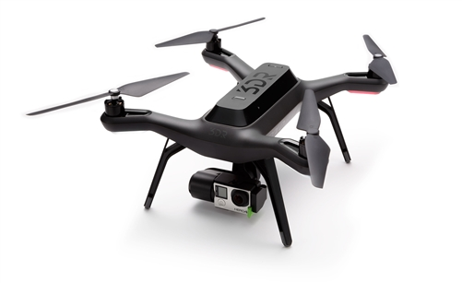
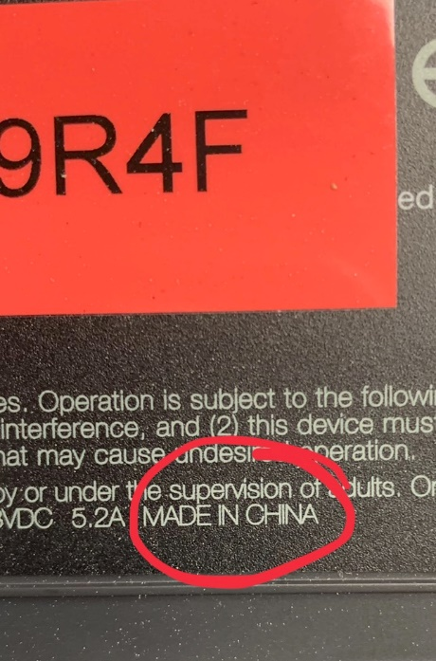
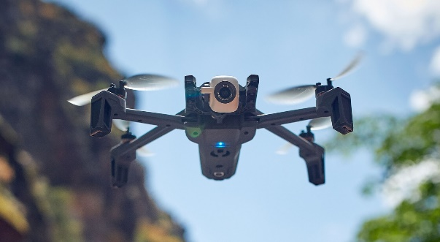
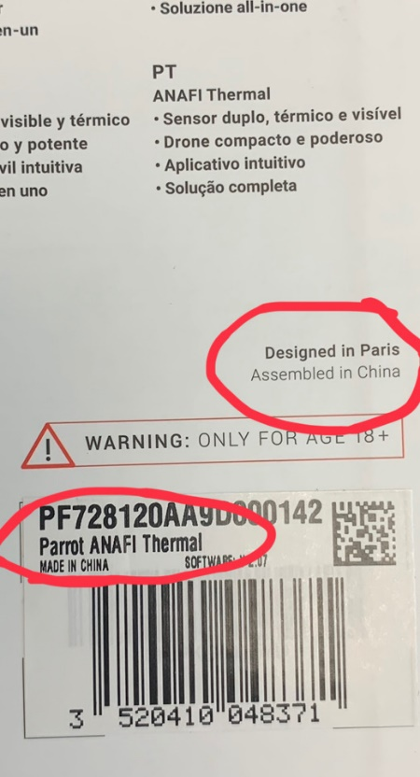
3D Robotics – “American” drone company, but drone manufactured in China
Parrot Anafi – “French” drone company, but drone manufactured in China
>76%
Notes:
Drones are a Global Product – The second myth we need to dispel is that of the “pure” American drone. Decades ago, consumer demand, business and governmental policy decisions resulted in a gradual, but unrelenting shift in the manufacture of commercial technology products. What had been a U.S. dominated market in many sectors, has now transitioned to a global market with most technology products consisting of components and commodities from many different countries, often with manufacturing conducted overseas where labor rates are cheapest. This has been no different for the commercial drone industry.
While there has been a lot of discussion among pundits, media types, and others about the “dangers” of foreign manufactured drones and the need to only buy “American” drones, little has been written or discussed about the realities of the commercial drone as a global product. One only has to look at Interior’s initial purchase of American drones and DOD’s recent announcement regarding its examination of similar American and allied country drones to understand that the “pure” drone is as much a myth as the unicorn.
If you flip over one of Interior’s 450+ Solo drones manufactured by the 3D Robotics Company of Berkley California, you will see the MADE IN CHINA stamp. Likewise, if you do the same with the Parrot Anafi, recently selected by DOD (and also part of the DOI fleet) you will see that it was “Designed in Paris,” but MADE IN CHINA. Based on these facts, both these American and French drones would be subject to the same cautions contained DHS industry alert as other drones that have been the subject of so much focused concerns by pundits and the press.
The real danger with this continued use of imprecise and inaccurate classification of drones based on where the company is located is the complacency that can result; complacency that might hide from us through our own blindness, real risks and security vulnerabilities.

Slide 11
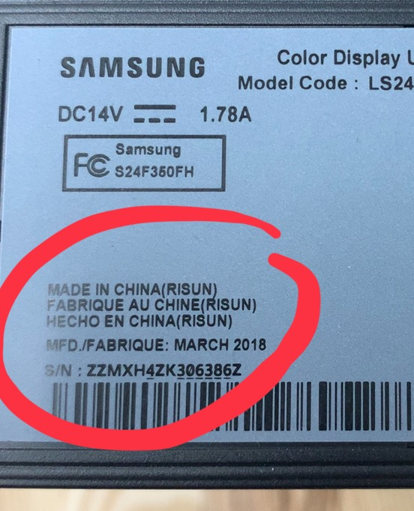
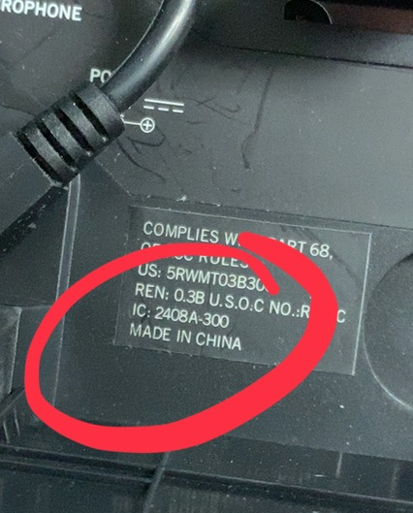
This is an “everything” issue
*
Your Computer Monitor and Webcam…are “THEY” Watching You?
Your Office/Conference Room Polycom…. are “THEY” Listening to You?
“DoD purchased and used COTS information technology items with known cybersecurity risks…., such as Lenovo computers, Lexmark printers, and GoPro cameras, with known cybersecurity vulnerabilities”
* Source: The US military spent $33 million on tech known to be vulnerable to Chinese Cyberespionage - By Justin Rohrlich, July 31, 2019
Notes:
It’s Not a Drone Issue, It’s an “Everything” Issue – Many would argue this complacency already exists, exemplified by the third myth, that this is simply just a “drone issue.” The reality is this isn’t a drone issue, it’s an EVERYTHING issue. From your smartphone to your computer, monitor, webcam, smart speaker, polycom, printer, etc., all were likely either MADE IN CHINA or contain significant components and/or commodities manufactured/assembled there. This fact and our continued complacency toward it was recently reinforced by a DOD Inspector General Audit that was detailed in an article by Justin Rohrlich and featured on the Quartz online news site: The US Military Spent $33 Million on Tech Known to be Vulnerable to Chinese Cyberespionage. Again, this speaks to the need to thoughtfully and carefully define what constitutes “bad” and as important, what we accept as “good” when it comes to our data management assurance standards. Deciding that “Made in America” is the standard of ‘secure” doesn’t necessarily speak to the potential mixed provenance of the components and commodities that make up the product. On the other hand, making a determination that “good” can only be achieved with pure American components, commodities, and manufacture, without understanding the current market, might leave us with no available products to choose from. Bottom line: we need thoughtful discussion, not uninformed hyperbole.

Slide 12





WHAT ? 2017 - 2019
S
O
L
U
T
I
O
N
S
Security
Platform
Mission
Payload
Processing
Master DOI UAS Requirements
Performance
Price
Scalability
Notes:
What? – Given the realities of the commercial drone space in 2016 (and today) and aware of the myths of absolute information security, the “pure” American drone, and that security is just a drone issue, OAS embarked on a 3-pronged strategy to identify solutions to meet the UAS data management assurance element of the DOI Master UAS Requirements.
1. Building on our long partnership with DOD, we partnered with the Defense Innovation Unit (DIU, in 2017 referred to as Defense Innovation Unit Experimental – DIUx).
2. We also worked with Dronecode, a consortium of drone industry companies intent on delivering a collaborative and shared open source platform for unmanned aerial vehicles.
3. Finally, we worked with DJI. In 2015, we had made them aware of our data management assurance requirement and the fact their products did not meet it. With an estimated 70%-80% market share of the commercial drone space, it made sense to see if they would be interested in developing and fielding a solution that would meet our requirements and provide Interior bureaus with access to this range of products. Look at it this way, if you were responsible for fulfilling the purchasing of products that were critical to the business success of your clients, would you overlook Amazon because they were unable to meet one key requirement, or would you seek to work with them to find a way they could meet your requirement and you could provide your clients with the cost and mission effective products they needed? It’s easy for policy wonks, media pundits, academics, and others who aren’t responsible to the American Taxpayer for timely, efficient, and effective delivery of products and services to shout that we should just wait for the “unicorn” to appear, but for those of us who have those responsibilities, we must work with the “mustangs” to get the job done in the best way possible.
With each of the participants, we made it clear that we had no preferences; whoever was able to provide the best solution first would be the one we would approve for use within Interior, opening it up for possible acquisition through the normal open and competitive federal contracting process. We also made it clear to all parties that this would be a continuing process, always on the lookout for solutions that provided the right combination of mission and security Performance, Scalability, and Price in meeting the DOI Master UAS Requirements for Platform, Payload, and Processing.
DOD and DJI successfully delivered prospective solutions for follow-on test and evaluation.

Slide 13
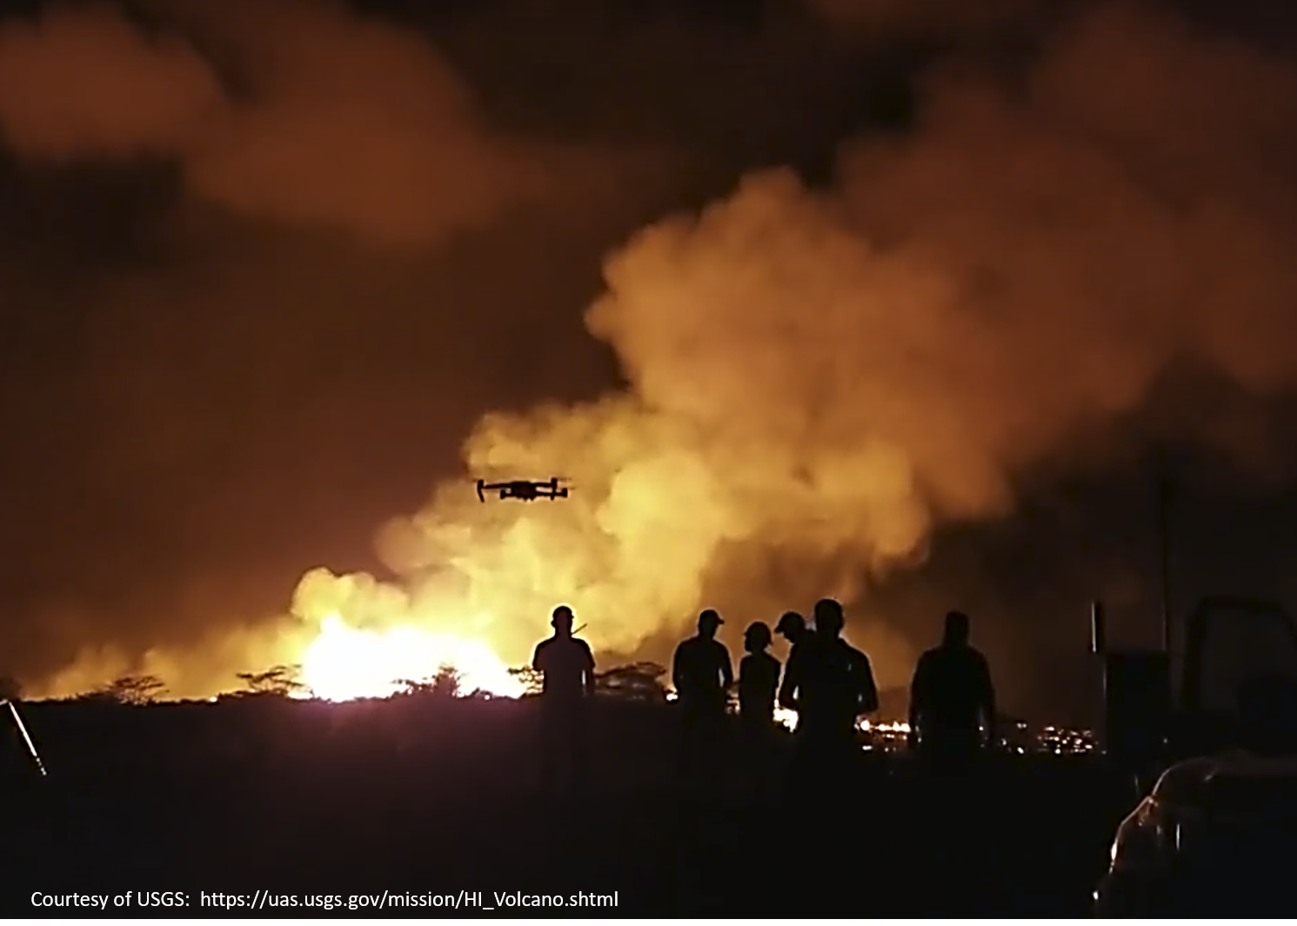
How?
> 2,200 test flights
Volcano response and monitoring.
  Gas detection, assessment, and monitoring.
  Crater mapping.
  Lava flow speed determination.
Search and Rescue (SAR).
Prescribed fire area inspections.
Aerial ignition in support of wildland firefighting.
Wildland fire perimeter mapping.
Wildland fire pre/post vegetation mortality mapping.
Ground-penetrating radar payload assessment.
Emergency equipment delivery (proof of concept).
Volumetric determination for surface mining.
Water sampling.
Doppler radar for stream flow measurements.
Methane gas detection.
Beach sand tidal distribution volumetric mapping.
Light Detection and Ranging (LIDAR) assessment and application.
Archeologic and historical site mapping.
Dam infrastructure mapping and inspection.
Animal species population density census.
Avian off shore nesting site inspections.
Aircraft accident mapping and inspection.
Situational awareness and reconnaissance flights for managers with live streaming.
Tethered power supply testing for persistent surveillance and reconnaissance.
Notes:
How? – Leveraging the OAS Director’s extensive experience in engineering, program management, and in the hands-on planning, execution, analysis, reporting, and organizational leadership in experimental flight test, OAS developed and executed a comprehensive functional flight test and technical evaluation plan to assess the DOD and DJI provided solutions. In accordance with standard flight test protocols, each of the 59 DOI trained and carded (and FAA Part 107 certified) UAS operators who participated in the test plan were required to read and sign that they read and understood the requirements of the test plan.
The functional flight test plan put the DOD and DJI developed solutions through a wide variety of representative DOI sUAS missions. Over 2,200 test flights were flown, with qualitative and quantitative data collected and assessed.
Based on the DOI Master UAS Requirements and in consultation with the DOI bureaus for their most pressing UAS needs, the Matrice 600 Pro (M600) and the Mavic Pro platforms were chosen as the two vehicles for the validation and verification of both DOD and DJI developed solutions.

Slide 14
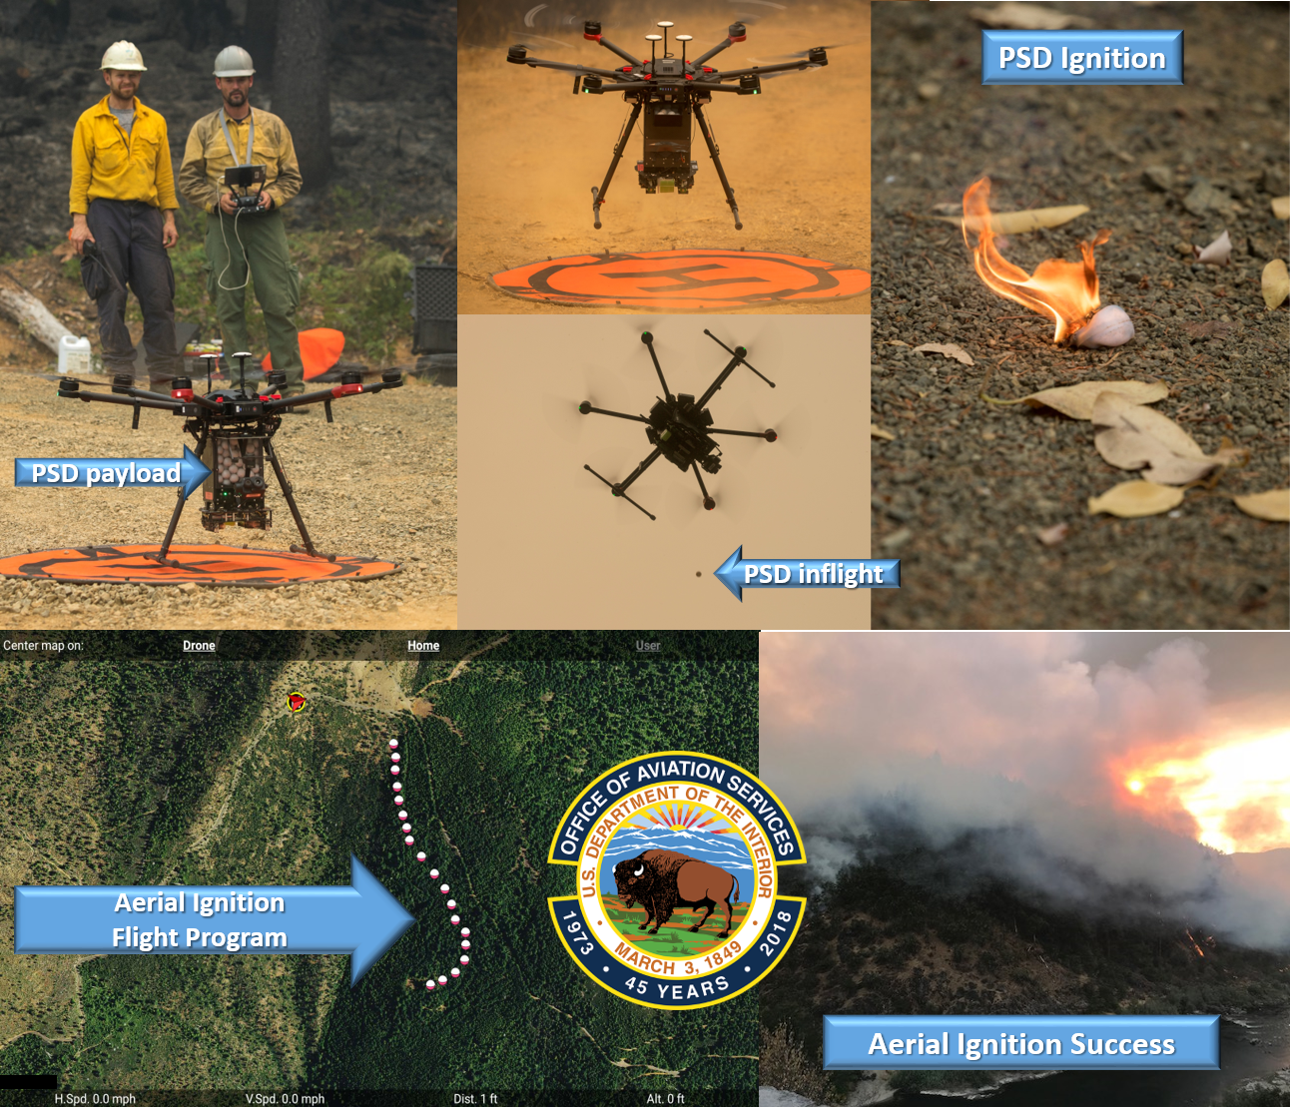
Ex: Aerial ignition
Matrice 600 Pro Hexacopter
Payload, endurance, range, redundancy.
177 flights, 50 hours, 12,000 PSD rounds.
Improved safety – 6 deaths, 3 helicopters lost in 14 years.
Improved responsiveness.
First-ever real-time monitoring capability.
First-ever night firing capability.
Supported President’s 12-21-18 EO – Active Management of Lands to Reduce Wildfire Risk.
Notes:
Example Mission – Aerial Ignition: An example of the mission areas tested that speaks to the importance of identifying and fielding a solution that increases Interior’s access to the commercial market, without sacrificing requirements is the aerial ignition mission.
Aerial ignition is a valuable part of the wildland firefighting mission. It is employed prior to the wildland firefighting year in what are known as prescribed burns, where land managers use fire to reduce hazardous fuel loads in identified high risk areas. By reducing the fuel load ahead of the fire year, the risk of a catastrophic wildfire is reduced. Aerial ignition is also utilized during prosecution of wildfires in what is known as “burnout” operations. Here, fuel the wildfire could consume is strategically burned out, often to increase the width of fire breaks established to contain the fire. In both prescribed fires and burnout operations, aerial ignition is traditionally carried out using helicopters utilizing plastic sphere dispensers (PSD) that release delayed incendiary rounds to ignite the hazardous fuels according to operation plan. Unfortunately, this places the helicopter in a very hazardous flight envelope; low and slow, offering no viable options in the event of an engine, transmission, or control issue occurring. The hazards of this mission have manifested themselves in the loss of three helicopters and six deaths while performing the aerial ignition mission over the last 14 years. Aerial ignition isn’t the only way to conduct prescribed burn or burnout operations. Crews with drip torches can also be used in these missions. However, this requires significant manpower and can be difficult and/or dangerous when burning in remote areas or in severe terrain.
In selecting the right drone for the aerial ignition mission, one that had the capacity to carry the required PSD rounds, the hopper, firing machinery, and monitoring sensor was required. It also had to have the range and endurance that would enable it to successfully deploy the PSD rounds according to the desired mission pattern and then be able to remain airborne to monitor the ignitions and subsequent burn progress. In assessing the Matrice 600 Pro for this mission, over 12,000 PSD rounds were successfully deployed over the course of 177 flights and 50 flight hours on multiple fires.
Not only did the drone-payload system meet all required minimum test criteria, but it enabled significant new “first-ever” opportunities, such as real-time monitoring and night firing. The night firing has been particularly exciting to fire managers as conditions tend to be more conducive to managed prescribed burns and burnout operations at night than during daytime periods (i.e. lower winds, lower temperature, and higher relative humidity).
By adding a drone-based aerial ignition capability to the wildland firefighter’s toolbox, federal agencies are better able to support the President’s recent Executive Order to actively manage lands to reduce wildfire risk.

Slide 15

How?
Local Data Mode
experience
Drones
Amplified
Data Management Assurance Technical Evaluation
Industry
DOI Specific
G.E.
Hardware
Firmware
Software
Federal
Federal
Federal
& Natl Lab
partner
Master UAS Requirements
(Pilot App version 1.3 19743, Assistant 2 GE Version 9-5)
Notes:
How? – While OAS had significant flight test and mission relation expertise with which to assess the functionality of the DOD and DJI provided solutions for diverse DOI bureau missions, we lacked the ability to adequately assess the data management assurance performance of the provided solutions. For the data management assurance technical evaluation we relied on the expertise of one industry and two federal partners.
Drones Amplified was chosen as the industry partner based on their previous work and performance in assessing the previous DJI data management assurance solution known as “Local Data Mode.” Following DJI’s launch of Local Data Mode in 2017, OAS enlisted Drones Amplified to conduct a data management assurance assessment; specifically to determine if it met the DOI UAS Master Requirement “to decline and lock out any device information sharing including telemetry through aircraft, software or applications preventing any automated uploads or downloads.” Drones Amplified reported that DJI’s Local Data Mode continued to “leak” data. As a result, OAS made the decision not to authorize the procurement or operation of DJI aircraft equipped with Local Data Mode. Given the positive previous experience OAS had with Drone’s Amplified in assessing a DJI-developed data management assurance solution, they were chosen as our industry testing partners for this phase. NASA was chosen as one of our federal testing partners based on the long and productive UAS-related partnerships OAS-DOI had enjoyed with NASA since the beginning of our UAS program in 2006. NASA Kennedy Space Center believed they could conduct the requested verification and validation of the data management assurance claims of DJI’s DOI-specific Government Edition (GE) suite of hardware, software and firmware. OAS also reached out to a close federal teammate in the security space and their national laboratory partner to conduct a second government assessment of GE. They have asked to remain anonymous. Each technical evaluation of GE was conducted independently. During the process, Drones Amplified and NASA identified improvements to GE (related to functionality, not security) that were incorporated into follow-on versions that were also evaluated. In the end, all three testing partners independently concluded the DOI-provided GE version performed as required and met DOI requirements for data management assurance, giving DOI the ability: “to decline and lock out any device information sharing including telemetry through aircraft, software or applications preventing any automated uploads or downloads.”

Slide 16
Non-sensitive missions collecting publicly releasable data
So What?
DOD solution – OK, but limited.
GE solution – OK, fully functional.
Same layered defense on top.
High performance, scalable, & cost-effective solution to the field, now.
System prevents user error / override.
NO connection to DOI network: Air-gapped
ALL updates security tested before approval
Tested secure by proven industry, federal partners before authorization
Notes:
So What? – During the 15-month flight test and technical evaluation program, both the DOD and DJI provided, DOI-specific GE solution were assessed. While the DOD solution proved secure, it was unable to provide the full functionality of the parent DJI platform, payload, and processing elements, limiting its utility for Interior’s complex missions and derived data product requirements.
The final GE solution, improved through feedback from functional flight tests and the technical evaluation process was able to meet DOI data management assurance requirements, while retaining full DJI platform, payload, and processing functionality.
Based on these results, a limited authorization to acquire and operate just the two tested DJI UAS (Matrice 600 Pro and Mavic Pro), equipped with the DOI-specific GE version (Pilot App version 1.3 19743, Assistant 2 GE Version 9-5) was approved by the OAS Director as the lead aviation authority in DOI. As part of DOI’s layered approach to UAS program security, the authorization specifically stated that all subsequent updates would be tested and validated before being approved for acquisition and operation. The same would apply with any additional DJI aircraft types desired by the bureaus.
Consistent with OAS policies for all its UAS, these aircraft would also be “air-gapped” from the DOI network, alleviating any risk associated with connecting to the DOI network. This has been standard practice since the beginning of Interior’s UAS program with all drones.
On top of this, OAS insisted DJI build in “protections” that prevented the user from intentionally or inadvertently overriding the GE suite and connecting the drone to the internet. Forcefully doing so rendered the UAS inoperative.
As a final layer of data management assurance risk mitigation, the limited authorization said these aircraft should only be used on non-sensitive missions where publicly releasable data was collected.
Through this traditional layered approach, we believe we have successfully mitigated the data management assurance risk of using these products to a reasonable and workable level.

Slide 17
Non-sensitive missions collecting publicly releasable data
So What?
DOD solution – OK, but limited.
GE solution – OK, fully functional.
Same layered defense on top.
High performance, scalable, & cost-effective solution to the field, now.
System prevents user error / override.
NO connection to DOI network: Air-gapped
What’s Next?
Interim solution.
Time consuming & costly to scale.
Exploration & assessment of alternatives and long term solution options continues.
ALL updates security tested before approval
Tested secure by proven industry, federal partners before authorization
“Best is the enemy of better, better is the enemy of good enough, but NOTHING is the enemy of all of these.”
Mark L Bathrick 2019
Notes:
What’s Next? – So, what’s next? As discussed in the report, while Interior’s commitment to test each new GE update and new DJI product before authorizing it for acquisition and operation by the bureaus provides a high level of continued data management assurance, it is a time consuming and costly process that is difficult to scale, making this an interim solution.
Interior and OAS is continuing to work closely with industry and government partners to develop a long-term, elegant solution that is secure and agile. FedRAMP compliance is part of that vision for the future.
Until then, we will continue to leverage the incredible power and cost efficiency of UAS technology while managing the data management assurance risk through a prudent, layered security structure, remembering that while “Best is the enemy of better, and better is the enemy of good enough, NOTHING is the enemy of all of these.” Today we have moved beyond “nothing” to at least good enough, while we keep striving for better and best in the future, strengthened by the experience we gain through risk managed operations in support of delivering results for the American Taxpayer in managing “the People’s Lands.”

Slide 18

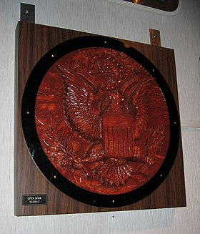
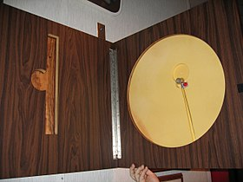
Final Myths
  Buy American Act prevents – “domestic non-availability.”
  Trade Agreements Act prevents – “small business set aside.”
  “Pure American commercial drone.”
  Commercial supply chain security.
  Components are critical, but commodities are not
    ”The Thing,” 1945.
  Banning products will spur the U.S. drone industry.
    …..and the lifecycle for an sUAS is 2-3 years.
https://en.wikipedia.org/wiki/The_Thing_(listening_device)
August 4, 1945 – Soviets plant a passive listening device in a carved wooden plaque, given to the U.S. Ambassador
Notes:
Final Myths – Before we conclude, there are a few final myths I need to dispel; myths you often see from pundits who seem to only read and speak in 240 character segments, with a commensurate level of knowledge and understanding.
First, neither the Buy American Act (BAA) nor the Trade Agreements Act (TAA) prevents an agency from buying a “foreign” anything. As it does with most laws, Congress place provisions in both acts to account for “domestic non-availability” in the case of the BAA and to support small American businesses in the TAA (“small business set-aside provision).
Second, there is currently NO such thing as a “PURE” American COMMERCIAL drone. All current commercial drones are either manufactured / assembled in China or have significant Chinese components………just like your TV, cellphone, printer, camera, computer, webcam, polycom, monitor, Alexa, Google Assistant, smart speaker, car electronics, etc., etc., etc.
Third, there is no such thing as a “secure” commercial supply chain. While companies do take measures to ensure the consistent quality of parts in their supply chain, commercial supply chains don’t have the security requirements of military or intelligence community products. Relying on a secure commercial supply chain for your data management assurance is like waiting for a unicorn.
Fourth, it is a myth that only “components” can be used to compromise security. In 1945, the Soviet Union placed a passive, largely untraceable listening device in a “commodity,” a wooden Great Seal of the United States that was given to the U.S. Ambassador. This security compromised commodity went undetected for years. Focusing only on electronic components and not commodities opens up a possible path for bad actors to exploit.
Finally, there are many well-intentioned, but misguided folks who believe that banning competing UAS products will magically and immediately spur the U.S. drone industry to a new renaissance. Imagine if the U.S. banned Japanese cars in the 70’s. Do you think that would have spurred the U.S. industry to produce better cars? I think we’d all still be driving Pintos, worried about being hit from behind and going up in flames. Banning products has never worked to spur an industry. Only competition and the American spirit of innovation have worked in the past and will be the only thing that can work here………if we believe that’s what’s important for our future….yet we made business and policy decisions decades ago to “offshore” almost all technology manufacturing.
……..oh, and it’s a myth that the lifecycle for a small UAS is only 2-3 years and therefore a ban of current foreign UAS products won’t matter much as agencies will be looking for new UAS. The majority of our UAS are approaching 4 years old and are still running strong. By leveraging versatile payloads and processing applications, we can continue to successfully leverage the “old truck” far into the future.
One “oh by the way” associated with the Trojan Horse in the top right hand corner. If we are impetuous and unthinking in how we approach the issue of UAS data management assurance, preferring the hyperbole of “ban the foreigners” and giving a “free pass” to non-requirements based vision of what’s “pure and safe,” we are then inviting known or new bad actors to make simple adjustments that could place an undetected threat within our midst.

Slide 19

Conclusions
Military UAS cookie-cutter is an ill fit.
Requirements: mission & security context, disciplined adherence are key.
Commercial drones provide Performance, Price, Scalability, & ROI.
Lack of consensus on “Good vs. Bad” is a security risk – U.S. company, foreign made, foreign components, commodities, data, supply chain, internet access, etc.??
No “pure” U.S. component & commodity commercial drone.
Security should always be a concern and planning factor.
Industry collaboration & layered defense = better risk management.
danger
Complacency
Notes:
Conclusions – A few concluding thoughts.
First, if you are a “beltway bandit” who just hired a former military aviator or “UAS expert,” please understand that they need considerable “seasoning” in the many differences between the military UAS world and the commercial UAS space……and please don’t waste your time or mine by coming to Interior with “your solution to problems we don’t have.”
Second, the first key to success in a UAS is the development of solid platform, payload, and processing requirements, all derived within the context of your mission space and security needs. Focus on this, first. Beware the dangerous lure of the “Bright Shiny Object.”
3. Once you have determined your requirements, adhere to them. You will find that the commercial UAS industry will eventually evolve to meet your requirements. In doing so, they will offer you performance, scalability, price, and a resultant return on investment commensurate with this revolutionary technology that has “democratized the 3rd dimension.”
4. In my view, the biggest security danger we face today is the lack of informed and thoughtful conversation and consensus on what is “good vs bad” in drones. Confusion over what it means to be a “U.S. company,” whether foreign components, commodities, where data is stored, whether the supply chain can be secured, whether the platform, payload, or processing application communicate with the internet…and whether you know it or can control it have clouded the conversation and necessary important decision making. Making an uninformed decision that results in “false security” could also instill a dangerous complacency of a “safe product” that really isn’t, leaving the front door wide open while we close and monitor the condition of an upstairs window.
5. There is no such thing as a “pure” U.S. component or commodity commercial drone….or commercial phone, computer, monitor, TV, camera, printer, etc., etc., etc.
6. Security should always be a constant concern and planning factor……it can never be “one and done.”
7. Finally, collaborating with industry to encourage them to build products that meet both your mission and security requirements, while building in a system of layered defenses (verify before you trust) is a much better risk management approach than relying on some false sense of security………like buying technology from an “American” company.

Slide 20
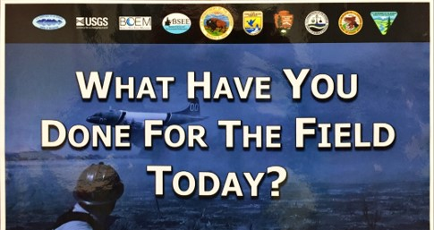
Thank you,
Questions?
Mark L Bathrick SES
CAPT USN (Ret)
Mark_Bathrick@ios.doi.gov
www.doi.gov/aviation/uas/news
MLB 2019
Notes:
Thank you……….any questions for the Horse?
Additional Information Sources:
August 13, 2019 - DOI Drone vs Services Procurement Decision Guide
July 25, 2019 - U.S. Department of the Interior Small UAS Selection and Acquisition Process
July 19, 2019 - Key Messages and FAQ's - OAS UAS Data Management Assurance Flight Test and Technical Evaluation Report
July 2, 2019 - Flight Test and Technical Evaluation Report - DJI Unmanned Aircraft System (UAS) Mission Functionality and Data Management Assurance Assessment: This Flight Test and Technical Evaluation Report presents results of an assessment of the flight, payload, and data management assurance performance of the SZ DJI Technology Co., Ltd. Matrice 600 Pro and Mavic Pro unmanned aircraft systems (UAS) modified with DJI Government Edition (GE) hardware, firmware, and software for suitability in selected Interior bureau missions. Test articles were operated under the Office of Aviation Services (OAS) Test Plan for Validation and Verification of Data Security Software for Employment of DJI UAS Platforms, originally signed on April 9, 2018 and later updated with approved Modifications One and Two of November 14 and 16, 2018, respectively.
July 3, 2019 Limited Authorization to Acquire and Operate Selected SZ DJI Technology Co., Ltd Unmanned Aircraft Systems: Based on the conclusions and recommendations contained in the Flight Test and Technical Evaluation Report of the completed DJI Unmanned Aircraft System (UAS) Mission Functionality and Data Management Assurance Assessment, this letter provides limited authorization for Interior to acquire and operate selected and specially configured DJI UAS in support of wildfire, SAR, emergency response, natural resources, and other applicable bureau missions.
DOI UAS Best Practices for Responsible Operations
Master UAS Requirements for the DOI
DOI UAS News & Media

