Slide 1
An Introduction to Audio Description
Christopher Delano
Audio Description Coordinator

Slide 2
Your Presenter
Christopher Delano is an Audio Description specialist. He earned a degree in Theatre Arts and English at Columbus State University. His background in writing and criticism of dramatic and poetic literature has led to publications in the area of literary art. Christopher served for a number of years in a student support position at Columbus State University before joining CIDI. He has passion for providing necessary accommodations to all students, and has channeled that passion into the work he does today. Christopher and his description team have attended trainings in Audio Description with the LEAD conference at the Kennedy Center and through Joel Snyder.

Slide 3
CIDI’s Captioning and Described Media Team
Provide live remote captioning for classroom sessions, meetings, conferences, and events such as commencement ceremonies.
Create accessible and high quality captions for post-production video media.
Provide a complete Audio Description service, including initial researching of video content, writing scripts, recording audio with human voice actors, editing audio for clarity, and adding the final audio recordings to video content.
Prepare trainings and presentations (just like this one).

Slide 4
Audio Description – What Is It?
“Audio Description involves the accessibility of the visual images of theater, television, movies, and other art forms for people who are blind, have low vision, or who are otherwise visually impaired... Audio Description is commentary and narration which guides the listener through the presentation with concise, objective descriptions...”
From the American Council of the Blind – http://www.acb.org/adp/ad.html

Slide 5
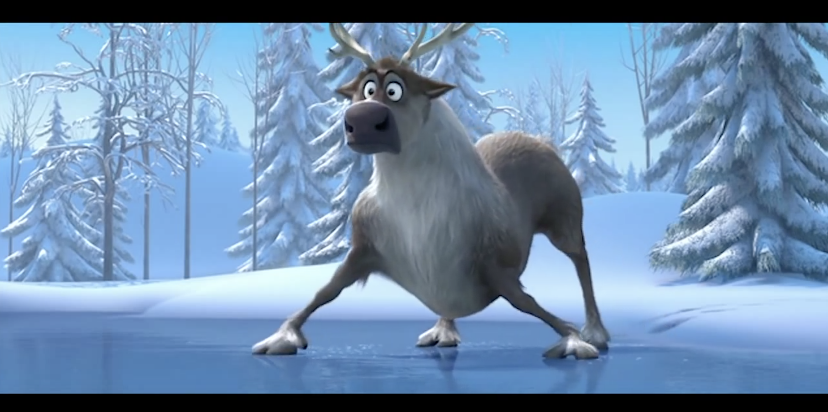
Audio Description Example – Frozen
Disney's Frozen - Trailer with Audio Description

Slide 6
How Did We Get Here?
1974: Gregory Frazier developed concept of Audio Description.
1982: Metropolitan Washington Ear hosts simulcast of AD for American Playhouse on radio reading services.
1987-1988: WGBH pre-recorded Audio Description for American Playhouse productions broadcast using SAP for first time.
1992: WGBH takes lead on AD for first-run films nationwide.
1998: Section 508 of Rehabilitation Act requires AD on federal agency media.
2008: Described and Captioned Media Program publishes its Description Key, guidelines for captioning and the description of educational media.
2017: The Section 508 refresh requires WCAG 2.0 Level AA adherence, which includes Audio Description (1.2.5).

Slide 7
Educational Audio Description
Consider the educational goal of the video and use that as a guiding factor in choosing description.
For example, the same video can be shown in several classes with different goals in each—identify the goal for this use.
Prioritize information over aesthetics.
Time is limited, so educational elements should be described before entertaining or artistic elements.
Exclude unnecessary and confusing description.
Information overload and description fatigue can ruin the experience.
Trust the listener’s ability to comprehend the material.
Do not condescend, patronize, or talk down to listeners.

Slide 8
How Do I Know I Need AD?
Obvious: Important visual information is presented without spoken description.
Title images, charts, graphs, et cetera.
Any movements or actions that affect or influence the scene.
Names and titles.
Less Obvious: Visual information that enhances the information is presented without spoken description.
”B-Roll” footage that shows the concepts in action.
Costuming or other physical characteristics that influence perceptions, such as uniforms and cultural features.

Slide 9
The Audio Description Tests
Closed-Eye Test
Audio-Off Test
In this test, you would “watch” the video with your eyes closed, then make notes about what elements of the video were hard to understand without visuals. If you find that there are audio elements that confuse you without the visual, the video will need description.
In this test, you watch the video without the audio and make notes of what are the most interesting and engaging visual elements. Then, watch the video again. If the most interesting visual elements are not explained or described, the video will need description.

Slide 10
Post-Production AD Considerations
Time
Post-production AD is going to take time to create, anywhere from a week to two months depending on the length and complexity of the video. Add it into your production timeline.
Cost
There’s no way around it: AD can be expensive.
Voice
Some AD creators choose to use synthesized speech while others will use human voice actors.
Delivery
Separate audio track.
Timed-text track.
Extended description or un-extended description on separate video.

Slide 11
How to Approach Adding Audio Description
As-Needed Post-Production
Planned Post-Production
Add AD to videos only when a need has been brought to your attention.
Gives much needed access.
Can cause delays in access to video by client.
Budgeting may not have been done.
Add AD to videos before release, but after they’ve been made.
Creates accessible content for any future client.
Costs should be accounted for in initial budgeting.
Need may never arise.

Slide 12
How to Get Post-Production AD
In-House Team
A dedicated team at your organization trained on proper description practices and equipped with the skills to record and edit descriptions.
Contract Vendor
A service provider agrees to complete your audio description, usually offering a fast turnaround and reduced price in exchange for a commitment to deliver a large number of videos.
CIDI
Membership based, à la carte ordering system.

Slide 13
Pre-Production AD Considerations
During Concepting and Creation
During Production
Work closely with the script-writer to insert AD into the narrative.
Plan for what visual elements need to be shown versus what can be removed to reduce confusion.
Allow text and graphics to remain on screen for longer period of time.
Give space between speakers so there is time for description.
Avoid loud background music.

Slide 14
How to Work AD Into Your Script
When creating the script for a video—or even when presenting without a script—do not consider any visual element to be a “given.” You will have viewers, clients, audience members, and more who can not or do not see the visual information. If a visual element is present, describe it with these considerations:
Content
For charts and graphs, describe trends and important figures, but avoid overload.
Context
Where is it located?
If it’s moving, how and where?
Aesthetics
What color is it? What shape is it?

Slide 15
Other Ways to Make Your Content AD-less
Introductions
Introduce yourself and your speakers.
Reading Text
Always read the full text that you are displaying.
If the text you are displaying is too much to read, consider making cuts.
Avoid Clip Art
The more you add, the more you describe.
Images can be confusing and distracting.

Slide 16
How to Host Audio Description
Online
In Person
WCAG guidelines advise hosting a separate video with extended description so to allow users to choose which version to view.
YouTube hosting allows for videos to be made private or unlisted.
Presenting the described video to all audience members is good for access if described video contains captions.
You can also offer an audio recording of descriptions to play simultaneously with video.

Slide 17
Simplicity in Audio Description
“Before you leave the house, look in the mirror and take at least one thing off.”
— Coco Chanel

Slide 18
Audio Description Practice
Look at the image on the right. Describe it how you believe an audio describer would describe it.

Slide 19
My Description
An older man holds an air horn outside of a home. Text reads “Jeff Foster: Tired of Birds.” The Weather Channel logo appears in the lower right.

Slide 20
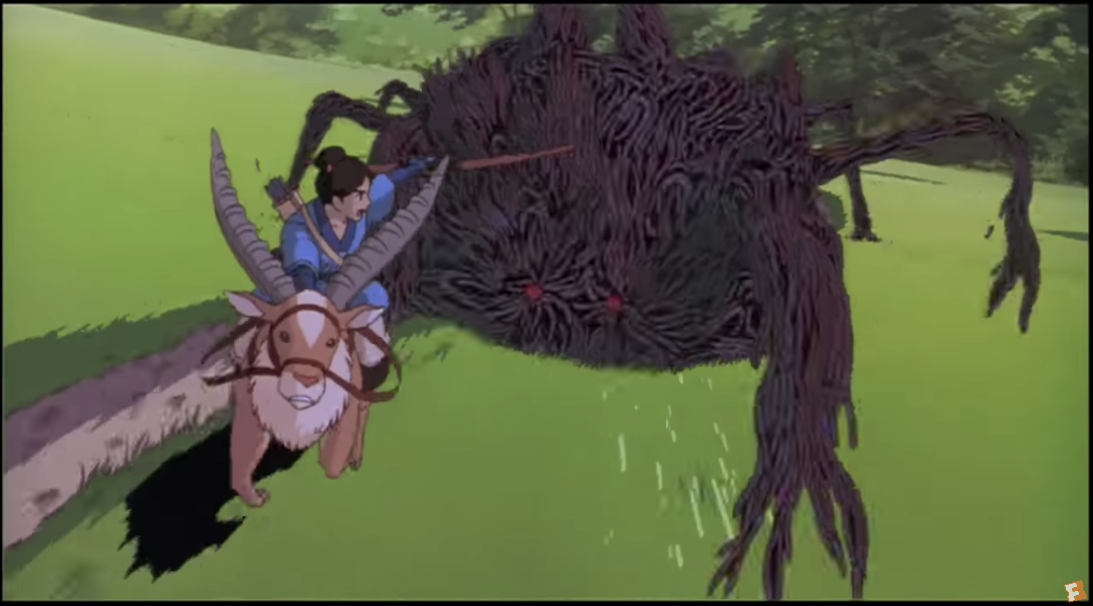
Practice Video Description
Princess Mononoke - Calm Your Fury (First 15 seconds)

Slide 21
My Video Description
Ashitaka, carrying a bow, rides his galloping red elk through the forest. A monster crashes through the trees pursuing him.

Slide 22
So Why is My Description so Short?
When writing this description, I considered these to be the key factors:
Names: In this case, the boy’s name is Ashitaka.
Location: The forest.
Context: Down a hill, or toward the town; on the back of a red elk; away from a monster.
Details: Carrying a bow.
Descriptors: Quickly; closely.

Slide 23
Writing My Concise Description
My original text: “Ashitaka, carrying a bow, quickly rides down a hill in the forest on the back of a red elk away from a monster.”
This description is clear, but it is also wordy and long. Let’s identify some of the areas of improvement.
It does not convey the urgency of the scene.
The spatial context is cluttered in one spot of the sentence.
There are too many thoughts in one sentence.
By splitting the description into two sentences, we could more cleanly formulate a description. Cutting the adverb “quickly” and instead using a more vivid adjective in “galloping” brought more intensity into the scene. The spatial context of “down a hill” was unnecessary. The second sentence gives action and urgency by using words such as “crashes” and “pursuing” instead of “away from.”

Slide 24
Considering Educational Content of this Clip
Consider the video as if it is being shown in these different contexts:
A Japanese history class focused on 1500s Japan.
An animation class.
A course on fashion in Japanese animation.
A history of animation class.
What would you describe differently in these different contexts?
How would you describe things differently if the class is about Japanese history versus animation history?

Slide 25
Questions?

Slide 26
Resources
DCMP Description Key
Listening is Learning
CIDI
LEAD Conference and Training

