Slide 1
Creating Accessible PDFs
Rob Haverty, Sr. Product Manager Adobe, Document Cloud Accessibility

Slide 2
Agenda
Session 1 – The Basics of PDF Accessibility
Session 2 – Getting Ready in Acrobat Pro DC
Session 3 – Fixing Inaccessible PDF Documents
GOALS:
It is possible for a PDF document to be accessible
Understanding what people need to know to make PDF documents accessible
There is always more to learn ☺

Slide 3
Session 1 – The Basics of PDF Accessibility

Slide 4
Compliance
Section 508 of the Rehabilitation Act (508)
The requirements to make ICT accessible
Web Content Accessibility Guidelines (WCAG)
Referenced in 508
W3C and ISO standard for Web Content
Standard for compliance is WCAG 2.0 AA
PDF/UA – ISO 14289 (PDF/Universal Access)
Referenced in WCAG
Subset of ISO 32000 (PDF standard)
Compliance is just the start of accessibility – ultimately it is about the User Experience!

Slide 5
Let’s Talk About PDF/UA – ISO 14289-1
Subset of ISO 32000 for accessibility.
Provides the text, structure, and organization of the content to assistive technologies.
Shall vs. May
e.g., lists – Individual list items shall be specified by <LI> tags. <Lbl> and <LBody> tags may be included.
Organizations define their own specific rules
e.g., requiring <Lbl> and <LBody> tags for compliance
<Document> tag should be the first tag in the tree structure (not required by PDF/UA)
May artifact images w/captions (not in PDF/UA)

Slide 6
Hierarchy of Tasks
Is the PDF created from a scanned image?
If yes – perform text recognition
Is the PDF a form with fillable form fields?
If yes – add the form fields
Does the PDF document or form contain links?
If yes – add the links
Does the PDF have multimedia?
If yes – add the accessible multimedia
Now – tag the document
If you edit the document the Tag Tree may become corrupted and you’ll have to start over.

Slide 7
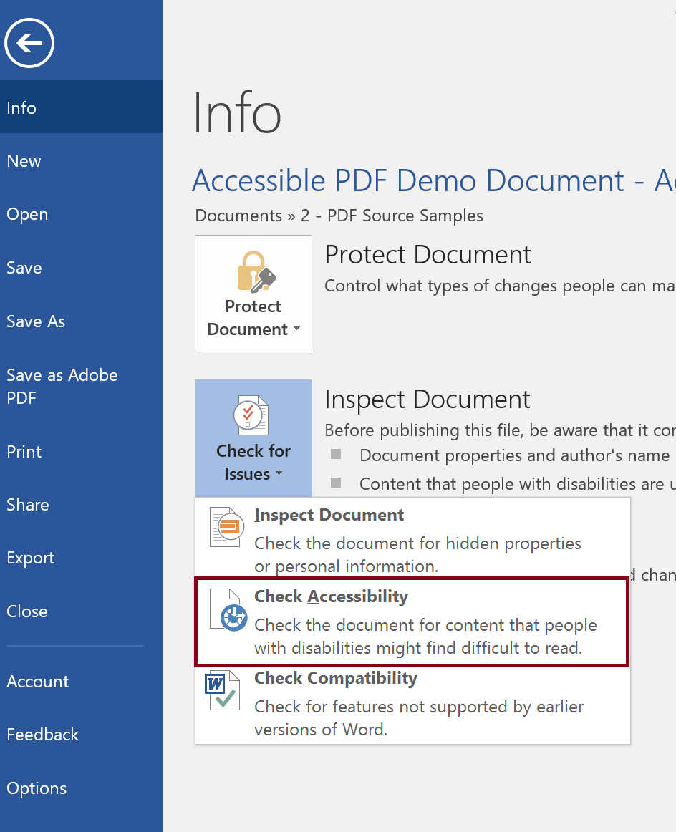
The Source Document is Supreme
It is usually easier to fix the source document then the converted PDF document.
Considerations:
Does the authoring tool support creating an accessible document (e.g. Accessibility Checker in Word)?
Does the author know how to create an accessible document (e.g. using Styles for Headings)

Slide 8
Conversion: Source Document to PDF
Multiple Methods
Acrobat Plug-in
Application Save As
Export
Print to PDF
Other conversion tools or plug-ins
Varying Results
Tables and Lists may be inaccurately tagged
Resulting PDF may be untagged
Custom tags may be created

Slide 9
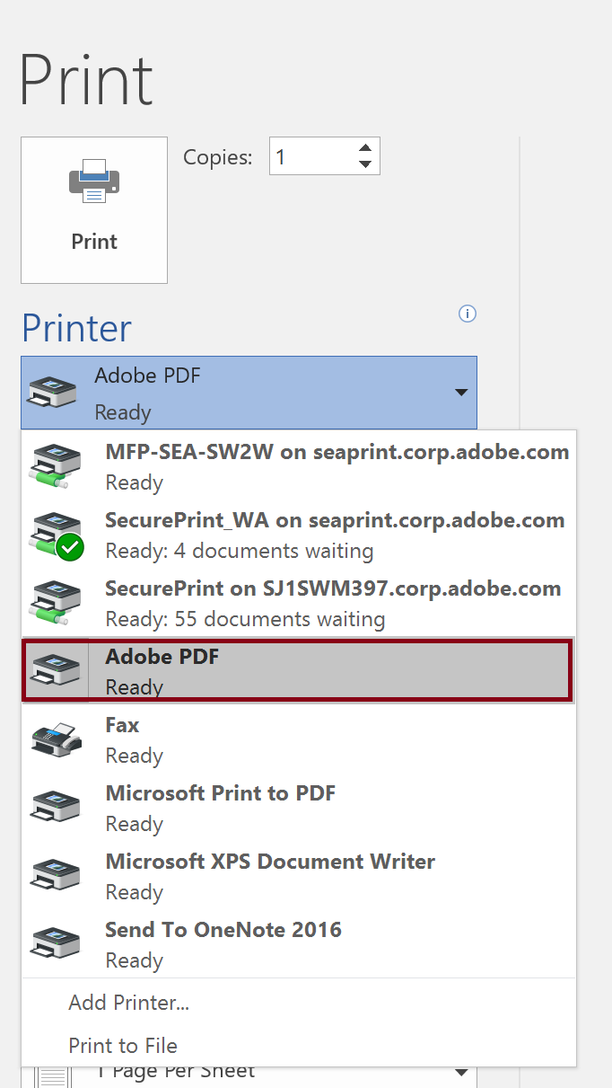
PDF Conversion from Word – Adobe Process
Converting an Accessible Word Document
Acrobat Plug-in (Office Ribbon)
Print to PDF

Slide 10
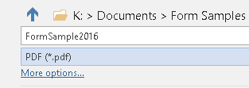
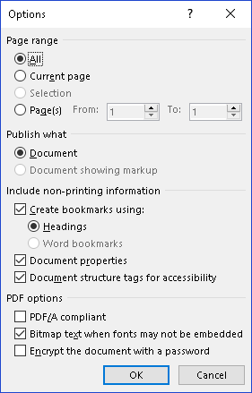
PDF Conversion from Word – Office Process
Converting an Accessible Word Document
Office Save As
Under More Options, open Options and make sure Headings are used for Bookmarks is checked.

Slide 11
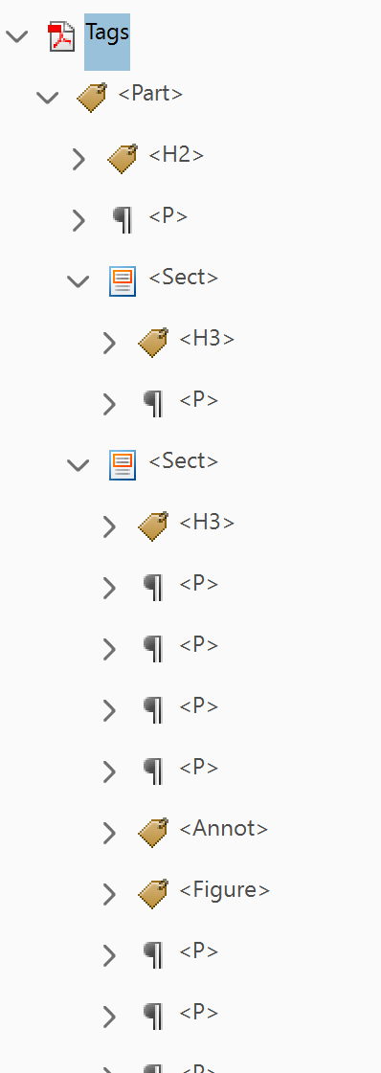
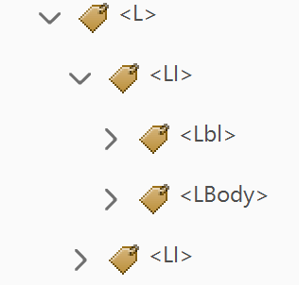
PDF Maker vs. Make Accessible
PDF Maker uses the semantic information of the source document to tag the PDF
Make Accessible (Auto tagging) attempts to imply the structure of the document
PDF Maker
Make Accessible

Slide 13
Session 2 – Getting Ready in Acrobat Pro DC

Slide 14
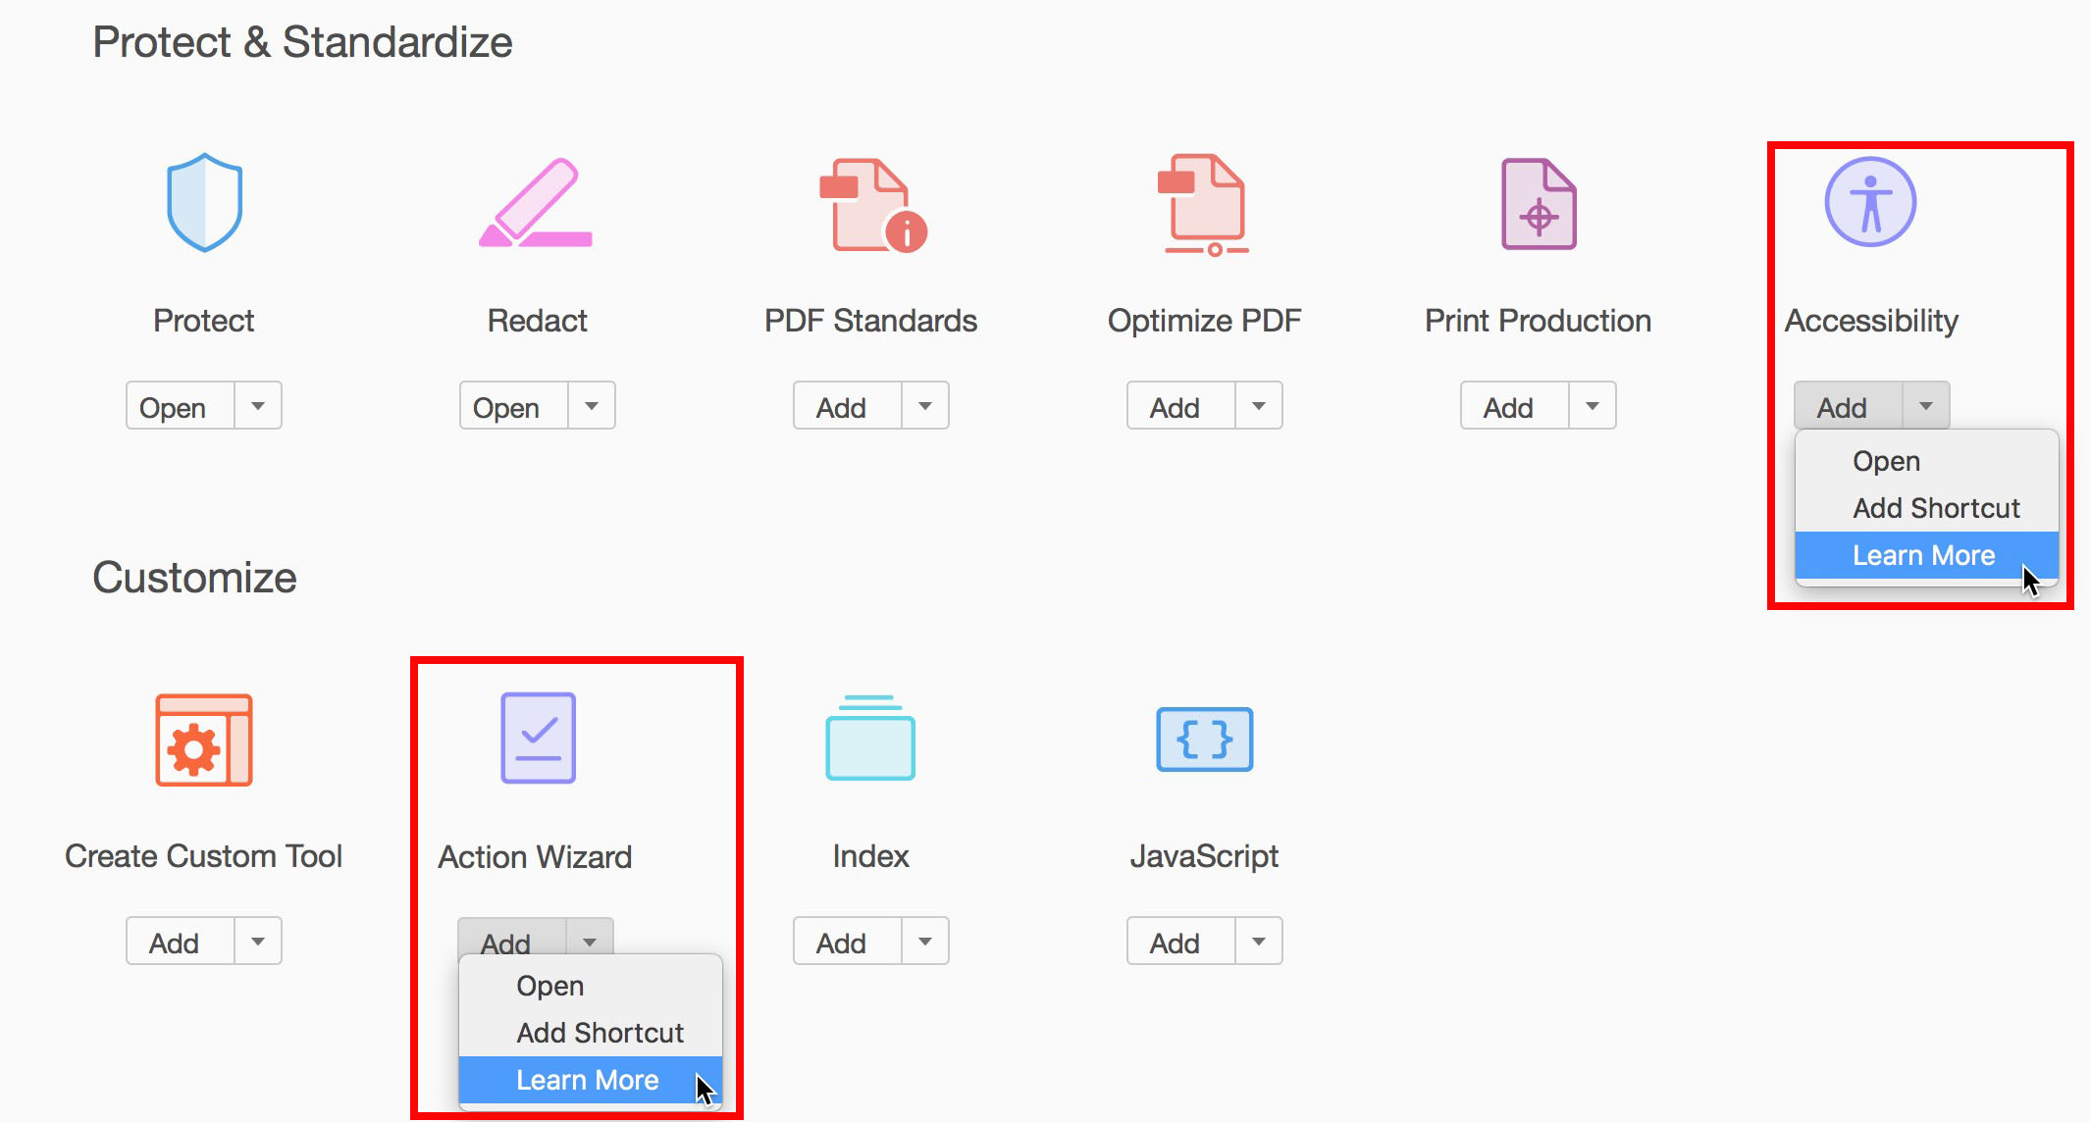
Acrobat Setup – Tools Pane
Tools Pane (Tools Tab > Select & Add Tool)
Action Wizard
Accessibility

Slide 15
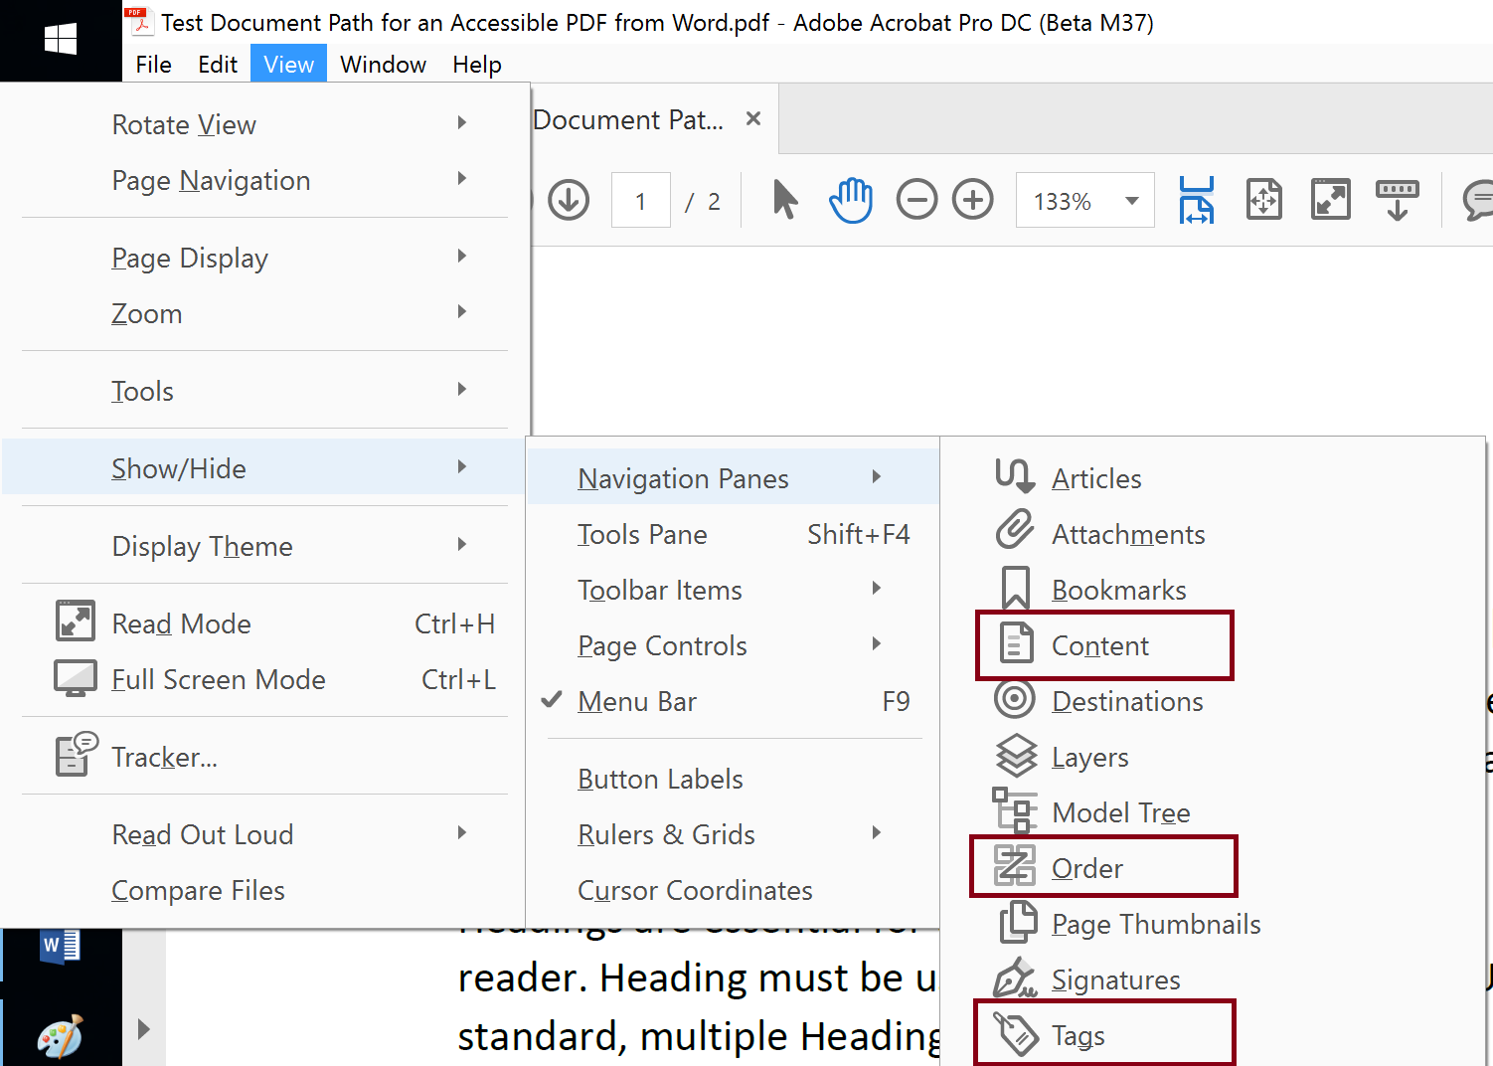
Acrobat Setup – Navigation Pane
Navigation Pane (View > Show/Hide > Navigation Panes)
Tags Panel
Content Panel
Order Panel

Slide 16
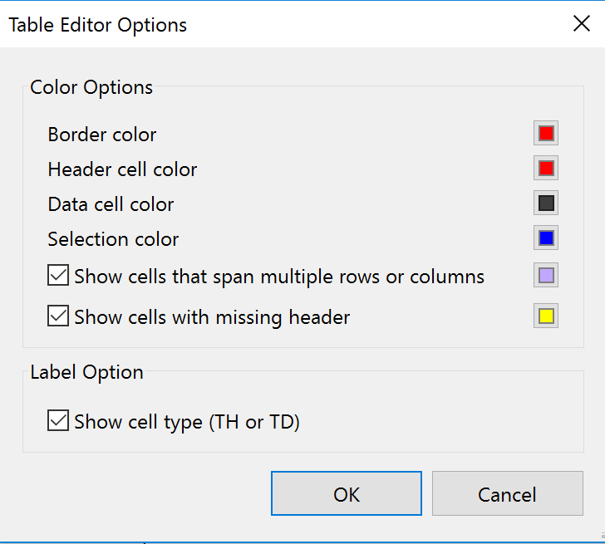
Table Editor
Set up Table Editor
Access via Tag Tree and Reading Order tool
Set display
Enhancements
Click anywhere
Select Cell

Slide 17
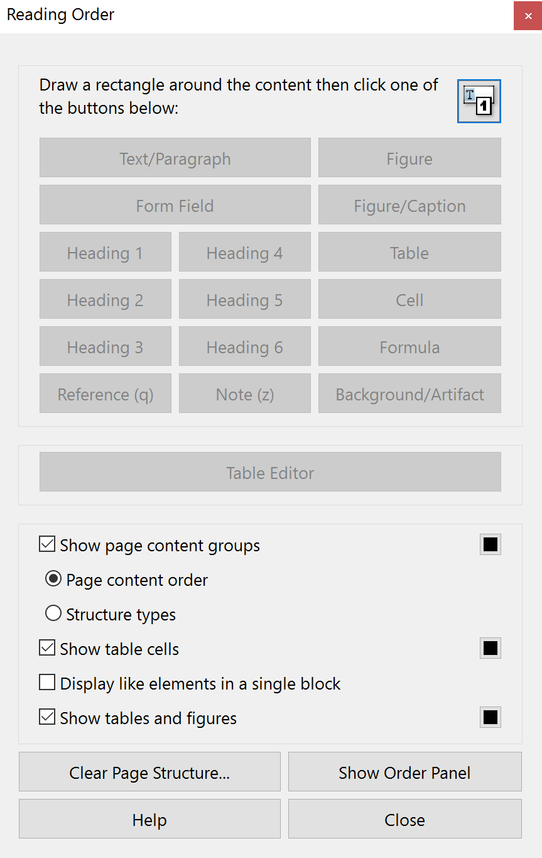
Reading Order Tool
(Was known as the TURO or Touch Up Reading Order tool)
Access via Order Panel or Tag Tree
Set up Display
Editing Tags in Reading Order tool

Slide 18
Keyboard Navigation
Standard Navigation (Tab & Arrow Keys)
Keyboard Shortcuts
https://helpx.adobe.com/acrobat/using/keyboard-shortcuts.html
F6
F2
Ctrl + D – Document Properties

Slide 19
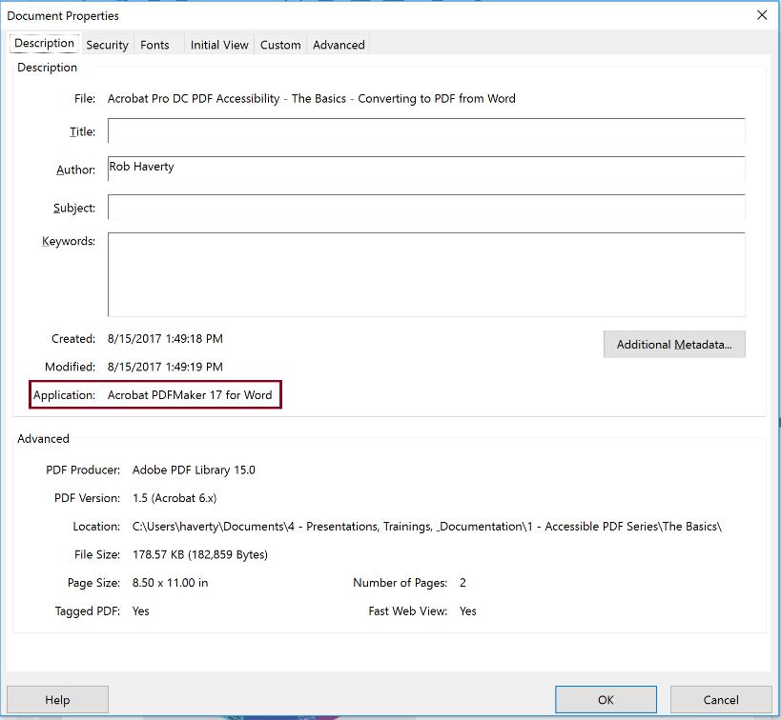
Document Properties (Ctrl + D)

Slide 20
Testing
Acrobat Accessibility Checker
Does not verify full WCAG conformance
Does not verify full PDF/UA conformance
PDF Accessibility Checker (PAC 3) - Free
http://access-for-all.ch/en/pdf-lab/pdf-accessibility-checker-pac.html
Full check against the PDF/UA Standard
Does not verify full WCAG conformance
Other Checkers

Slide 21
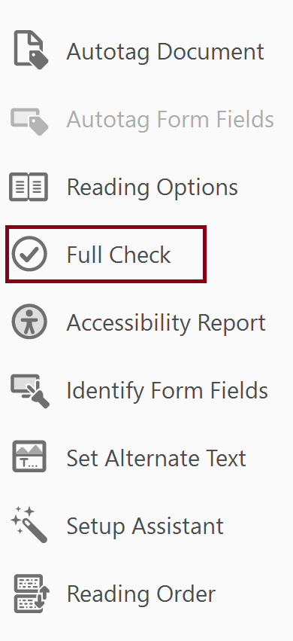
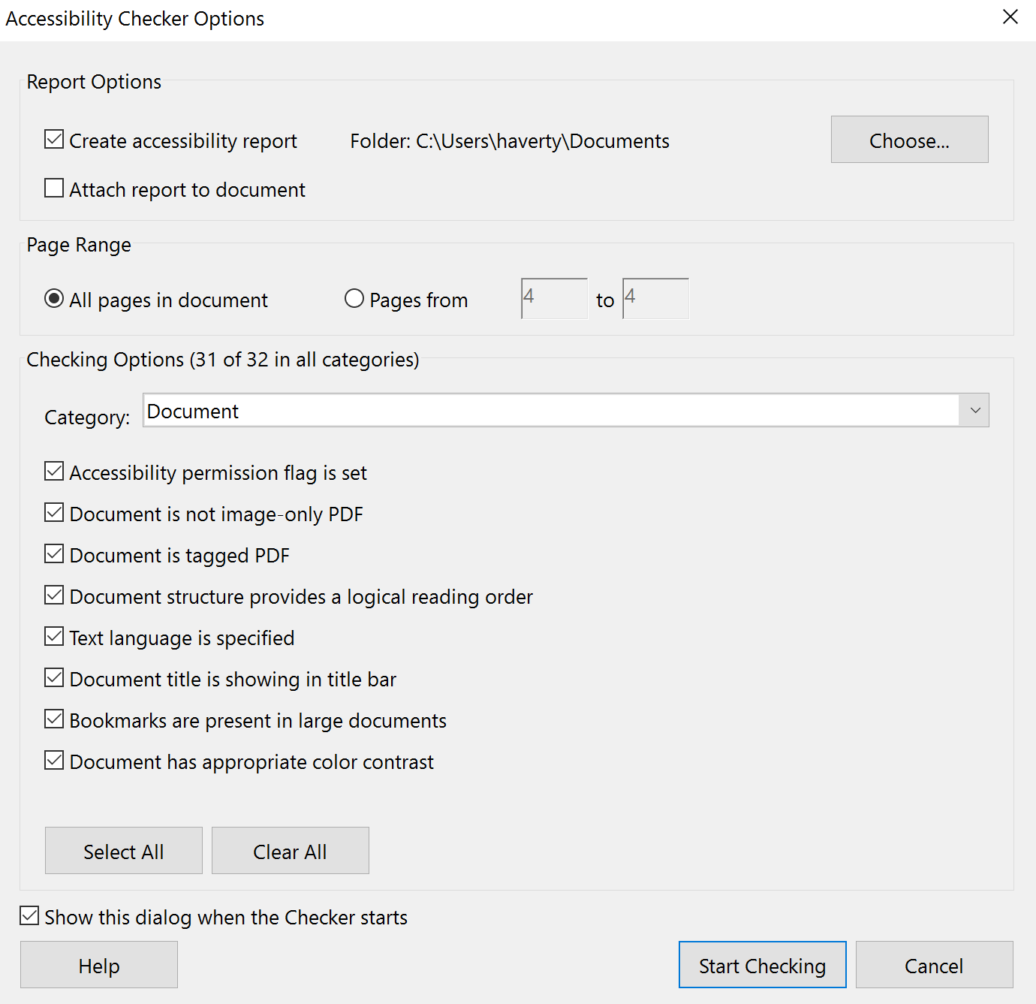
Running the Acrobat Accessibility Checker
In the Accessibility Tool, select Full Check, then Start Checking.

Slide 22
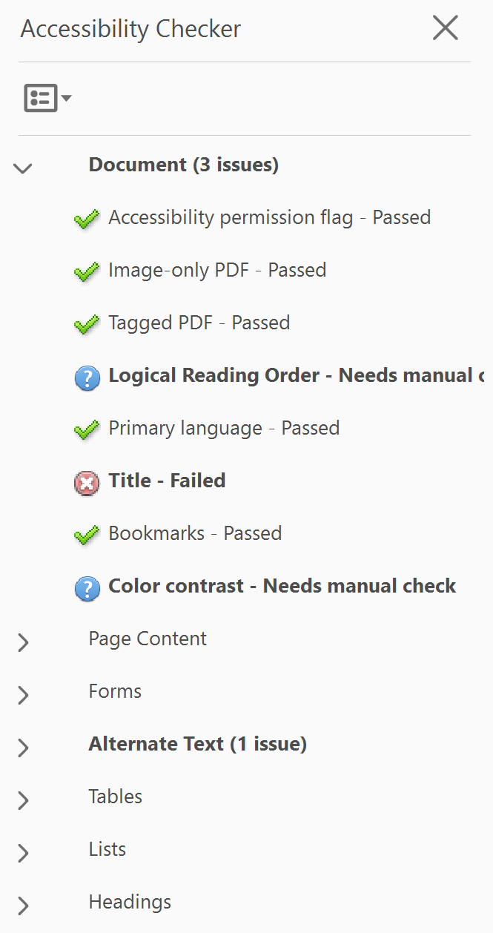
Results of the Acrobat Accessibility Checker
Document will typically have issues.
Some of the results cover WCAG.
Some additional manual testing will be required.
Accessible PDF but not fully PDF/UA compliant.

Slide 24
Session 3 – Fixing Inaccessible PDFs

Slide 25
Fixing Tags
Tag Content in the Logical Reading Order
Common areas for review:
Tables and Lists
Figures and Artifacts
Unique considerations depending on the source document and means of conversion:
Scanned Document
Role Mapping
Links
Form Fields

Slide 26
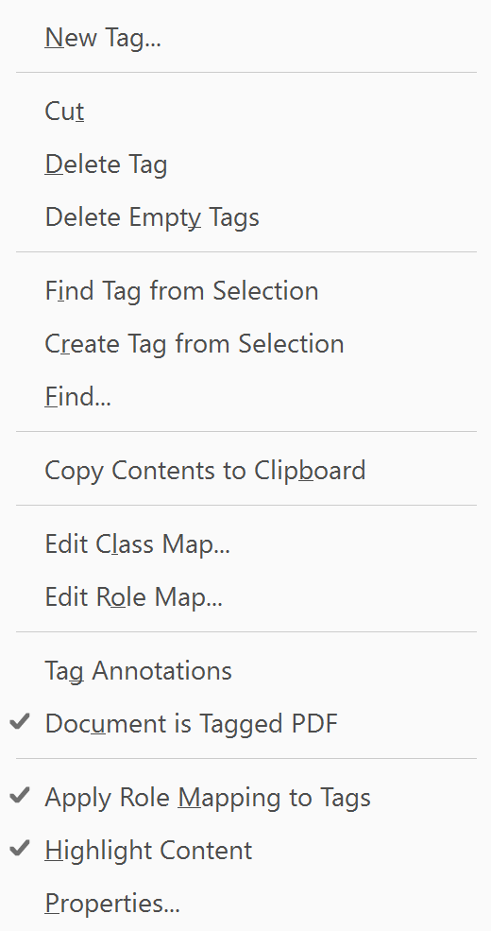
Editing in the Tag Tree – The Basics
Covered in specific exercises later.
New Tag
Select where you want the new tag inserted in the Tag Tree (inserts below selected tag)
Right click to open the Context Menu
Select “New Tag” and the tag type
Move Tags
“Drag and Drop” or “Cut and Paste”
Change Tag
F2

Slide 27
List Basics
PDF/UA states, a list must have the List <L> tag and List Item <LI> tags. They may also have the Label <Lbl> and List Body <LBody> tags.
Use PDF 3 - Word Document with Errors
Open Tag Tree
Find mis-tagged list items (usually will have a <P> tag)
Create <L> tag
Change list items <P> tags to <LI> tags and make them children of the <L> Tag

Slide 28
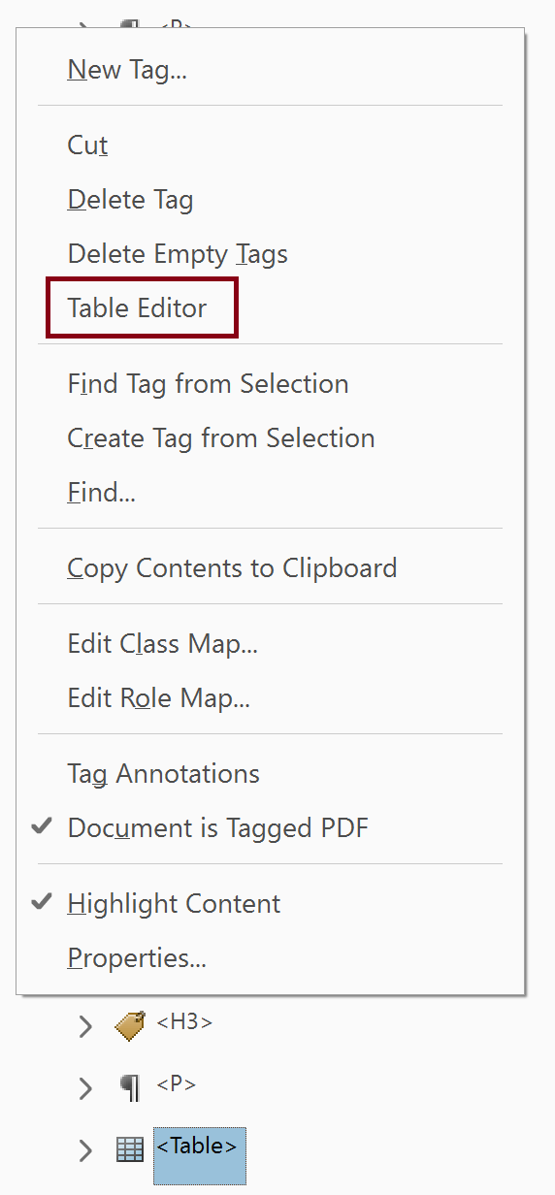
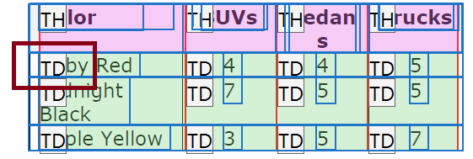
Table Basics
Use <TH> tag for Column and Row Headers and <TD> tag for data cells
Use PDF 3 - Word Document with Errors
Open Table Editor (context menu in Tag Tree or TURO)
Select and change <TD> tags to <TH> tags and add Scope

Slide 29
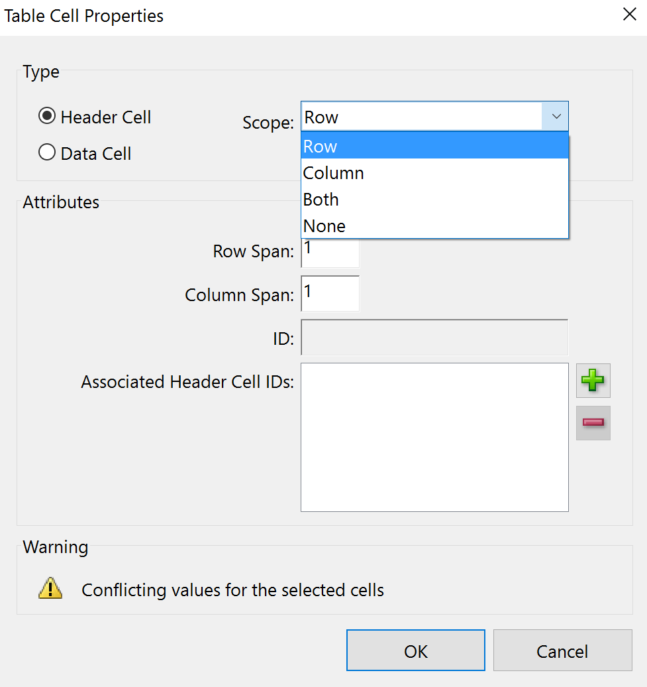
Tables with Merged Cells
Use PDF 3 - Word Document with Errors
Add scope and span to Merged Cells

Slide 30
Artifacts
Content that does not provide meaningful information such as decorative images or line spaces. Artifacts should not be in the Tag Tree.
Use PDF 3 - Word Document with Errors
Open document in Acrobat
Open the Tag Tree and find an empty <P> tag
Open Reading Order tool
Select item number for content to be artifacted
Select “Background” in Reading Order tool
Note <P> tag is removed from the Tag Tree

Slide 31
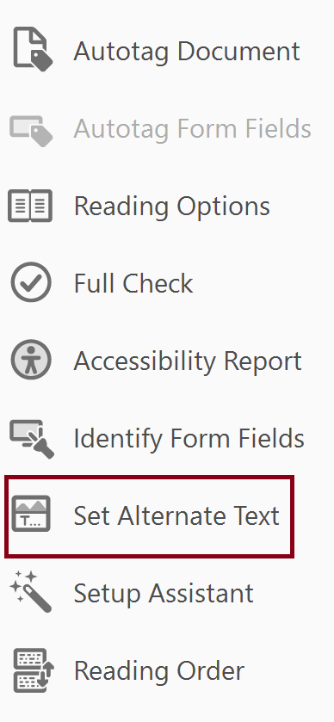
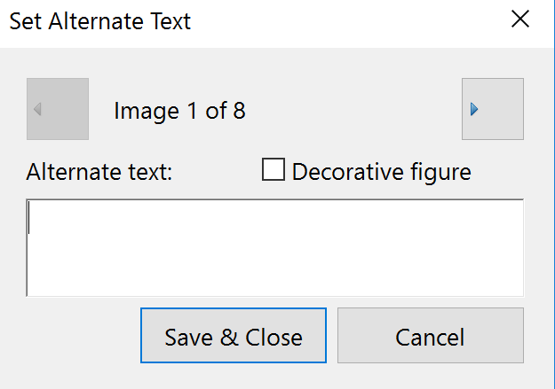
Images
Use document 3 - Word Document with Errors
Figures with Captions (Artifact?)
Without Captions (Alternative Text)
Accessibility Tool

Slide 32
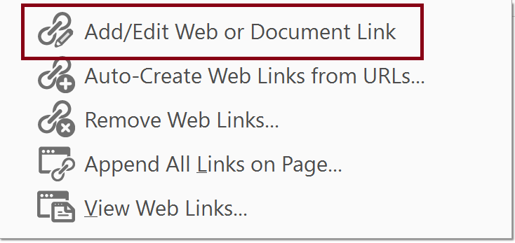
Links
Convert Word doc 4 - Links with PDF Maker
delete tags and
re-add tags (can work for forms – see hierarchy)
Convert 4 - Links with Print and
Add links using Edit tool (similar to scanned doc).
Only need short URL

Slide 34
Contacts
Rob Haverty
Haverty@Adobe.com
Adobe Accessibility Website
www.Adobe.com/Accessibility
Adobe Blogs
Document Cloud Blog
https://theblog.adobe.com/document-cloud/ (search for PDF or Accessibility)
Accessibility Blog
blogs.adobe.com/accessibility/
Follow us on Twitter @AdobeAccess

