Slide 1
Overview of the Formerly Used Defense Sites (FUDS) Program
Jeff Waugh
Headquarters, US Army Corps of Engineers
(202) 761-7263
e-mail: jeffery.h.waugh@usace.army.mil
September 2008

Slide 2
Agenda
Formerly Used Defense Sites (FUDS) Program Overview
Military Munitions Response Site Inspection Program
Engineering Knowledge Online
MMRP SI Planned Actions
Summary

Slide 3
Formerly Used Defense Sites
FUDS are real properties:
  That were owned by, leased by, or otherwise controlled by the United States, and
  Where DoD had jurisdiction when contamination occurred, and
  That were disposed of prior to 17 October 1986
FUDS properties are/were not :
  Currently under DoD jurisdiction (e.g., active DoD Installations)
  Disposed of under BRAC
  Disposed of on or after 17 October 1986
  Under the jurisdiction of other non-DoD federal agencies when contamination occurred (e.g., DOE, DOI, GSA, etc.)
  Owned by States, Tribes, local governments, or private individuals when contamination occurred
  Outside the United States
  Personal property

Slide 4
FUDS Authority to Perform
Response Actions
DERP Statute at 10 USC 2701 authorizes the Secretary:
  Identify, investigate, research, and cleanup contamination from hazardous substances, pollutants, and contaminants (CERCLA responses).
  Correct other environmental damage which creates an imminent and substantial endangerment to the public health or welfare or to the environment (Military Munitions and POL responses).
  Demolish and remove of unsafe buildings and structures (BD/DR responses).

Slide 5
FUDS Eligibility
Eligibility under the FUDS – a two tier framework:
  Property Level Eligibility – records must demonstrate that the property was:
    Owned by, leased by, or controlled by the United States
    Under the jurisdiction of DoD
    Disposed of before 17 October 1986
    Within United States, Districts, Territories, Commonwealths, or Possessions over which the U.S. had jurisdiction
  Project Level Eligibility:
    Known or potential contamination or hazards attributed to DoD activities not the result of act of war requiring actions under:
      Hazardous, Toxic, and Radioactive Waste
      Containerized Hazardous, Toxic, and Radioactive Waste
      Military Munitions Response
      Building Demolition/Debris Removal

Slide 6
FUDS Property and Project
Eligibility Determination Process
USACE Districts perform:
  Records searches
  Coordinates with EPA, States, Federal Land Managers, affected Tribes, and local officials
  Consultation with the lead regulatory agency
Prepares Findings and Determination of Eligibility (FDE) that:
  Recommends whether property is eligible under the FUDS Program
  Is signed by USACE Division Commander
  Authorizes expenditure of DoD Environmental Restoration Program funds for FUDS eligible properties

Slide 7
FUDS Property and Project
Eligibility Determination Process
If eligible, CERCLA Preliminary Assessment conducted to:
  Eliminate from consideration properties with that pose little or no threat
  Determine potential need for removal response
  Set priorities for Site Inspections
  Gather data for later evaluation by EPA under Hazard Ranking System
Results of FDE and Preliminary Assessment is documented in an Inventory Project Report (INPR) that:
  Identifies/Recommends potential FUDS HTRW, CON/HTRW, MMRP, and/or BD/DR Projects
  Obtains approval from USACE Division

Slide 8
Preliminary Assessment
During Preliminary Assessment, USACE:
  Coordinates with property owners, EPA, State regulatory agencies, local officials, and affected tribes
  Provides the lead regulatory agency with notice and opportunity for comment on the INRP
  For eligible properties with no hazards found, USACE must seek concurrence from lead regulatory agency
  Notifies landowners of the results of the eligibility determinations

Slide 9
Scope of the
Formerly Used Defense Sites
Properties:
  Total in Inventory 9,908
  Eligible for FUDS Program 6,866
  Requiring Response Actions 3,022
Projects:
  Total Projects Requiring Response Actions 4,990
  No DoD Action Indicated (NDAI) 761
  Total with costs incurred or planned 4,229
Cost to Complete (as of Oct 2007): $18.2B
Property – entire property formerly used by DoD, analogous to an “installation”.
Project – individual area of potential hazard, differentiated by type of hazard
(HTRW, CON/HTRW, MMRP, BD/DR), analogous to a “site”.

Slide 10
FUDS Funding Profile
Notes:
Note: Plus Up in FY07 & 08 includes OSD reprogramming of $9.1M and $7.5M in FY07 and FY08 respectively

Slide 11
FUDS PROGRAM BOUNDARIES
North Atlantic
Northwestern
EM CX
Pacific
Ocean
Division
South Pacific
LRD
*
South Atlantic
Southwestern
HNC
Pacific
Ocean
LEGEND:
Division HQ location
Division boundary
District boundary
State boundary
* Huntington District remain as
Project Manager for all FUDS
Projects in WV in LRD
7
Notes:
2

Slide 12
Scope of FUDS Program
Data: FY06 DERP Annual Report to Congress
Total Number of Distinct Properties: 2923
Total Number of Projects
(MMRP, MMRP/CWM, HTRW, CON/HTRW, and BD/DR): 4659
WA
88
MT
27
ND
5
NH 20
MN
32
VT 14
ME
108
OR
48
SD
43
WI
44
ID
23
WY
33
NY
154
MI
122
MA 192
NE
88
IA
17
RI 89
IL
128
OH
83
PA
110
NV
47
CO
46
IN
36
NJ 72
CT 29
UT
29
KS
136
MO
80
WV
58
DE 24
KY 15
VA
76
MD 66
CA
675
OK
81
DC 31
AZ
132
NM
182
AR
22
TN 31
NC 57
MS
47
AL
46
SC
41
GA
66
TX
327
LA
37
Northern Mariana Islands(CN) 24
Palau (PT) 0
Puerto Rico (PR) 44
U.S. Virgin Islands (VI) 8
American Samoa (AS) 9
Guam (GM) 17
AK
294
FL
214
0-10 projects = white
10-50 projects = light blue
50-100 projects bright aqua
100-200 projects = dark teal
200+ projects = dark blue
HI
92

Slide 13
Distribution of FUDS MMRP Projects by State
WA
15
MT
9
ND
0
NH 4
NWD
177
MN
0
VT 1
ME
23
SD
17
WI
2
LRD
45
OR
13
ID
13
WY
11
NY
20
MI
22
MA 40
NE
25
IA
7
RI 14
IL
9
OH
7
PA
27
CT 3
NV
15
UT
13
CO
15
IN
3
NJ 19
NAD
184
SPD
404
KS
41
MO
10
WV
2
VA
8
DE 8
KY 2
MD 10
CA
194
OK
14
TN 10
DC 7
AZ
62
NM
120
AR
9
NC 20
MS
24
AL
10
SC
16
GA
14
TX
129
LA
10
Puerto Rico (PR) 21
U.S. Virgin Islands (VI) 3
AK
13
POD
78
FL
100
SWD
162
SAD
218
HI
48
FL
39
Northern Mariana Islands (CN) 6
Palau (PT) 0
American Samoa (AS) 2
Guam (GM) 9

Slide 14
FUDS CERCLA (Superfund/NCP) Implementation Strategy
Preliminary Assessment (PA)
Inventory Project Report and Archive Records Search
No DOD Action Indicated
Time Critical Removal Action (TCRA)- Action Memorandum
(NDAI)
Non-TIme Critical Removal Action - Engineering Evaluation/Cost Estimate
Site Inspection (SI)
Identify sites for further or further action and chacterize release
No DOD Action Indicated
Time Critical Removal Action - Action Memorandum
Non-TIme Critical Removal Action - Engineering Evaluation/Cost Estimate
Remedial Investigation/Feasibility Study (RI/FS)
RI charcterizes site to develop a Conceptual Site Model (CSM)
FS uses the CSM to develop and evaluate alternatives for remedy selection
No DOD Action Indicated
Treatability Studies, Operate Pilot Scale Systems
Proposed Plan (PP)
Summarizes the propseed remedial alternative
Record of Decision (ROD)/Decision Document
Identifies the remedial alternative chossen, detailed assessment of RI/FS data
Remedial Design (RD)
Detailed designs, plans, specifications for remedial action
requires an approved Explosive Safety Submission
Remedial Action (RA)
Construction and Operation Phases
Response Complete (RC)
Long Term Management (LTM)
Cleanup objective as defined in ROD is done
of site may be required for the response action
Five Year Reviews
Determine if implemented response is still protective

Slide 15
MMRP Site Inspection
Program Objectives
Confirm presence of MEC or MC contamination identified in the PA phase on ranges or other MMR areas identified in the ASR or range inventory efforts
Collect appropriate information necessary to:
  Eliminate from further consideration those releases that pose no significant threat to public health or the environment
  Determine potential need for removal action
  Collect or develop additional data, that may support Hazard Ranking System (HRS) pre-score by EPA, if so desired; and
  Collect data, as appropriate, to characterize release for effective and rapid initiation of remedial investigation and feasibility study (RI/FS)
Secondary objective
  Collect data to complete the Munitions Response Site Prioritization Protocol (MRSPP)

Slide 16
Site Inspection Scope
SI focuses on those areas identified through historical documents as having been used as a range, OB-OD, or burial area
Additional areas are included that are identified by the regulators or stakeholders that have evidence of ordnance use from DoD activities
Areas of the former site that do not have historical evidence of ordnance activities are not included
SI activities are from ER 200-3-1

Slide 17
SI Project Delivery Team Members
MM and Chemical Warfare Materiel (CWM) Design Centers
  SI execution
FUDS Project Management Districts
  Conduct overall project management activities
Regulators and Stakeholders
  Provide input and help develop the Data Quality Objectives (DQO)
Environmental & Munitions Center of Expertise (EM CX)
  Subject matter expertise regarding MEC and MC

Slide 18
Technical Project Planning (TPP)
Process to involve regulators and other stakeholders.
Corps (with it’s contractor) works with regulators and stakeholders to develop appropriate Data Quality Objectives (DQOs) that will allow an informed decision be made on the path forward.
Initial Conceptual Site Model (CSM) provides information on the “source, pathway, and receptors” that DQOs should address.
  Contractor’s technical approach is usually based upon information provided to them from the archive search report and other documents
  If additional information is provided during the TPP or at other times this information will be included into the technical approach.

Slide 19
MMRP SI Process
Regulators, stakeholders, districts, and DC review TPP Memo - 45 Days
Contractor conducts TPP with regulators, stakeholders, Corps district and DC
Contractor prepares TPP Memorandum
MM DC awards
project
Contractor prepares & provides Site Specific Work Plan Addendum (WPA)
Milestone #1 - TPP Memo is approved
Milestone #2 - WPA approved
Regulators, stakeholders, districts, and DC review WPA - 45 Days
Cont. next page

Slide 20
Cont. from previous
Contractor conducts field work
Milestone #3 - Field work complete
Contractor prepares & provides Draft SI Report
Regulators, stakeholders, districts, & DC review Draft Final SI Report - 45 Days
Contractor incorporates comments & prepares Final SI Report
Contractor incorporates comments and prepares Draft Final SI Report
Districts and DC review Draft SI Report - 30 Days
Contractor conducts TPP #2 & presents MRSPP
Milestone #4 - SI Report approved
Army Panel begins MRSPP QA process

Slide 21
Current Status of 765 Baseline Projects
(43% Completed)
NWO MM DC – Northwest
NAB MM DC – Northeast
WA
29%
MT
ND
NH
MN
VT
ME
38%
OR
57%
SD
25%
WI
0
ID
8%
WY
NY
25
MI
MA 58%
NE
50%
IA
0
IL
OH
PA
RI 67%
NV
90%
IN
CT
UT
0%
CO
0%
KS
31%
MO
20%
WV
NJ 60%
VA
MD
DE
KY
DC
CA
27%
OK
TN 40%
NC 50%
AZ
35%
NM
33%
AR
MS
56%
AL
33%
SC
60%
GA
50%
SPD MM DC – Southwest
TX
37%
LA
33%
AK
50%
FL
33%
Puerto Rico (PR) 60%
U.S. Virgin Islands (VI) 0%
HI
41%
Red < 80% Underway
Amber <90% Underway
Light Green >90% Underway
Dark Green 100% Completed
HNC MM DC – Pacific/Southeast
Northern Mariana (CN) 0%
American Samoa (AS) 0%
Guam (GM) 100%
Baseline is Based on FY04 Annual Report to Congress

Slide 22
Scope of MMRP SI Program for Department of Interior
Agency | Total # Projects | # Projects Started | # Projects Completed | # MRS
Bureau of Indian Affairs | 15 | 6 | 1 | 6
Bureau of Land Management | 122 | 81 | 47 | 91
National Park Service | 13 | 3 | 7 | 23
US Fish & Wildlife Service | 21 | 9 | 19 | 31
Total | 171 | 99 | 74 | 151

Slide 23
Preliminary MRSPP Results for DOI MRS
Agency | 2 | 3 | 4 | 5 | 6 | 7 | 8 | EP | NKSH | Total
BIA |  |  |  |  |  |  |  |  | 6 | 6
BLM | 2 | 11 | 19 | 18 | 13 | 18 | 2 | 1 | 7 | 90
NPS | 5 | 1 | 6 | 2 |  | 2 | 2 |  | 5 | 23
USF&WS | 5 | 8 | 5 | 5 | 2 | 1 |  |  | 5 | 31
Total | 12 | 20 | 30 | 25 | 15 | 21 | 4 | 1 | 23 | 151
EP- Evaluation Pending
NKSH – No Known or Suspected Hazard

Slide 24
SI Remedial Recommendations
Agency | Evaluation Pending | NDAI | RI/FS (MC) | RI/FS (MEC & MC) | RI/FS (MEC) | Total
BIA |  | 6 |  |  |  | 6
BLM | 1 | 7 |  | 18 | 65 | 90
NPS |  | 5 | 1 | 8 | 9 | 23
USF&WS |  | 5 | 2 | 18 | 6 | 31
Total | 1 | 23 | 3 | 44 | 80 | 151

Slide 25
SI Results for
Emerging Contaminants
 | Soil (3118 Samples) |  |  | Water (353 Samples)
 | Exceeds Residential Limit | Exceeds Industrial Limit | Detections | Exceeds Residential Limit | Exceeds Federal MCL | Detections
Perchlorate | 0 | 0 | 3 | 0 | 0 | 40
RDX | 0 | 0 | 11 | 0 | 0 | 3
Total Chromium | 24 | 14 | 1920 | 0 | 4 | 103
Naphthalene | 0 | 0 | 27 | 0 | 0 | 0
Beryllium | 0 | 0 | 1701 | 0 | 0 | 47
TCE | 0 | 0 | 0 | 0 | 0 | 0
Perfluoro-octanoic Acid | NA | NA | NA | NA | NA | NA
Notes:
This Information Would Seem To Cover The most Important Concerns Of the Proposed Legislation and Is Within DoD’s Immediate Control
For The Future, Perchlorate Is Included As One Of The Potential Contaminants To Be Reviewed For Sampling As Part Of The On-going Site Inspection Program

Slide 26
Some Other MC Results of Interest
Explosives
  Of the nearly 2400 soil samples analyzed, 19 individual explosive compound results have exceeded benchmark residential risk levels and 5 have exceeded industrial risk levels
  Of the more than 300 aqueous samples, 7 individual explosive compound results have exceeded benchmark residential water risk levels
Lead
  Of the more than 2700 soil samples analyzed, 81 results have exceeded benchmark residential risk levels and 40 have exceeded industrial risk levels
  Of the more than 300 aqueous samples, 13 results have exceeded benchmark residential water risk levels

Slide 27
Accessing Engineering
Knowledge Online
Non-AKO account holders
  Determine who your Army sponsor is (and that sponsor has CAC reader)
  Request guest account (need AKO user name of your Army sponsor: jeffrey.waugh@us.army.mil) https://www.us.army.mil/suite/login/welcome.html
Login 1st time here:
  https://eko.usace.army.mil/
After access granted, login in here:
  https://eko.usace.army.mil/virtualteams/mmrp/

Slide 28
Dcoument Access
Access granted to:
  TPP memo (draft and final)
  Comments on TPP memo
  Site-specific Work Plan (draft and final)
  Comments on SSWP
  Daily Quality Control Reports (during field work)
  Laboratory SEDD files
  GIS submittal files
  Site-specific SI Report (draft and final)
  Any other items not in “internal” folders
Access restricted to:
  IPR & monthly telecon info
  Site-specific SI Report (USACE-only draft)
  Any other items in “internal” folders

Slide 29
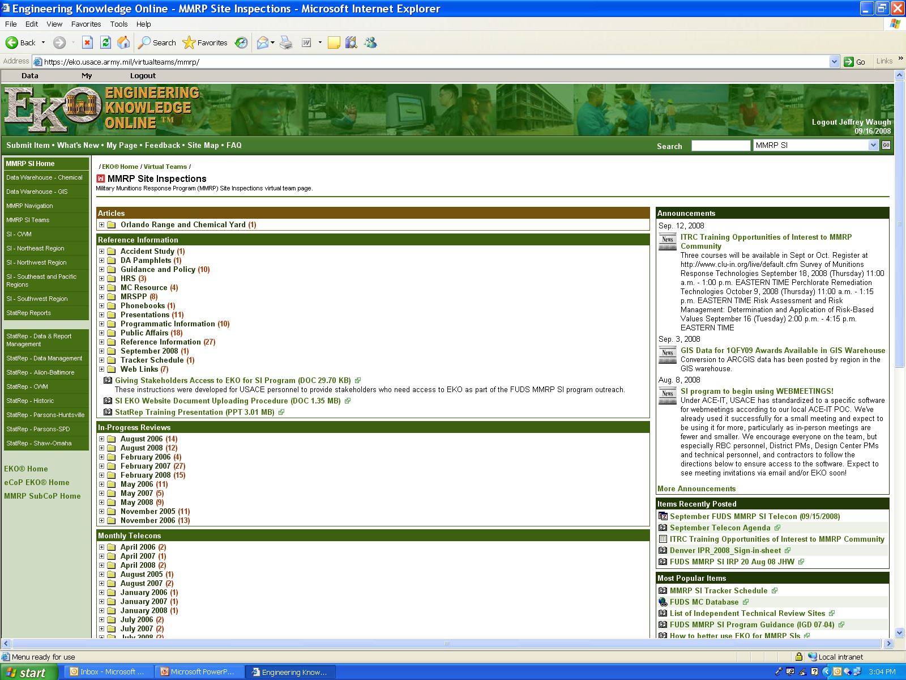
MMRP SI EKO

Slide 30
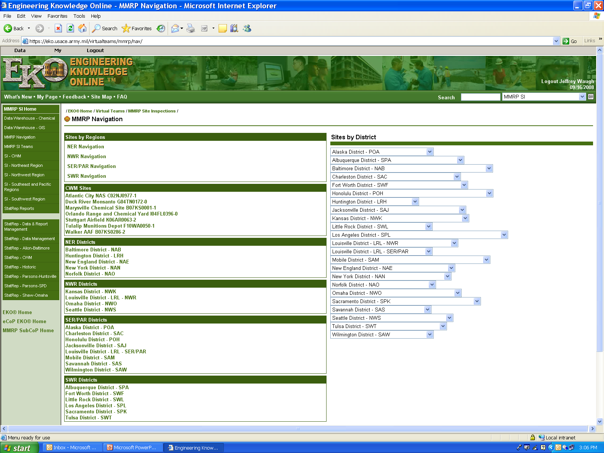
MMRP Navigation

Slide 31
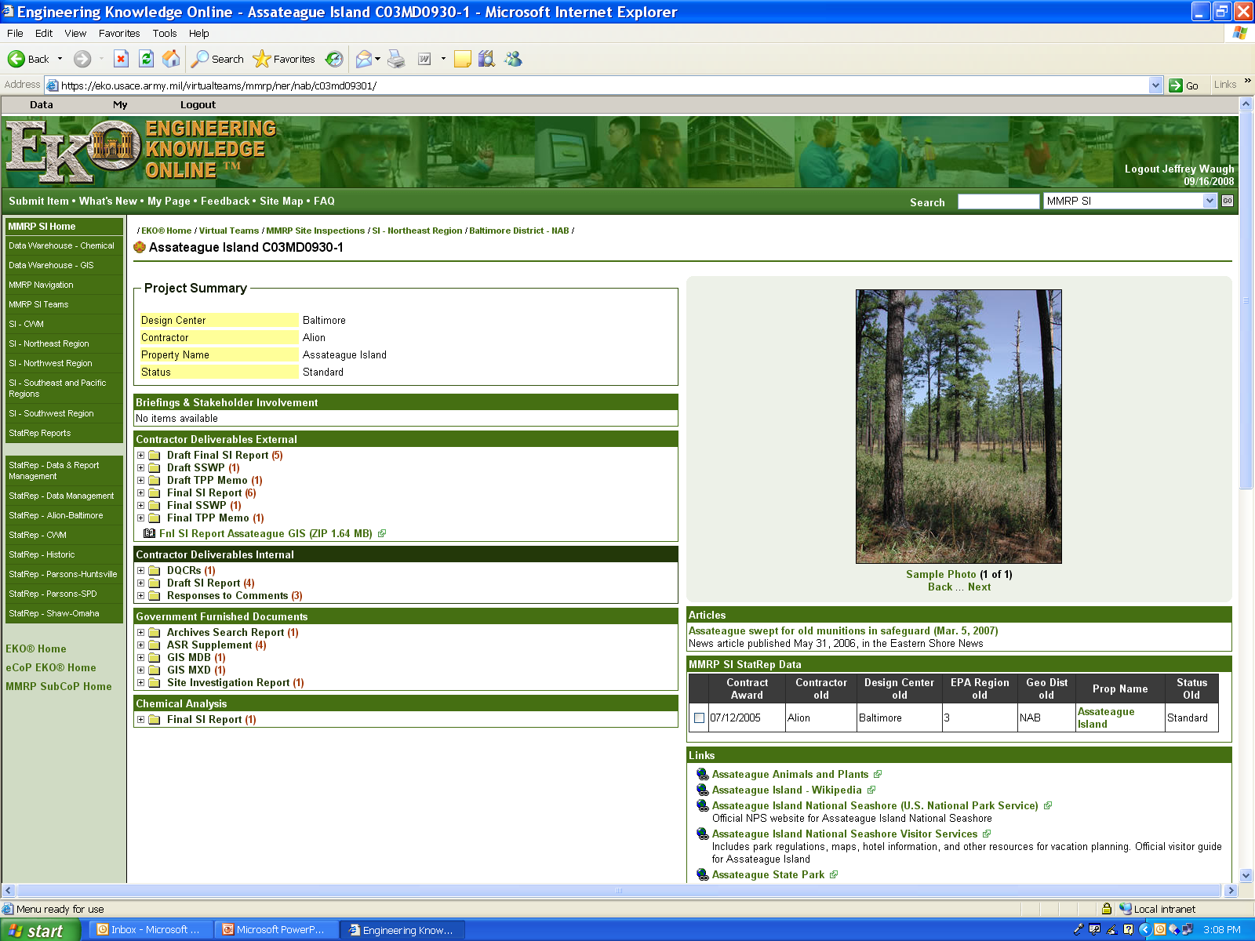
Project Page

Slide 32
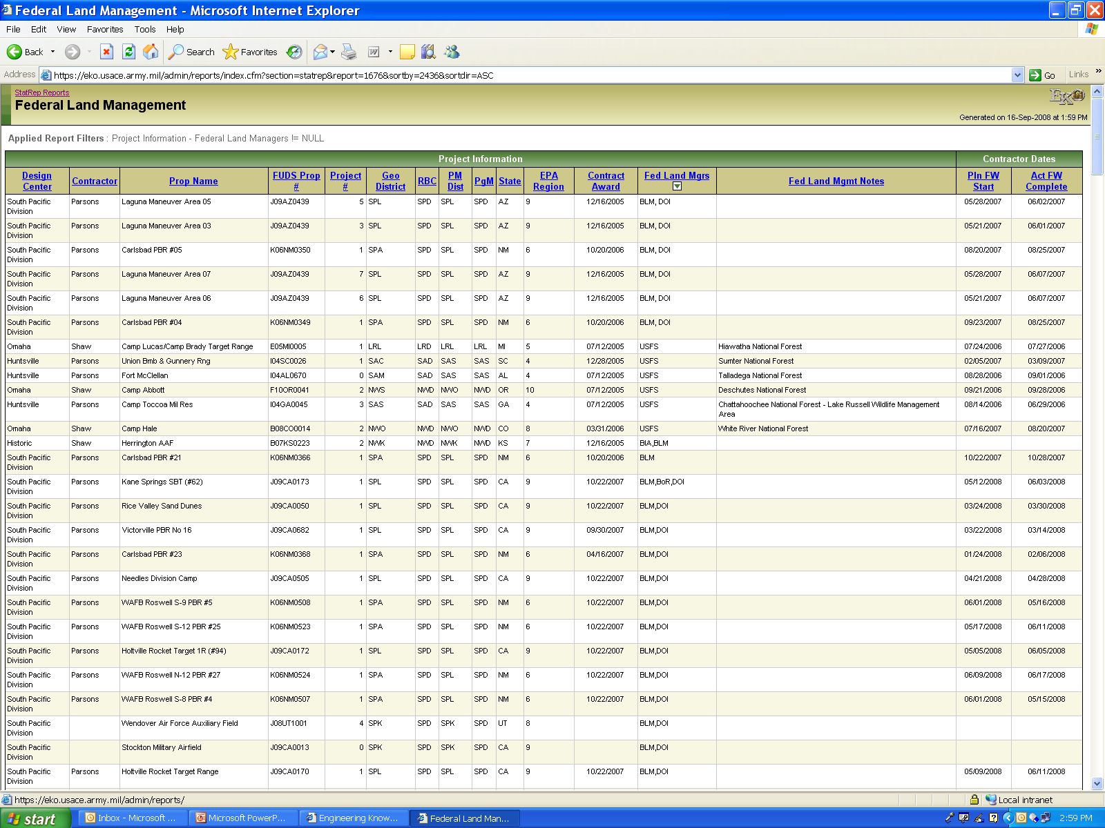
Federal Land Manager
STATREP Report

Slide 33
National Park Service
Name | PROPERTY_NAME | 2009 | 2010 | 2011 | 2012
CA
Death Valley National Park | SALINE VALLEY ATA GUN RGE |  |  | 1
Golden Gate National Recreation Area | Fort Baker |  |  | 1
 | Fort Barry |  |  | 1
Joshua Tree National Park | CLARK'S PASS |  | 1
Point Reyes National Seashore | Drakes Bay Range |  |  | 1
FL |  |  | 1 | 4
Canaveral National Seashore | MOSQUITO LAGOON TARGET |  |  | 1
Everglades National Park | OTTER KEY BOMB TARGET |  |  | 1
TX |  |  |  | 2
Padre Island National Seashore | BOMBING TARGET B-10 |  |  |  | 1
 | BOMBING TARGET B-3 |  |  |  | 1

Slide 34
Bureau of Indian Affairs
Name | PROPERTY_NAME | 2009 | 2010 | 2011 | 2012
CA
Fort Mojave Indian Reservation | FORT MOJAVE RESERVATION |  |  | 1
Fort Yuma Indian Reservation | CAMP PILOT KNOB |  |  | 1
NM
Cochiti Indian Reservation | KIRTLAND AFB PBR #S-13 |  | 1
Laguna Pueblo Indian Reservation | KIRTLAND AFB PBR #N-10 |  | 1
 | KIRTLAND AFB PBR #S-12 |  | 1
San Felipe Indian Reservation | KIRTLAND AFB PBR #N13 |  | 1
SD |  |  | 4
Cheyenne River Indian Reservatation | ARMSTRONG COUNTY ATG GUN RGE | 1

Slide 35
US Fish and Wildlife Service
Name | PROPERTY_NAME | 2009 | 2010 | 2011 | 2012
AZ
Kofa National Wildlife Refuge | KOFA NWR |  | 2
MS |  |  | 2
Noxubee National Wildlife Refuge | COLUMBUS PRC BOMB RGE #1 |  | 1
NM |  |  | 1
Sevilleta National Wildlife Refuge | KIRTLAND AFB PBR 17, TRGT S-4 |  | 1
 | KIRTLAND AFB PBR 18, TRGT S-5 |  | 1
 | KIRTLAND AFB PBR 19 TRGT S-6 |  | 1
NV |  |  | 3
Desert National Wildlife Refuge | NELLIS AIR FORCE RANGE, AREA E |  |  | 1

Slide 36
US Fish and Wildlife Service (cont.)
Name | PROPERTY_NAME | 2009 | 2010 | 2011 | 2012
PA |  |  |  | 1
John Heinz National Wildlife Refuge | ESSINGTON NG TAR RNG |  | 1
RI |  |  | 1
Sachuest Point National Wildlife Refuge | SACHUEST PT-NPORT NCM | 1
TX |  | 1
Lower Rio Grande Valley National Wildlife Refuge | LAGUNA MADRE GUNNERY RANGE |  |  | 1

Slide 37
Bureau of Land Management
State | PROPERTY_NAME | 2009 | 2010 | 2011 | 2012
AZ | CAMP HYDER |  | 1
 | FORT HUACHUCHA | 1
 | KINGMAN A AF-FORMER |  | 1
 | KINGMAN AIR TO AIR GUN RG |  | 1
 | LAGUNA MANEUVER AREA |  | 6
 | MOHAVE MANEUVER AREA C |  |  | 1
 | MUGGINS MOUNTAINS | 1
 | WELLTON GRO GUN RGE #1 |  |  | 1
 | YUCCA A TO A GR RGE |  | 1
 | YUMA PROVING GROUNDS | 1

Slide 38
Bureau of Land Management
State | PROPERTY_NAME | 2009 | 2010 | 2011 | 2012
CA | BOMB TARGET (#78) | 1
 | BOMB TARGET (#79) | 1
 | CAMP COXCOMB | 1
 | CAMP SEELEY COMBAT FIRING RG |  |  | 1
 | CAMP YOUNG (CAMA) | 1
 | SALTON SEA BOMB TARGET (FBT 11)(#52) | 1
 | SALTON SEA BOMB TARGET(10)(#51) | 1
 | SALTON SEA BOMB TARGET(9)(#50) | 1
 | SALTON SEA BOMB TARGET(FBT 13)(#54) | 1
 | SALTON SEA BOMB TARGET(FBT 17)(#58) | 1
 | SALTON SEA BOMB TARGET(FBT 18)(#59) | 1
 | SALTON SEA BOMB TARGET(FBT 19)(#60) | 1
 | SALTON SEA SKIP BOMB TARGET (#61) | 1
 | WILEY WELLS WATER POINT (CAMA) |  | 1

Slide 39
Bureau of Land Management
State | PROPERTY_NAME | 2009 | 2010 | 2011 | 2012
CO | MONTROSE NATIONAL GUARD TARGET RANGE |  |  | 1
ID | BLAINE COUNTY NG TARGET | 1
 | POCATELLO BOMBING RANGE #2 | 1
 | POCATELLO MOV TARGET RANG | 1
MT | FORT PECK AER GUN RGE |  | 1
 | GLASGOW PATTERN GUN RGE |  | 1
 | GREAT FALLS PATTERN GUN RGE |  | 1
 | LEWISTOWN PATTERN GUN RGE |  | 1
NV | NELLIS AIR FORCE RANGE, AREA H |  |  | 1
UT | Wendover Bombing Range | 1
 | Wendover Special Weapons Bombing Range | 1
WY | TORRINGTON NG TARGET RGE |  | 1

Slide 40
Bureau of Land Management
State | PROPERTY_NAME | 2009 | 2010 | 2011 | 2012
NM | DEMING AAF PBR #10 | 1
 | DEMING AAF PBR #11 | 1
 | DEMING AAF PBR #12 | 1
 | DEMING AAF PBR #13 | 1
 | DEMING AAF PBR #14 | 1
 | DEMING AAF PBR #15 | 1
 | DEMING AAF PBR #16 | 1
 | DEMING AAF PBR #18 | 1
 | DEMING AAF PBR #19 | 1
 | DEMING AAF PBR #20 | 1
 | DEMING AAF PBR #22 |  | 1
 | DEMING AAF PBR #23 |  | 1

Slide 41
Bureau of Land Management
State | PROPERTY_NAME | 2009 | 2010 | 2011 | 2012
NM cont. | DEMING AAF PBR #24 |  | 1
 | DEMING AAF PBR #3 | 1
 | DEMING AAF PBR #4 | 1
 | DEMING AAF PBR #5 | 1
 | DEMING AAF PBR #6 | 1
 | DEMING AAF PBR #8 | 1
 | DEMING AAF PBR #9 | 1
 | KIRTLAND AFB PBR #N-9 |  | 1
 | KIRTLAND AFB PBR #S-14 |  | 1
 | KIRTLAND AFB PBR #S-15 |  | 1

Slide 42
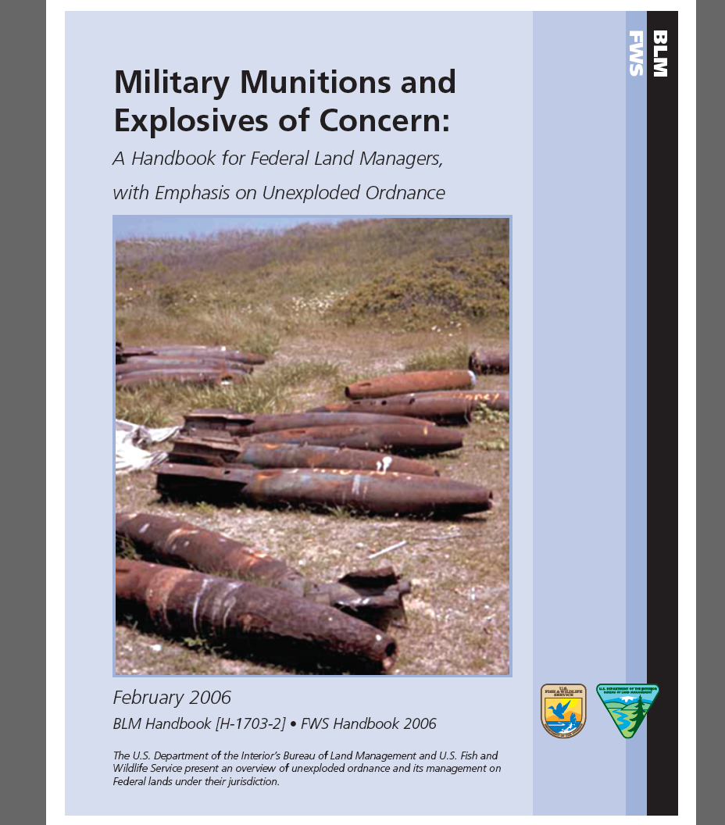
DOI Guidance

Slide 43

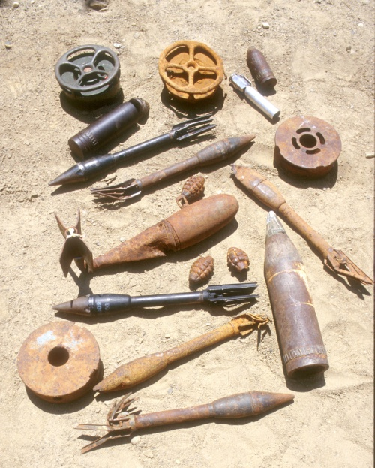
How to Get Help if You Encounter Unexploded Ordnance
DO NOT TOUCH!
DO NOT MOVE!
Note/record location
Call 911 or local law enforcement
First: Call local law enforcement or the nearest military installation.
Next: Call the appropriate personnel for your agency:
BLM employee
  Call the BLM ranger or call the hazardous materials coordinator at the BLM office, or BLM State office, that has jurisdiction for the site. If you cannot reach the hazardous materials coordinator, call the BLM State law enforcement office emergency number or the BLM national law enforcement office at (208) 387-5126.
FWS employee
  Call the regional environmental compliance engineer or regional safety officer.

