Slide 1
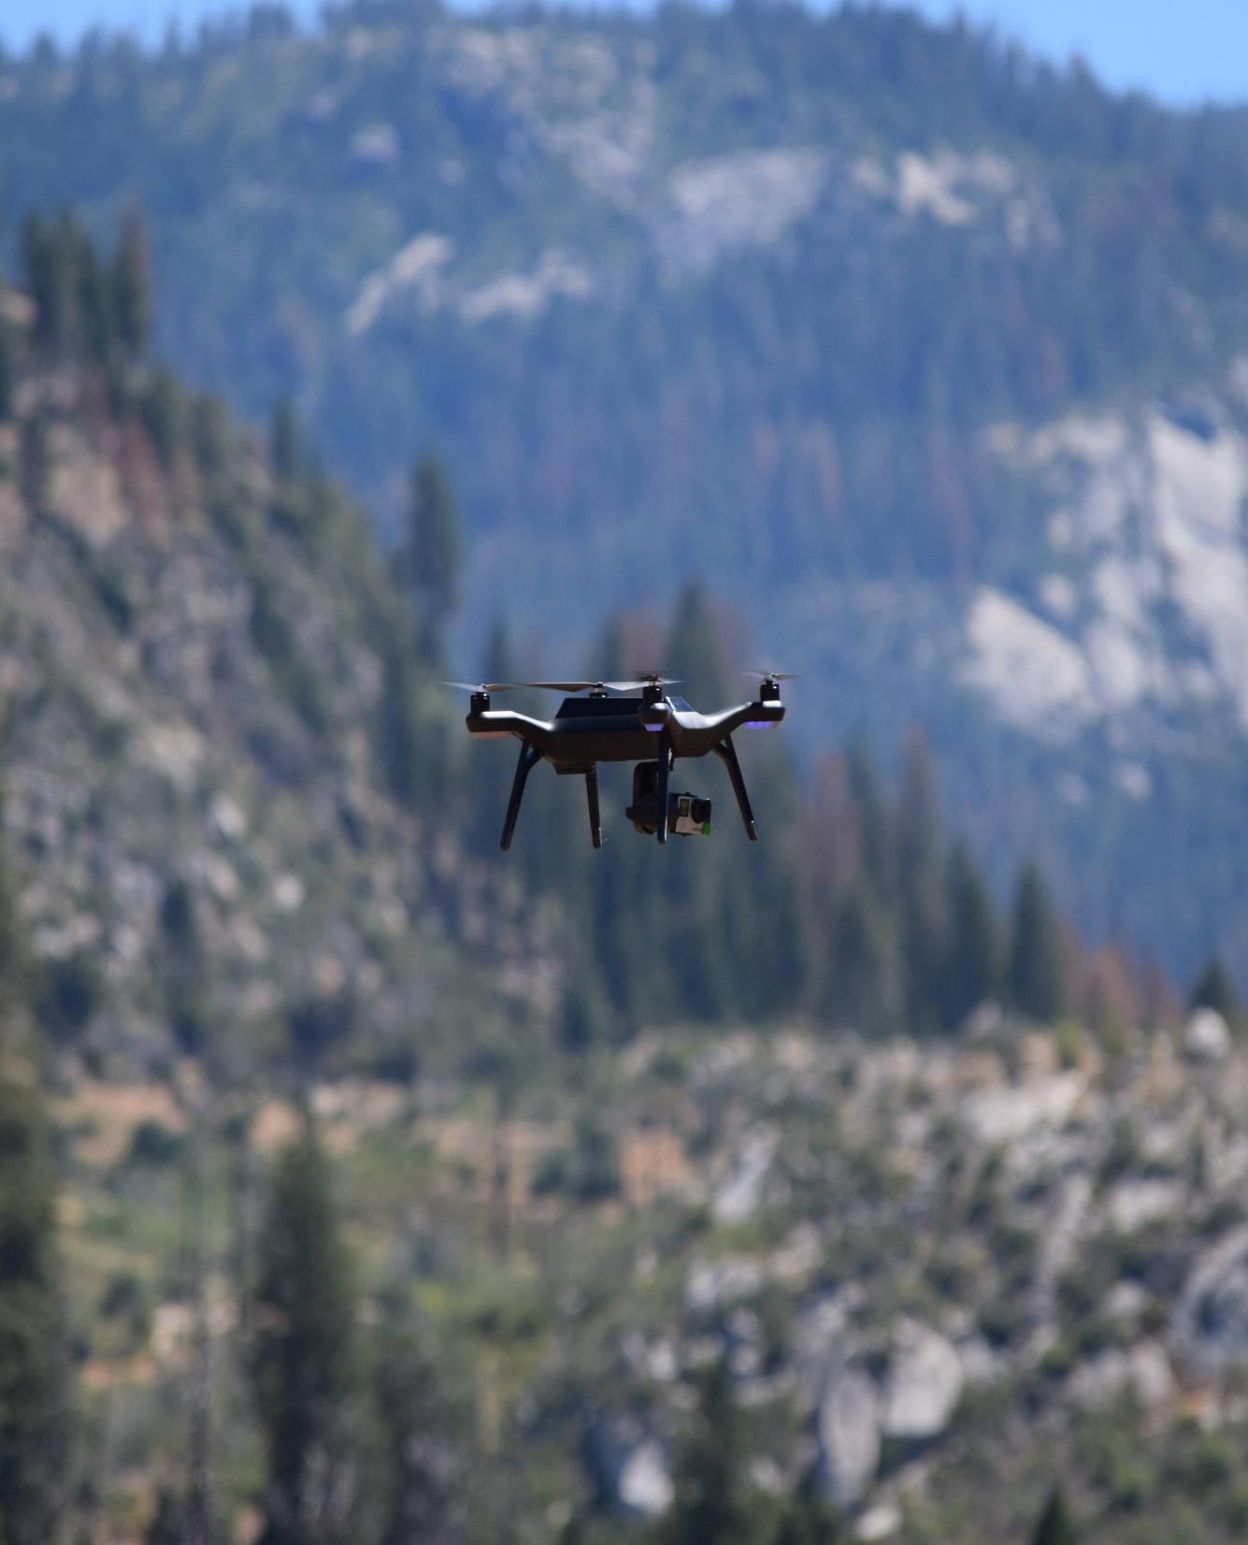

Four Must-Have Competencies for Commercial UAV Success
Commercial UAV Expo
Las Vegas, Nevada
Mark L Bathrick, Director
Office of Aviation Services
U.S. Department of the Interior
Boise, Idaho
https://www.doi.gov/aviation/uas
Notes:
You know I've attended a lot of great UAV shows and expos like this one over the past several years.
In each, I've listened to and/or been part of presentations that talk about the exciting potential of this new business and technology space.
But what struck me was the limited discussion on how to succeed in this competitive and fast-moving space, so……………
I thought I'd do something about that
Today I'm going to share four competencies that I believe all UAV businesses, whether involved in manufacturing drones, providing UAV and related equipment, data, or analysis services need to master to attain and sustain a competitive advantage in this space.

Slide 2
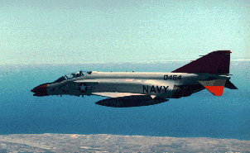
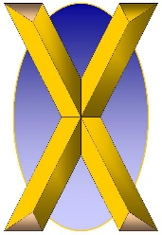

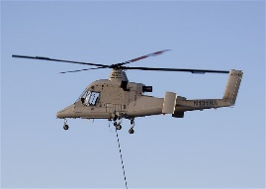
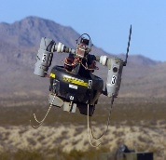

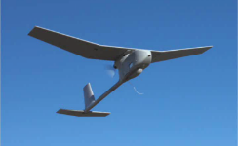
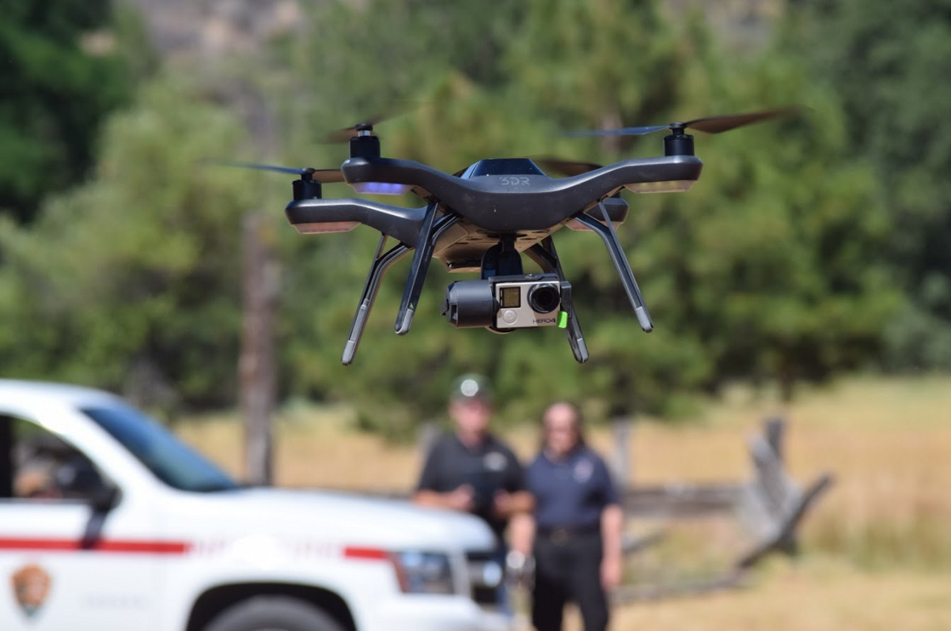


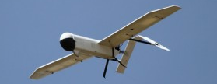
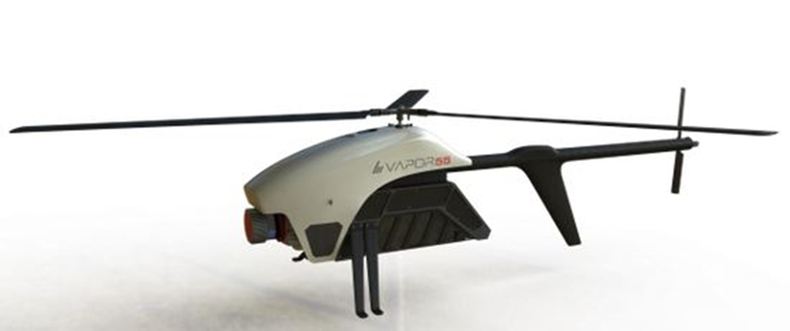
Why Me?
> 25 yrs
500M acres
1,200, $250M
~100 UAV
>25 applications
QF-4 Drone
Notes:
So, if you’re like most people, you’re probably asking yourself how is this “government guy” qualified to talk to me on the subject of how to succeed in the drone industry.
Among the unique aspects of the drone industry is that unlike many other tech…. innovations, widespread drone usage started with and for many years was restricted to government usage.
By virtue of that unusual “inversion” I’ve had the opportunity to build and sustain multiple UAS programs from concept to testing, acquisition, and operations.
The current UAV program I initiated in 2006 and continue to steward is arguably the largest, most diverse and accomplished government drone program outside the Department of Defense…………
with nearly 100 drones supporting dozens of diverse applications……….
in helping to manage over 500 million acres of public land across the U.S. and its territories………….
And is one of the only ISO 9001-2008 certified shared service businesses in the Federal government.
Finally, as an active angel investor and advisory board member, I’ve conducted and advised on due diligence studies and have heard a number of pitches from a number of drone and drone related startups.

Slide 3



$12B
500+
10,000
585,000
Part 107
Notes:
On August 29th, 2016 the FAA enacted Part 107, the first set of regulations to enable commercial UAV operations.
To date, there are nearly 585,000 unmanned aircraft registered with the FAA and…already exceeding the number of registered manned aircraft (306,974) by (277,793) in the U.S. by 90%.
Already there are nearly 10,000 newly certified and licensed unmanned aircraft pilots……(590,039 active manned aircraft pilots in the U.S.).
Current estimates project commercial drone revenue will exceed $12 billion by 2021. http://www.businessinsider.com/uav-or-commercial-drone-market-forecast-2015-2
According to UAV Global (http://www.uavglobal.com/list-of-manufacturers/ ), there are nearly 500 UAV manufacturers worldwide and hundreds more companies worldwide who deal in drone hardware, software, related technologies or services and their number grows, daily, each with their own innovation, passion for this new technology, and a belief their company will be the “next biggest thing.” That’s certainly what their investors hope!
The concepts and competencies I’ll discuss over the next twenty minutes will provide you with a competitive advantage necessary to skillfully ride this growing economic wave and….......
Avoid wiping out on the rocks of business failure…....a fate that awaits many current members of this community as competition for capital and customers in this space continues to tighten.

Slide 4
“A Great Idea, Poorly Executed is Never a Great Idea”
Culture
Aviation
Privacy
Security
Others business competencies are important too, but…….
Notes:
As a long-time leader of complex, technology-heavy programs and as an angel investor I’m constantly reminded that Execution is what often separates “Great Ideas” from “Great Outcomes.” Poor execution of even the greatest idea rarely if ever results in in a great outcome……
In my experience, the four key competencies that provide the foundation for the kind of disciplined execution that can result in Great Ideas becoming Great Business Outcomes are:
Aviation, Privacy, Security, and Culture.
Mastering these will provide you with a competitive advantage that will set you apart from the pack.

Slide 5
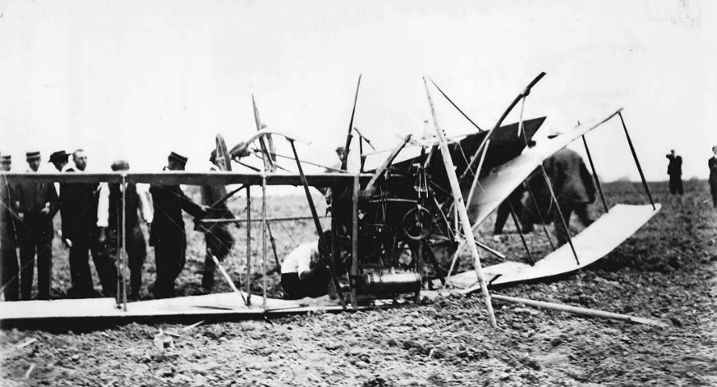
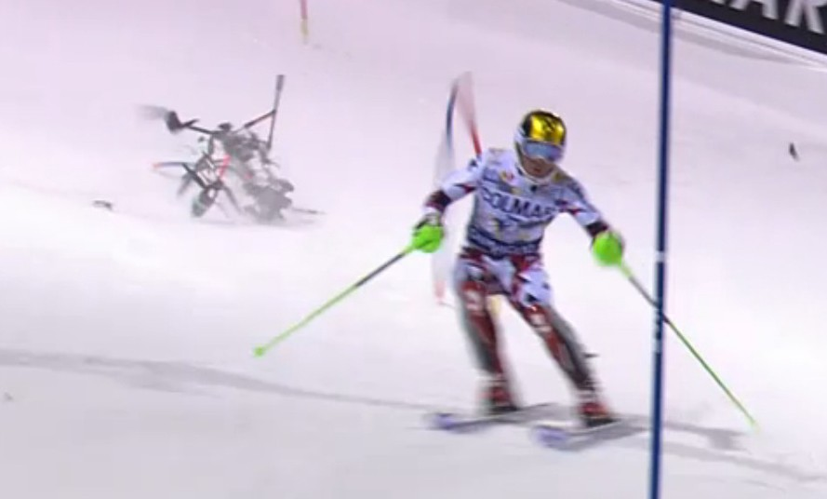
Aviation - The Unforgiving Nature
"Aviation in itself is not inherently dangerous. But to an even greater degree than the sea, it is terribly unforgiving of any carelessness, incapacity or neglect."—
Captain A. G. Lamplugh, British Aviation Insurance Group, London. 1930's
UAV vs. traditional terrestrial business risks.
Loss of aircraft, damage to property, injuries or death to bystanders
Drones are closer to people and infrastructure with less airspace for recovery
Density, training, experience
Key to success = Mastering the principles of safety management systems and aviation risk management
Photo Credit Wikimedia.org commons
Photo Credit ABC News
Notes:
While the focus of many UAV missions is rightly on the data, information, and resultant actionable knowledge that are the result of the data collected by these “airborne IT nodes,” the fact is that they are still aircraft, subject to the same laws of physics, aerodynamics, and human performance that affect all aircraft. As many have found since Orville and Wilber took flight over 113 years ago, aviation, while still safer than traveling our roads, is incredibly unforgiving to ignorance, complacency, hubris, or a lack of attention to detail.
While a software glitch, web service outage, or hardware quality issue in a traditional terrestrial business might result in an annoying customer experience, similar issues in the drone space could result in the loss of the aircraft, damage to property, and injury or death of people beyond the operator.
The low altitude nature of small drone operations; closer to people and infrastructure and with less airspace for recovery in the event of an inflight issue, adds to this risk.
Many drone startups are appropriately tech and IT focused.
However, if expertise and mastery of aviation isn’t achieved, you could be the next Pinto, Wells Fargo, or Samsung Galaxy Note 7……

Slide 6

Safety Management System - SMS
Aviation Safety
Risk
Management
Policy
Assurance
Promotion
Company – Industry – Government - Academia
Notes:
Safety Management Systems provide the structure on which sound aviation businesses are built.
Policy – Defines the bounds of authority, expectations for behavior and performance.
Risk Management - Provides the structure for understanding what where the businesses’ vulnerabilities are and the process for reducing them.
Assurance – Provides the oversight and quality control of established policies and risk management practices, while
Promotion – places positive value on hazard reporting, a just culture, and rewards acts that prevent or reduce the consequences of safety mishaps.
Safety Management Systems have become the standard in the aviation industry and work best when when supported by all stakeholders within the community.

Slide 7
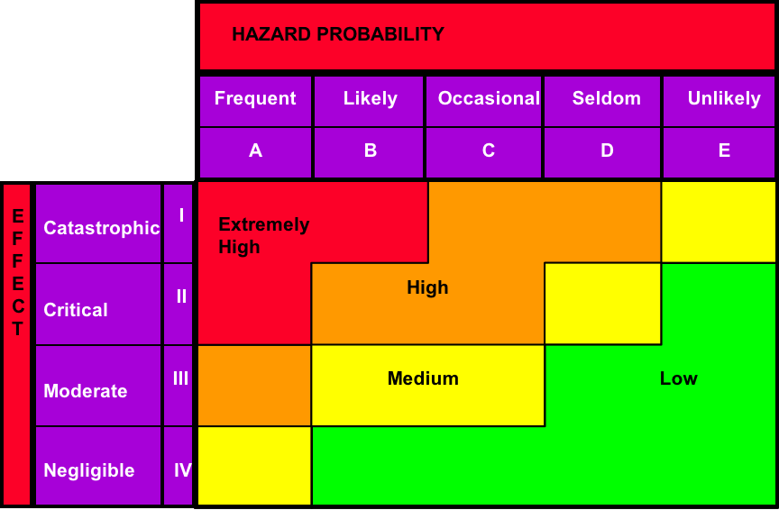
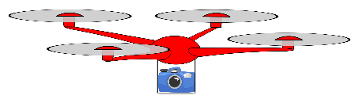
Risk Management
ID
Hazards
Monitor
&
Evaluate
Assess
Risk
Implement
Plans
Develop
Controls
Notes:
Focusing for a moment on the Risk Management piece, while UAV’s share some of the same hazards and risks as their manned aircraft counterparts, they also possess some unique ones that warrant thoughtful identification of these
Unique hazards and the attendant risks they present.
Due to the nature of UAV operations, the controls available to control these risks and the ability to monitor and evaluate the efficacy of implemented plans may differ from those associated with traditional aviation operations.

Slide 8
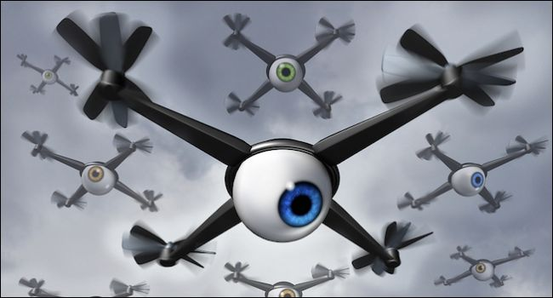
Privacy – Proactive Communication and Planning
Success in tackling drone privacy issues requires:
  Proactive communication and planning
  Meticulous, disciplined, and transparent operational execution
  Understanding of applicable laws and regulations
Thorough understanding of privacy issues
  Public sensitivity.
  How is data used?
  Who has access?
  How secure is it?
Failure = Damage to company reputation, possible civil or criminal repercussions
Photo Credit HowtoGeek.com
Notes:
PRIVACY - While experienced aviation managers are knowledgeable in accounting for the unforgiving nature of aviation, companies employing drones or drone services also need leaders who understand and are able to address drone-unique privacy issues.
Successfully addressing drone privacy issues requires proactive communication and planning, and meticulous, disciplined, and transparent operational execution.
Thorough understanding of privacy issues related to UAV usage.
Succeeding in drone privacy also requires an understanding of the evolving landscape of state and local privacy laws that stem from concerns regarding drones.
Privacy “mishaps” that threaten to violate privacy, civil rights, or civil liberties have the potential to damage a company’s reputation (and its bottom line through the result of civil litigation or criminal fines) as much as a safety mishap that results in serious property damage or personal injury.

Slide 9
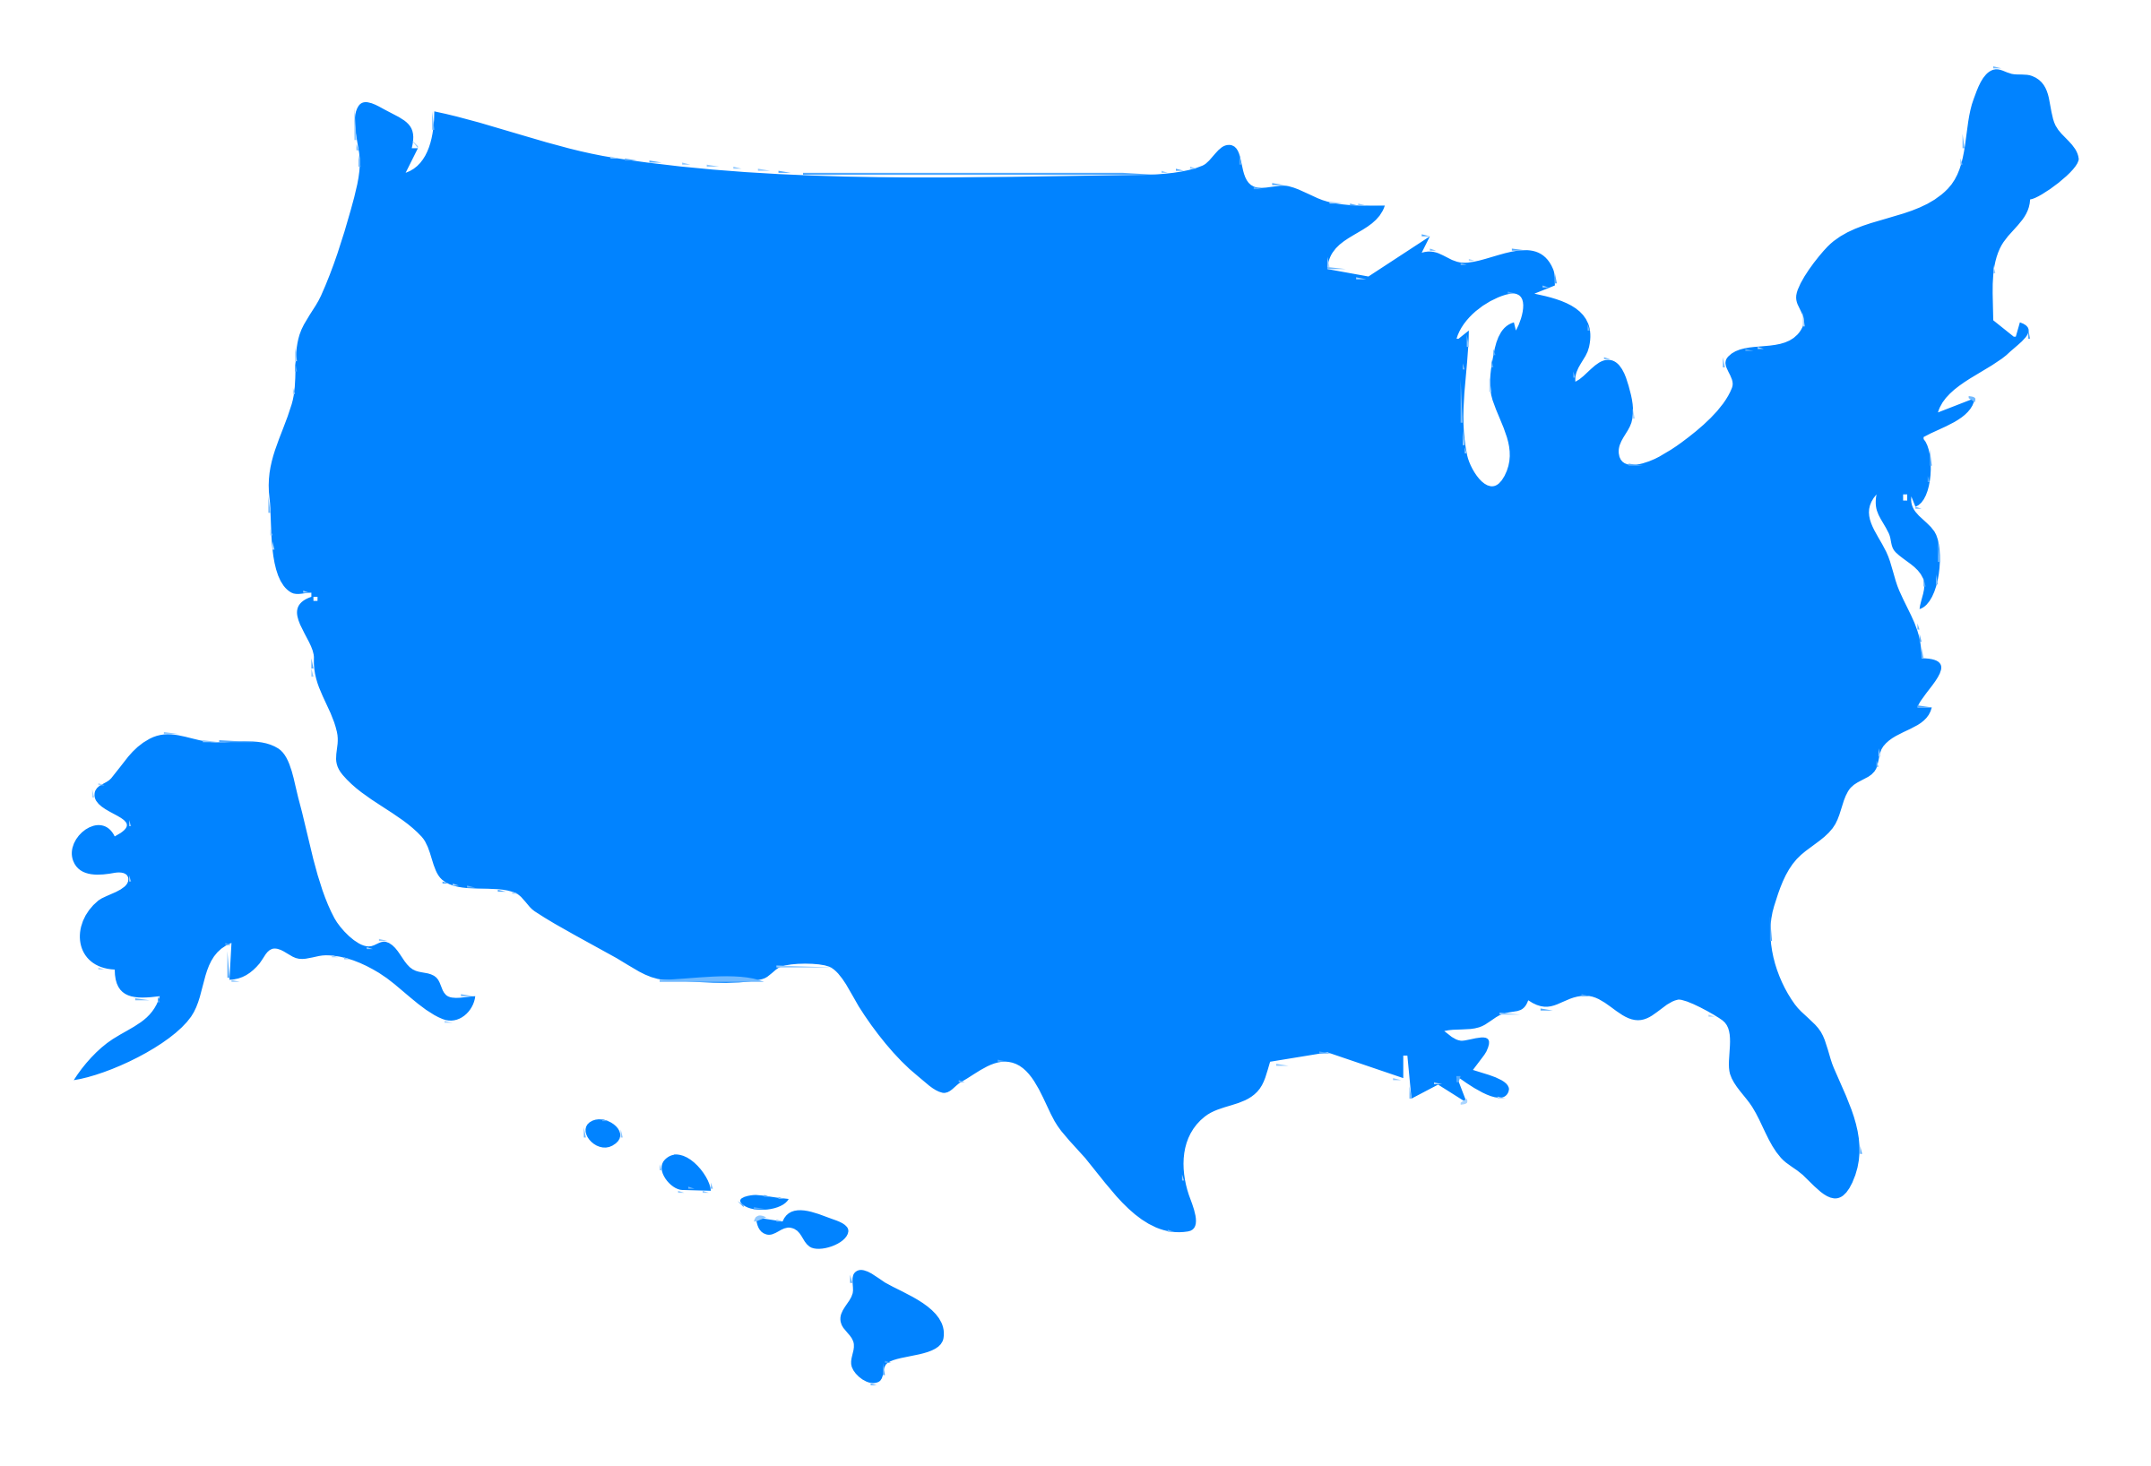


Part 107……
2013 - 43 states introduced 130 bills addressing UAV’s. 13 states enacted 16 new laws and 11 states adopted 16 resolutions.
2014 - 35 states considered UAS or UAV bills and resolutions; 10 states enacted new laws.
2015 - 45 states considered 168 bills related to drones
2016 - 38 states considered drone related legislation
Notes:
With the arrival of Part 107, the legal landscape for the operation of UAV’s in the national airspace system has gained important structure and stability.
However, Privacy as it relates to aircraft is an issue with no clear parent, but plenty of ”interested relatives” who each have different ideas on how, when, and with what controls UAV’s and the companies and people who operate them should conduct themselves.
Over the past several years, almost every State has considered, passed, or adopted some form of UAV bill or resolution.
This is likely going to continue at the State level and continue to find its way down to the local level where traditional land use, zoning, privacy, trespass, and law enforcement operations – generally are not subject to federal regulation.
What are you doing to understand current privacy laws and stay apprised of current and future legislative initiatives in this area?

Slide 10

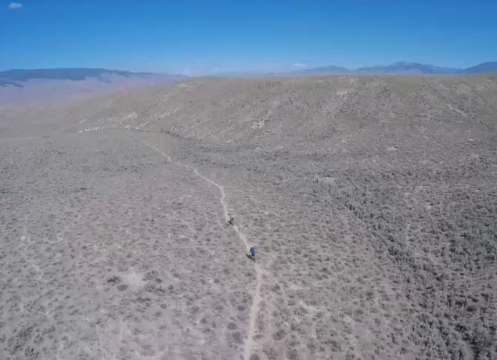
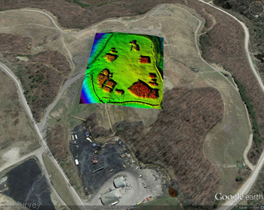
Privacy isn’t just about what you meant to capture…....
Notes:
In assessing dozens of UAV startups, one thing I’ve noted is that most don’t know that privacy considerations must extend beyond the objective of your mission.
On the right, we’re interested in mapping the green-highlighted area in the middle, yet during the course of our mission, we capture images outside the objective area.
These areas of potentially private, commercial, or public lands may be subject to laws that require we gain permission to take or use these images. At the very least, we need to be thoughtful on what we do with them and how we store them.
Likewise, even within the objective area, we may find, as in the video on the left that there may be elements that require special privacy considerations, like possible personally identifiable information.
Do you know what your compliance liabilities and/or requirements are and are you prepared to address them?

Slide 11
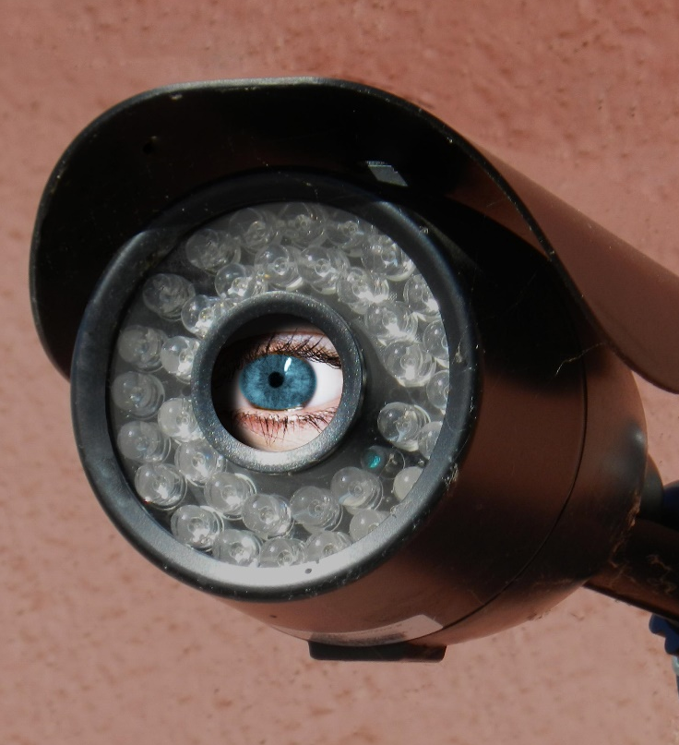
Privacy Best Practices
Proactive communication.
Public transparency.
Thoughtful data collection.
Responsible data storage and sharing.
Continuous improvement for data security.
Current and compliant with privacy laws.
NTIA Multi-Stakeholder Voluntary best Practices for UAS Privacy, Transparency, and Accountability - https://www.ntia.doc.gov/files/ntia/publications/uas_privacy_best_practices_6-21-16.pdf
Notes:
In my experience in managing large, complex UAV programs over public land, there are a number of best practices that while requiring some invested time and effort up front, pay huge returns and avoid even larger expenditures in the future.
Proactive communication.
Public transparency.
Thoughtful data collection.
Responsible data storage and sharing.
Continuous improvement for data security.
Current and compliant with privacy laws.
National Telecommunications and Information Administration (NTIA) Multi-Stakeholder Group for UAS Privacy, Transparency and Accountability best practices.

Slide 12

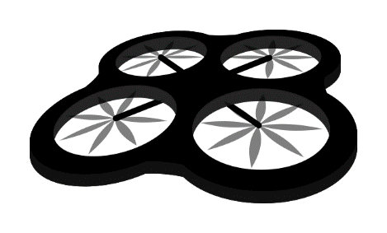
Security Vulnerabilities
Physical.
  Transportability.
Navigation.
  GPS jamming, blocking, spoofing.
Control.
  Electromagnetic Interference (EMI).
  Hacking.
Payload.
  Live stream interception.
Data.
  Storage, processing, distribution.
Notes:
SECURITY - Drone companies must also master unique security issues that can impact their long-term success.
Inventories of small, easily transportable drones present additional physical security challenges over manned aircraft.
Similar vulnerabilities exist for the GPS signals most drones rely on for geo-location/navigation; they can be jammed, blocked, or spoofed.
Because most small drones rely on two-way communication links for inflight control and payload data download they can be susceptible to intentional hacking.
Also, without proper design protections, drones can be susceptible to electromagnetic interference (EMI) that, while invisible, can take unintended control of a drone and command it to altitudes and locations that can result in serious safety and/or privacy mishaps.
Data collection, processing, distribution, and storage methods also present security exposures drone companies must consider and address for sustained business success

Slide 13
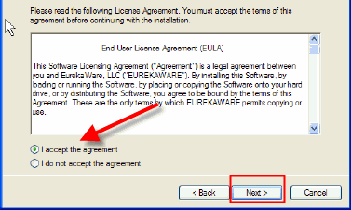
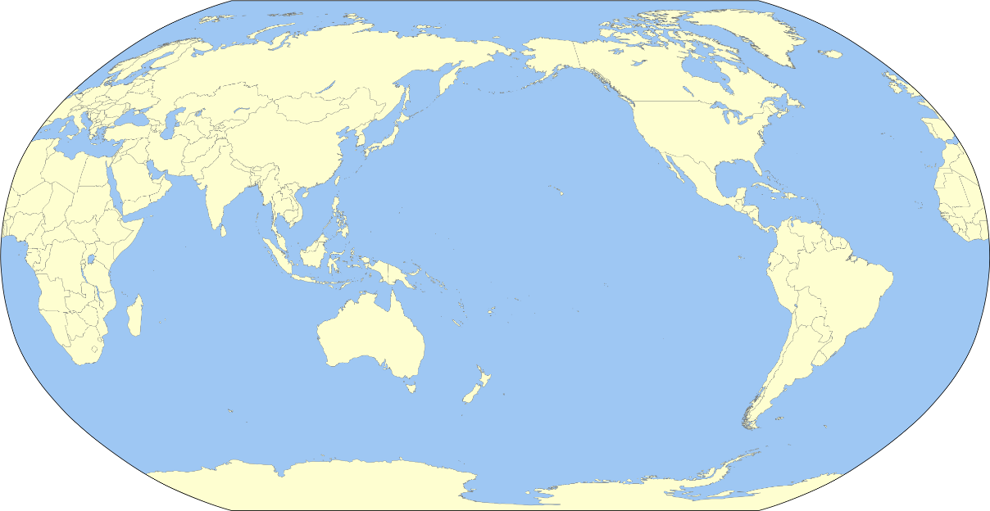
Security – Do You Know Where Your Data is Going?
Privacy policy?
Flight logs?
Cloud storage and processing?
Opt in/out?
?
?
?
?
Notes:
Another, often overlooked security issue involves the policies of the companies that manufacture the drones you use, those who process your data, or provide you with a “drone as a service.”
If you blindly accept or don’t read the user agreement, as most of us do when we get that software update, then….......
Your flight logs, your raw and perhaps even your processed data could be traveling to distant, exotic locations without your permission or knowledge and being used for purposes you (and your customers) might not be thrilled with.
You should always read and understand the privacy and data security policies of the companies who provide you with UAV hardware, software, or services and..............
Look for policies that allow you to selectively “opt-in” to data collection rather than those that force you/or don’t allow you to “opt-out.”

Slide 14
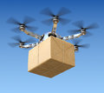

Organizational Culture – Ties it all together
Determines long-term success
Underlying set of beliefs, values, and principles
  Drive strategic and day-to-day behaviors
UAV company culture requires special attention.
Agile.
Risks of absence of appropriate Organizational Culture
  Adverse impact to customers’ and nonparticipants’ experiences
  Jeopardize company/corporation reputation and that of the industry on a whole.
Notes:
Last, but not least, Organizational Culture is the competency that ties all the others together for long-term success.
Organizational culture is often defined as the underlying set of beliefs, values, and principles that drive both the strategic and day-to-day behaviors of an organization and its members.
For many companies entering the drone space, their current corporate culture was not likely built with much thought toward aviation, privacy, and security issues.
Consider a consumer online retail company interested in entering the drone space. Their traditional interaction with the customers generally involved product selection, price, ordering, and post-delivery satisfaction. Mostly relying on third-party delivery providers, their liability for issues related to this process have been mostly tangential. Additionally, their interaction with the general public during this transaction was essentially nonexistent.
Manned pilots, due to their lengthy interaction with experienced pilot instructors through the process to obtain their license are given a cultural appreciation for the privilege of sharing the national airspace system with other users and the responsibility they share for not operating in a manner that unnecessarily jeopardizes the safety and /or interferes with the activities of people and structures on the ground beneath them.

Slide 15
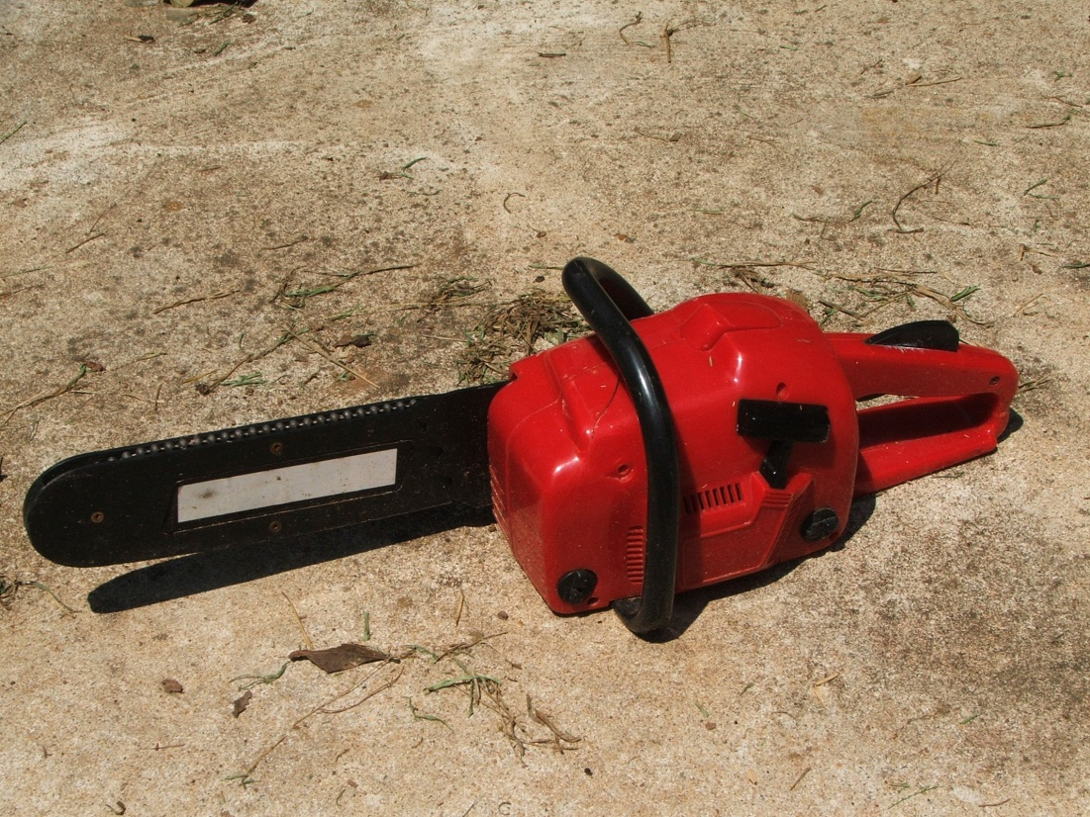
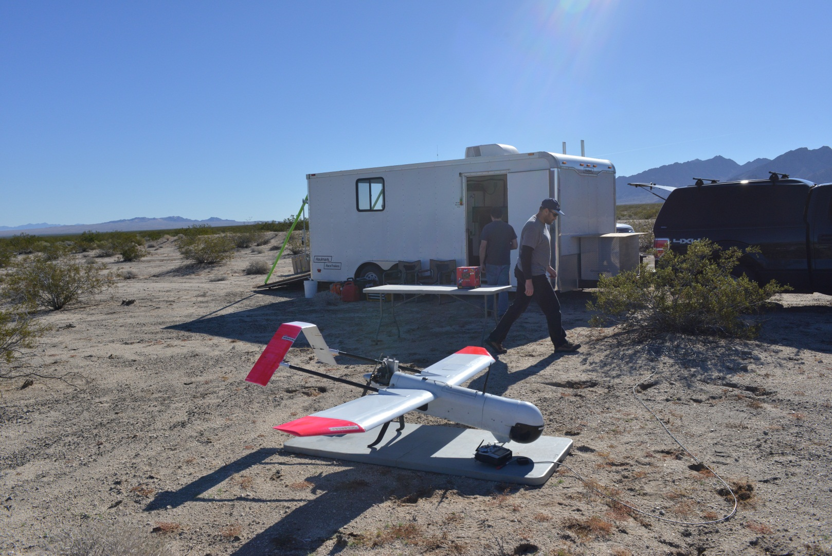
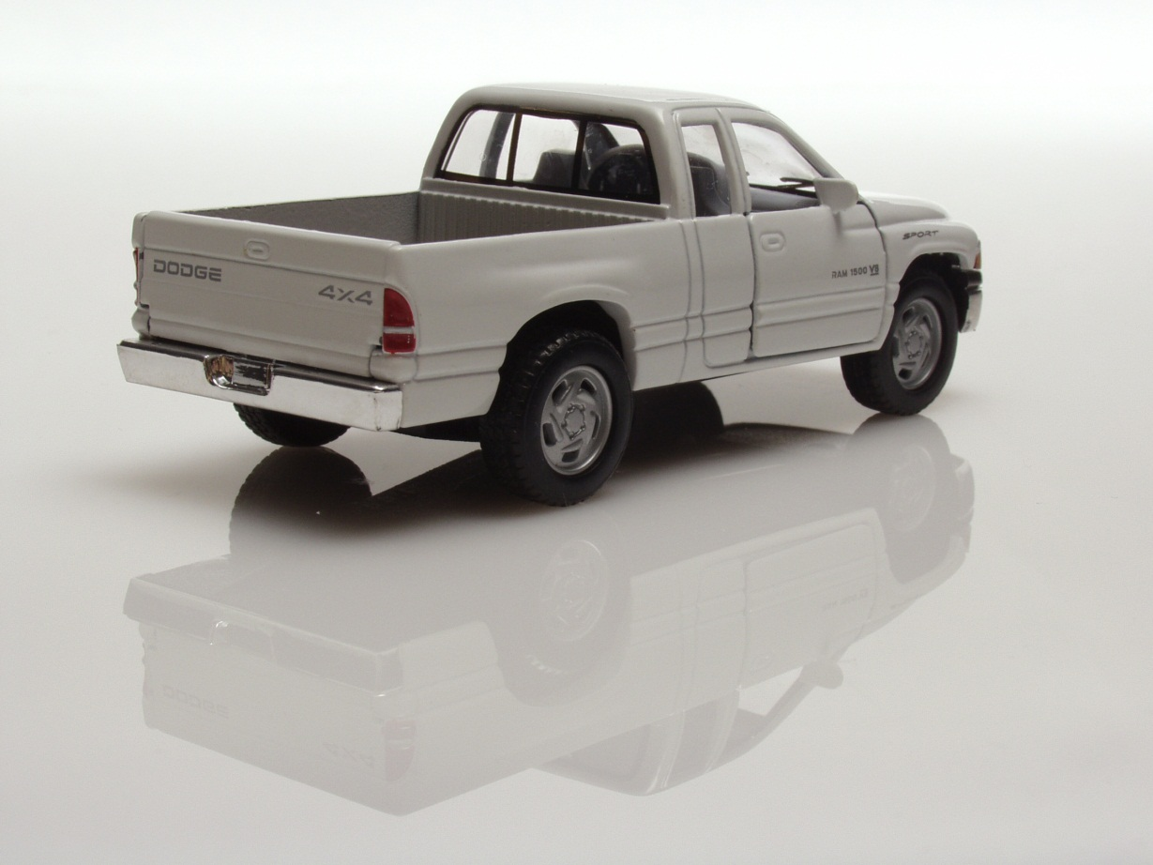
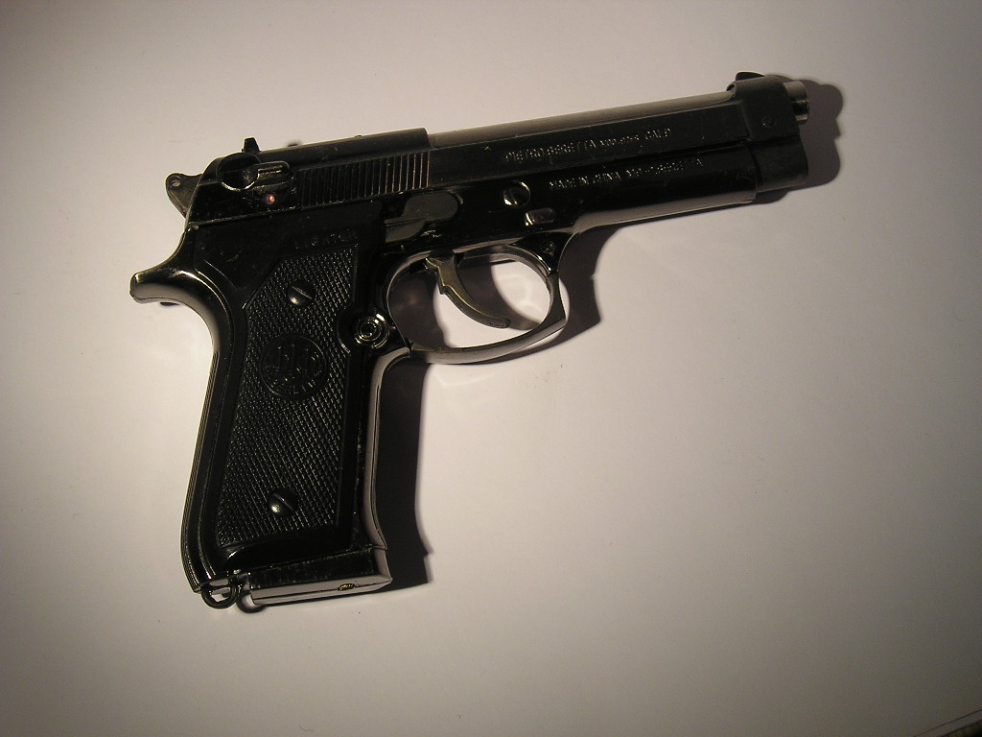
What do these
Have in common?

Slide 16
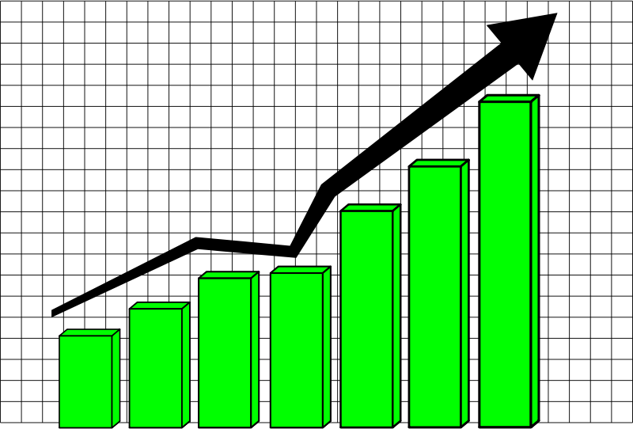
UAV Industry Offers Promise of Societal Benefits
Presents promise of societal benefits
  Higher agriculture yields
  Safer infrastructure inspections
  Enhanced emergency response
  Improved scientific research
Potential avenues for economic growth and technology development
New avenues of economic grown and technology development
Notes:
The drone industry offers the promise of significant societal benefits (e.g. higher agriculture yields, safer infrastructure inspections, enhanced emergency response, improvements in scientific research, etc.).
It also presents exciting new avenues of economic growth and technology development.
This industry’s trajectory depends on each drone business’s ability to master the aspects of drone aviation, privacy, security, and organizational culture our customers, the public, and regulators will demand.

Slide 17
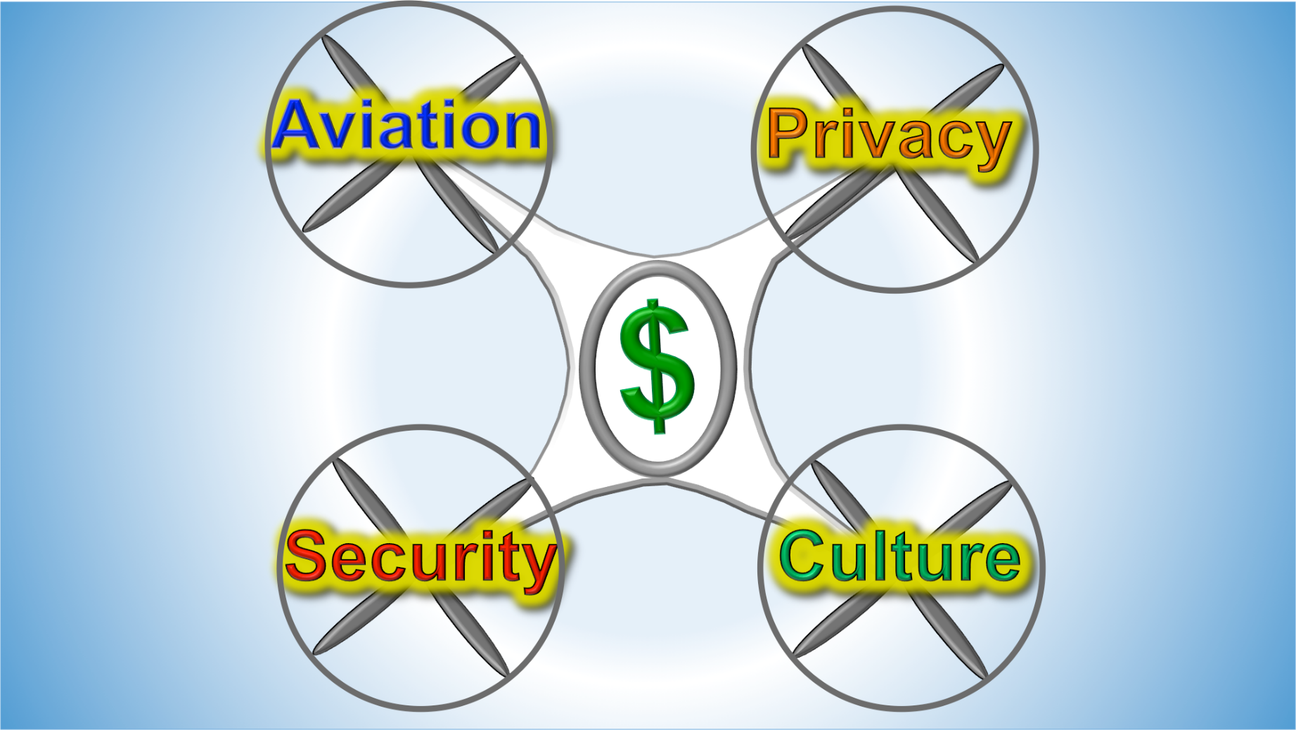
Success
Mark L Bathrick, Director
Office of Aviation Services
Boise, Idaho
Mark_bathrick@ios.doi.gov
Individual business and UAV community mastery
Unique blend
Commitment
Resources
Competitive advantage
Are you ready?
Notes:
Success within and of this fast-paced, exciting industry requires mastery of these four critical competencies by individual companies and the larger UAV stakeholder community.
Achieving this mastery requires a unique blend of knowledge, expertise, and program management skill.
It also requires leadership commitment to the “walking the talk” of foundational principles of each competency and ensuring that appropriate investment resources are available to achieve levels of mastery that…......
Will provide your business with the necessary competitive advantage to successfully catch and ride this growing economic wave.
Are you ready?

Slide 18

Questions/Discussion
Mark L Bathrick, Director
Office of Aviation Services
Boise, Idaho
Mark_bathrick@ios.doi.gov
Photo by FlashBuddy at Morguefile.com
Mark Bathrick 2016
https://www.doi.gov/aviation/uas

