Slide 1








BISON FILE & SERVE QUICK GUIDE
FOR FILING A NEW CASE OR APPEAL
This Quick Guide outlines how users can file a new case or appeal with the Office of Hearings and Appeals via Bison File & Serve.
For in-depth information on using Bison File and Serve, please review the User Guides.
Please consult the Standing Orders
on Electronic Transmission for additional guidance.
1
September 2026

Slide 2



DOI’s Office of Hearings and Appeals (OHA) has deployed Bison File & Serve (BFS), an online eFiling system for case adjudication, for five OHA units:
Departmental Cases Hearings Division (DCHD) Office of the Director (DIR)
Interior Board of Indian Appeals (IBIA) Interior Board of Land Appeals (IBLA)
White Earth Reservation Land Settlement Act Hearings Division (WELSA)
Please visit https://www.doi.gov/oha/bfs for information on BFS registration and login.
All users must register to access the system.
Please consult the Non-DOI User Guide before contacting the Helpdesk. OHA personnel cannot assist in BFS user issues; all technical questions or concerns must be directed to the Helpdesk.

Slide 3





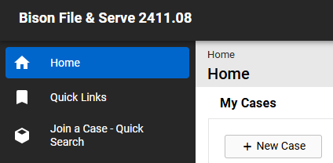
After logging in to BFS, click on + New Case from the eFiler home screen.
There is a five-step process for filing a new case.
NOTE: Following these steps will result in the submission of
a new case . Do not follow these steps to file a document in an existing case. Instead,
file a document in an existing case by first requesting to join the case.

Slide 4
Step 1: Click the Acknowledgement checkbox and click “Save.”

Slide 5





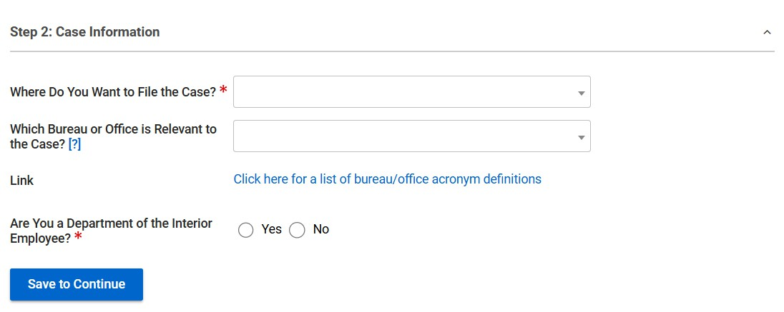

Step 2: Select the OHA unit where you want to file your case and indicate whether you are a DOI employee. You may also select the bureau or office that is relevant to your case.
Click “Yes” if you are a DOI Employee. Otherwise, select “No.”

Slide 6


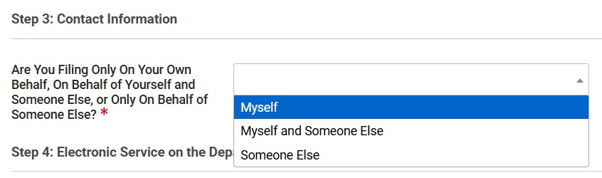

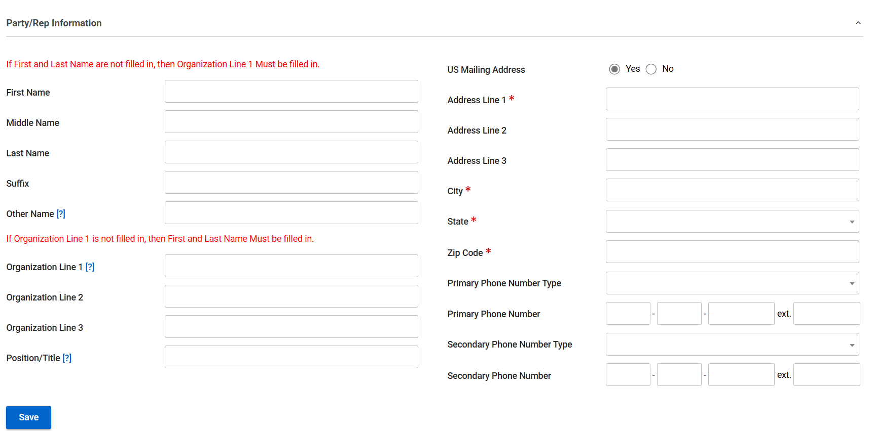

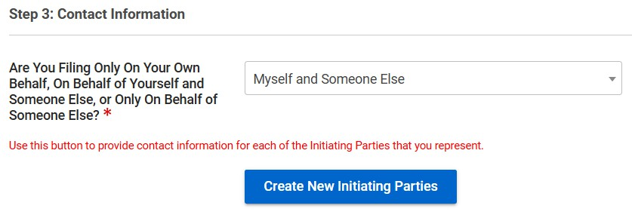
Step 3: Fill in the relevant contact information.
Select whether you are filing on your own behalf (i.e., you are an appellant or initiating party), on behalf of yourself and someone else (i.e., you are an appellant or initiating party and a representative), or only on behalf of someone else (i.e., you are only a representative of the appellant or initiating party).
If you are filing on behalf of someone else, you must click the “Create New Initiating Parties" button to add contact information for the parties that you represent. Do not fill out your own contact information. Your contact information will be automatically added to the case from your user registration information regardless of whether you are filing on your own behalf or on behalf of someone else.

Slide 7
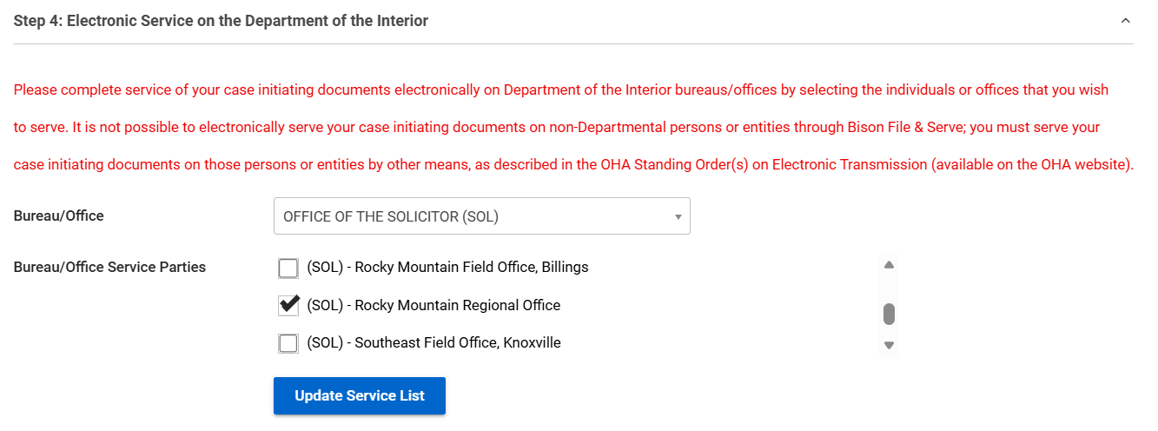

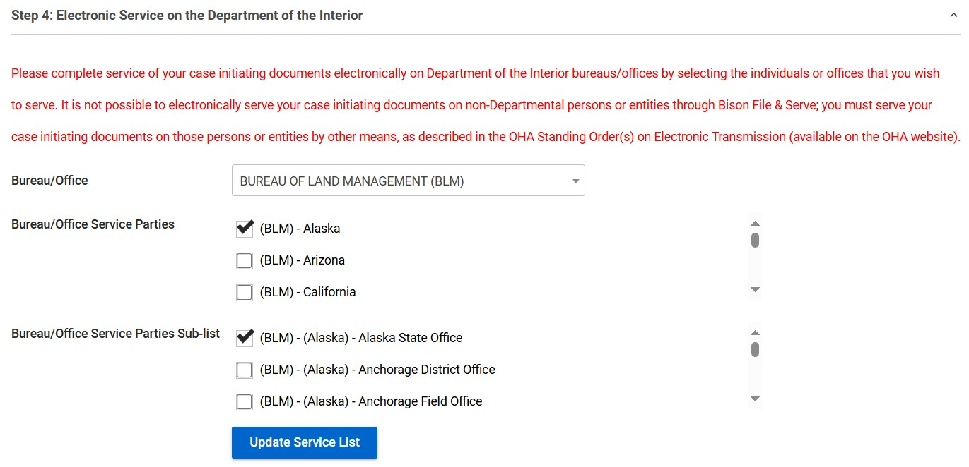
Step 4: Select the DOI bureaus and offices to be notified of your new case.
Bureaus and offices selected at this step will receive an email notification that your case has been filed with OHA. Any documents submitted with your new case will be attached to the email notification, which will constitute service of those documents on the selected bureaus and offices. For most cases, you will need to serve the DOI bureau or office that issued the decision being challenged and the appropriate Office of the Solicitor. Check the service terms specified in the OHA Standing Orders for more information on effecting service of your case.
OHA Standing Orders | U.S. Department of the Interior
Check the boxes next to the DOI bureaus and offices that you want to receive service. The service list is tiered, starting with the highest level offices and filtering down to the agency and field offices.
Once you have selected the bureaus and offices that you want to serve, click "Update Service List."

Slide 8
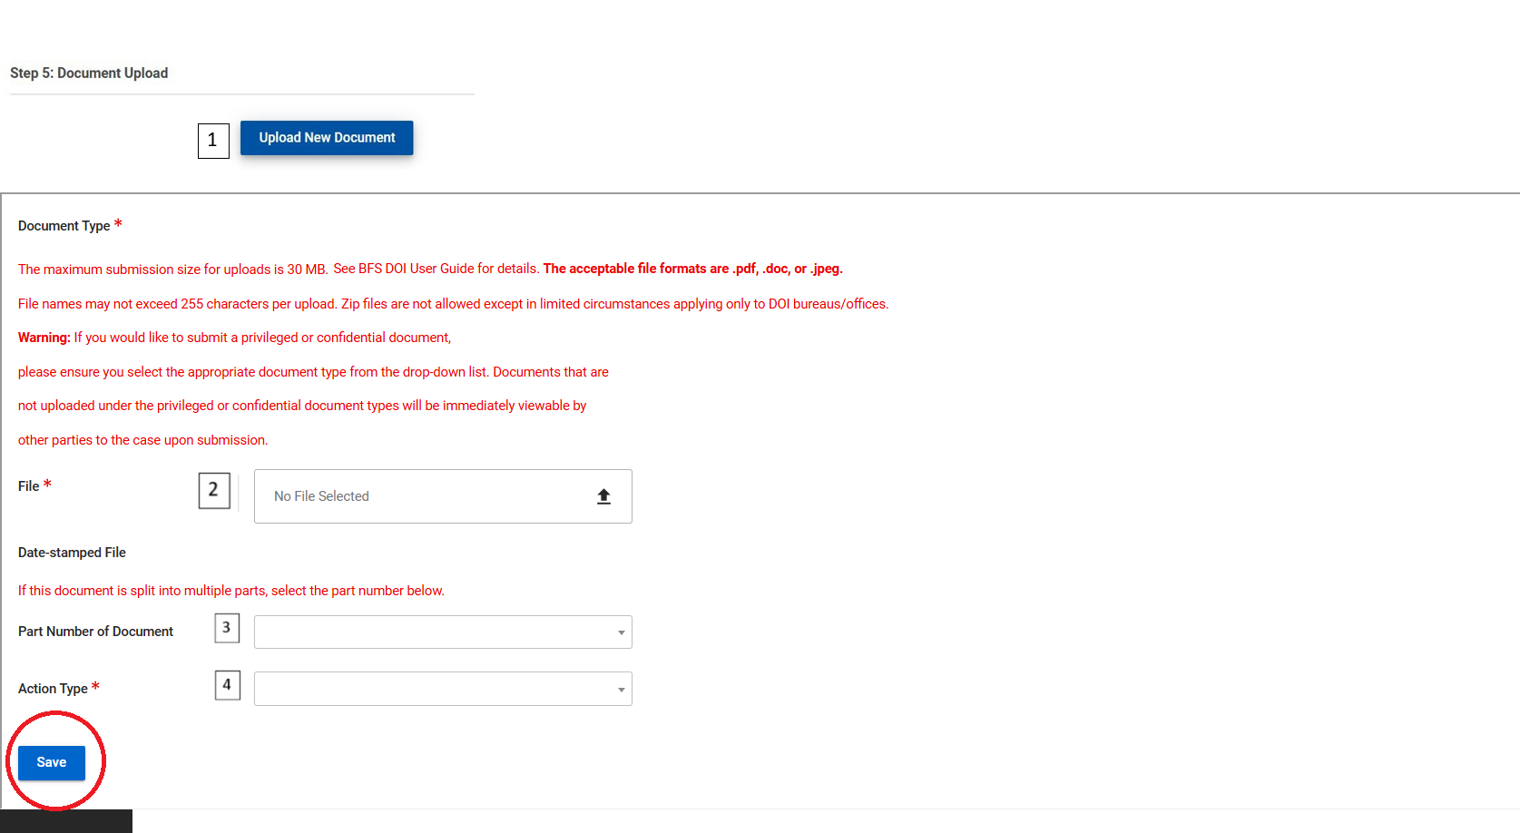
Step 5: Upload the documents that you want to submit to OHA.
1. Click “Upload New Document.”
2. Select a file to Upload to your case. The maximum submission size for case-initiating documents is 30 MB.
3. If you are splitting a document into multiple parts, you may assign a consecutive number to each part. If you are not splitting a document into multiple parts, do not assign a part number.
4. Select an Action Type and Sub-Type, if applicable. The Action Type options vary by OHA unit. A list of the available Action Types is included in Appendix 1 and 2 of the User Guides, https://www.doi.gov/oha/bfs/support.
5. Click “Save” to add your document to the submission.
IMPORTANT: Selecting the proper Action Type is essential to protect privileged and confidential information from being improperly disclosed to OHA and/or parties to the case. For detailed guidance on filing privileged and confidential information, see the BFS eFiling Confidential or Privileged Documents User Guide.
5

Slide 9

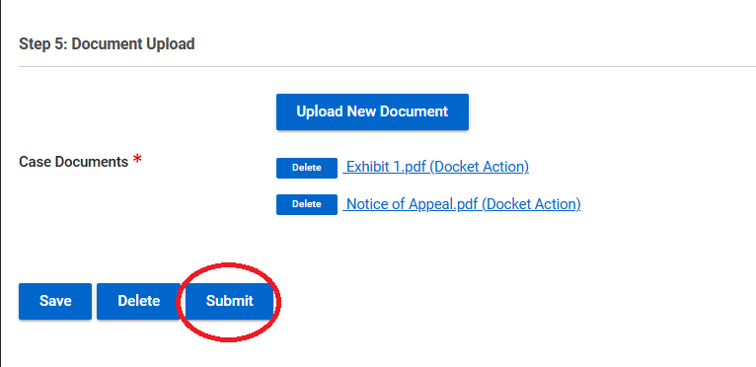
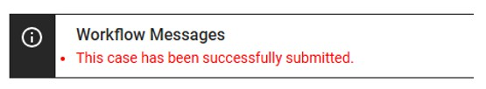
Final Step: Submit your case.
After you are done uploading your documents, click “Submit” to file them with OHA.
A “Workflow Message” will appear at the top of the screen
A “Submission Confirmation”
email will be sent to your
email address if your
submission is successful.

