Slide 1

OIA GRANT MANAGERS’
WORKSHOP #3 – May 27, 2026
OIA Discretionary Grants

Slide 2
Today we will discuss …
I – Reminders
II – Grant Terms & Conditions (GT&C)
III – Authorization to Proceed (ATP)
IV – Your Questions anytime (Q&A)

Slide 3

Shout Out to the VI!
Component Units Fiscal Year 2025 Audit Kick Off Meeting (Virgin Islands Government - May 18, 2026)
    Meeting highlighted goals of timely financial reporting, critical areas for audit preparation including grant reconciliation, AP, capital assets and internal controls. Also updates on single audit requirements, new uniform guidance, etc.
Notes:
Congrats to Clarina Modeste Elliot (Finance Commissioner Kevin McCurdy) and Cherise Hodge Tucker (OMB Director Julio Rhymer)
Promoting best practices
Other Insular Areas have similar meetings that OIA grant managers can also join in over Teams or Zoom, please let us know.

Slide 4
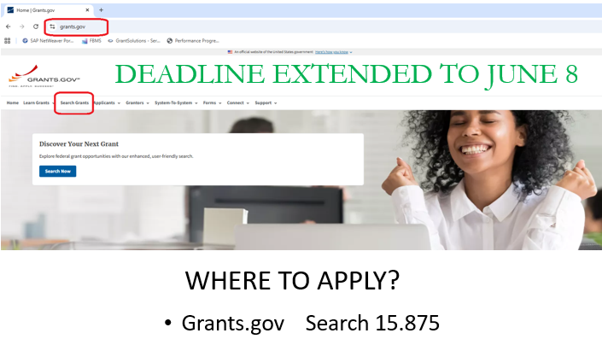
Reminder #1
OIA Discretionary Grant Deadline
Extended from May 18 to June 8
Deon Team - Virgin Islands Component Units Fiscal Year 2025 Audit Kick Off Meeting – giving guidance on financial statements management, grants management, reporting, etc.

Slide 5
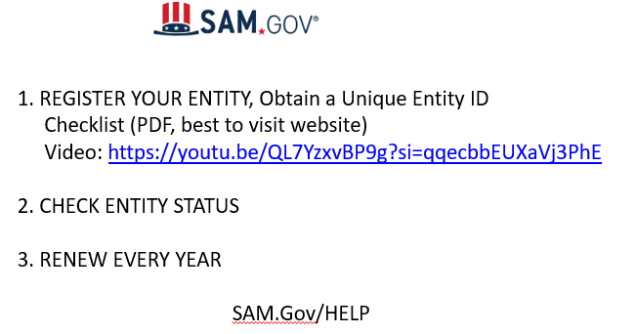
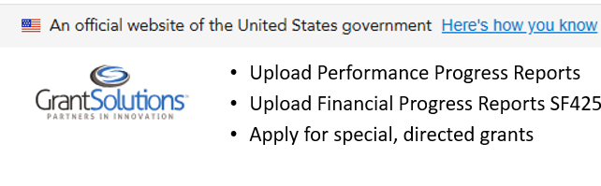
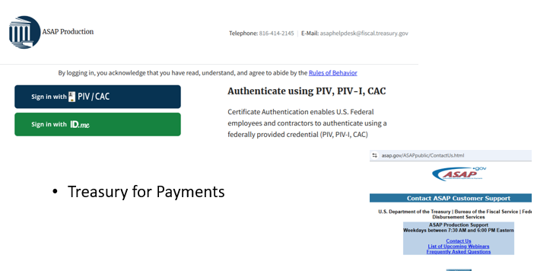
Reminder #1.5
Four Platforms – Use Same Data
Deon Team - Virgin Islands Component Units Fiscal Year 2025 Audit Kick Off Meeting – giving guidance on financial statements management, grants management, reporting, etc.

Slide 6
Reminder #2
Grant Reporting and Requests for Payment
GrantSolutions – Performance Report (PPR and Narrative) along with Financial Report (FFR)
  When? Every 6 months (or as per NOA)
  Keep reporting up to date
ASAP.Gov – Requests for Payment
  Anytime you spend down on the grant
  Is Reporting up to date?
  Is Form 270 submitted? Does it jive with FFR?
  Are receipts/proof of expenditure included?
Notes:
CARES Act Reporting was 3 months. Check the NOA. Discuss with your Grant Manager if questions.
Recommend submit payments as soon as possible. 1) Helps you keep track of expenditures 2) Helps us show that the grant is active and being used

Slide 7
Reminder #3
Reimbursement or Advance ?
Most Common and more Secure - Reimbursement – Spend money up front, submit contracts/receipts/proof of purchase, etc. for reimbursement.
Rare and More Risky – Advance Payments – Receive agreement from Grant Manager, Send Pro-forma’s/budget to show what funds will be spent on.
In all cases reporting must be up to date.
Notes:
OIA discretionary funding has for the most part been granted on a reimbursable only basis. This means that grantees spend the funds up-front from their own operating funds and then are reimbursed by providing documentation/receipts of spending. Reimbursement can be very quick depending on how quickly the Form270 and supporting documents are submitted (to the grant manager) in requesting for reimbursement.
OIA has also, from time-to-time, authorized grantees to be advanced the funding. The grantee submits the request for advance payments providing any pro-forma invoices and other proposed uses. The grantee must spend the funding exactly as they proposed and following what was authorized by the grant manager.

Slide 8
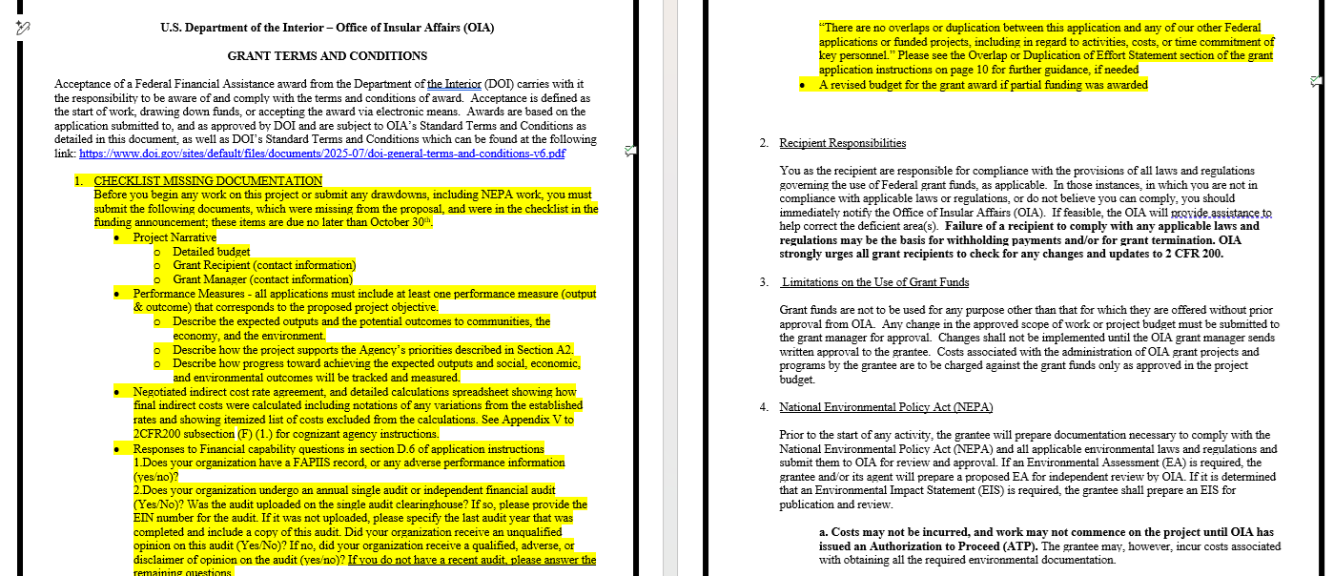
Slide 1 of 2
The GTC
II Grant Terms & Conditions
Notes:
Is it a legal document? Look in old training manuals for laws that govern grants – 2cfr200
Notice of Grant Award
Keep it with Grant Documents

Slide 9
Slide 1 of 2
The GTC
II Grant Terms & Conditions
1. Checklist Missing documents – to be submitted asap (caveat)
2. Recipient Responsibilities
3. Limitations on Use of Grant Funds
4. National Environmental Policy Act
5. Insurance & Indemnification
6. Marketing and Branding
7. Scope of Work Requirements
Notes:
Is it a legal document? Look in old training manuals for laws that govern grants – 2cfr200
Notice of Grant Award
Keep it with Grant Documents

Slide 10
Slide 2 of 2
The GTC
II Grant Terms & Conditions
8. Procurement of Goods and Services with Grant Funds and Record Retention
9. Capital Assets
10. Grant Fund Payment and Drawdown Requirements
11. No Cost Extension Requests
12. Reporting Requirements
Performance Goal Table
13. Grant Close Out
14. Contact Information
15. Terms & Conditions Reminder – subject to DOI Terms & Conditions
Notes:
Is it a legal document? Look in old training manuals for laws that govern grants – 2cfr200
Notice of Grant Award
Keep it with Grant Documents

Slide 11
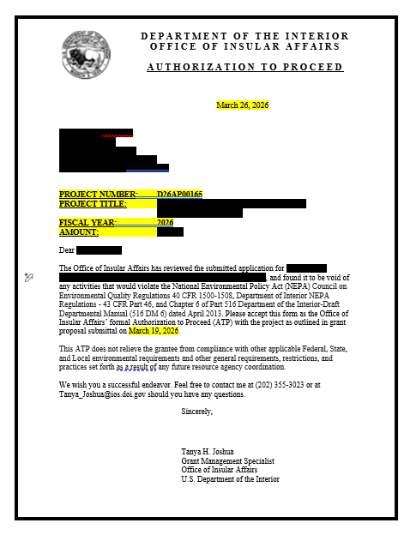
Slide 1 of 2
The ATP
III The Authorization to Proceed

Slide 12
Slide 1 of 2
The ATP
III The Authorization to Proceed
Every grant must undergo an environmental review
If no impact to the environment, can go ahead and proceed
If there is an environmental component, USACE will work with you.
Please provide answers to questions
USACE when done will alert OIA Grant Managers and then ATP will be issued
For FAS Discretionary Grants, n/a. Discuss 106.

Slide 13
Questions ??

Slide 14
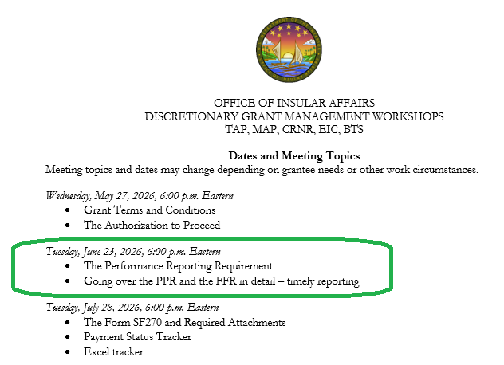
Next Meeting: June 23, 2026

Slide 15
OIA Grant Managers
Territory Grant Managers
  Krystina_Alfano@ios.doi.gov – Northern Mariana Islands (CNMI)
  Tanya_Joshua@ios.doi.gov – American Samoa
  Hailey_McCoy@ios.doi.gov - Guam
  Merriam_Porter@ios.doi.gov – U.S. Virgin Islands
Freely Associated States Grant Managers
Rebecca_Zepeda@ios.doi.gov
Weihao_Feng@ios.doi.gov
  Martin_Moore@ios.doi.gov
  Ryan_Edgar@ios.doi.gov
  OIA continues to carry out internal realignment. We appreciate your patience as we work to transfer grant files and make sure that all grant managers are brought up to speed on grant programs in each area.

